Slide 1
History of the German Province from 1915 to today

Slide 2
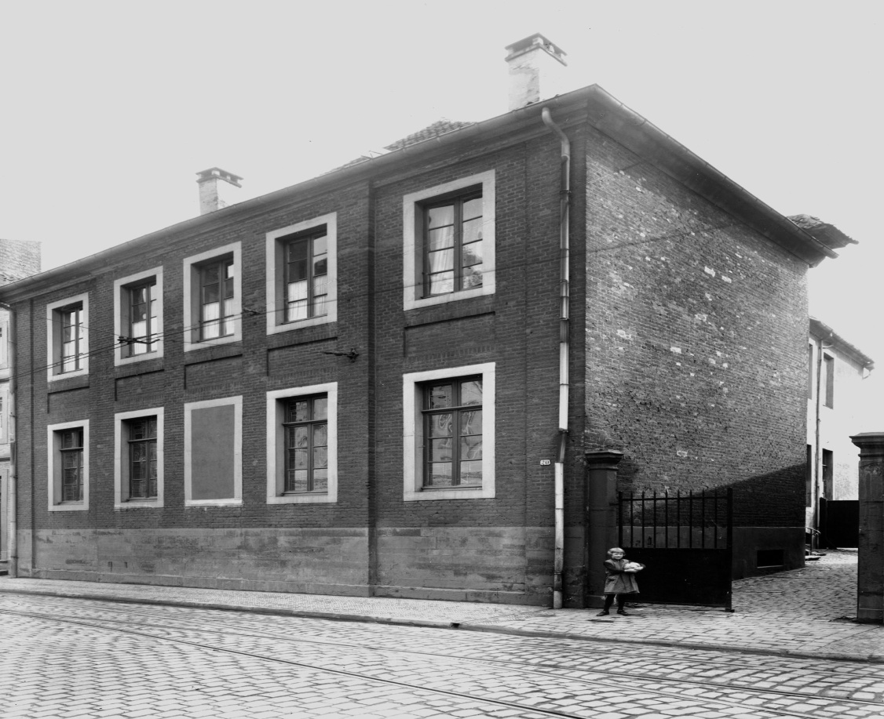
Lourdeskloster Convent
in 1915 - First home

Slide 3
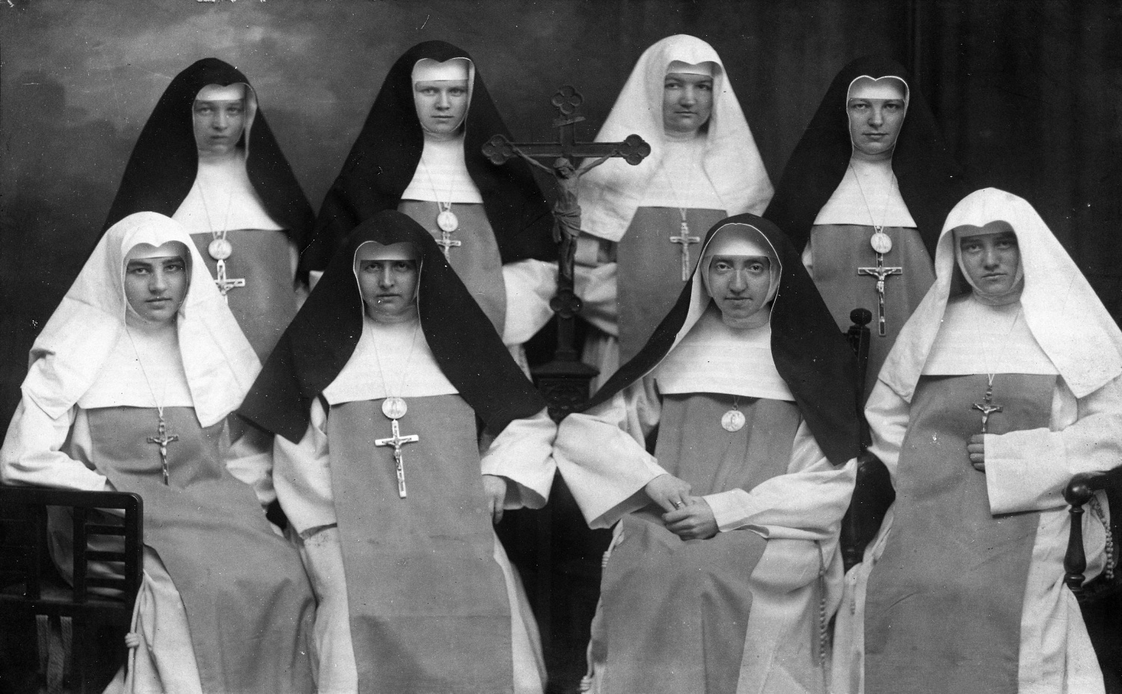
M. Immaculata
Mother Immaculata and Missionaries in 1915

Slide 4
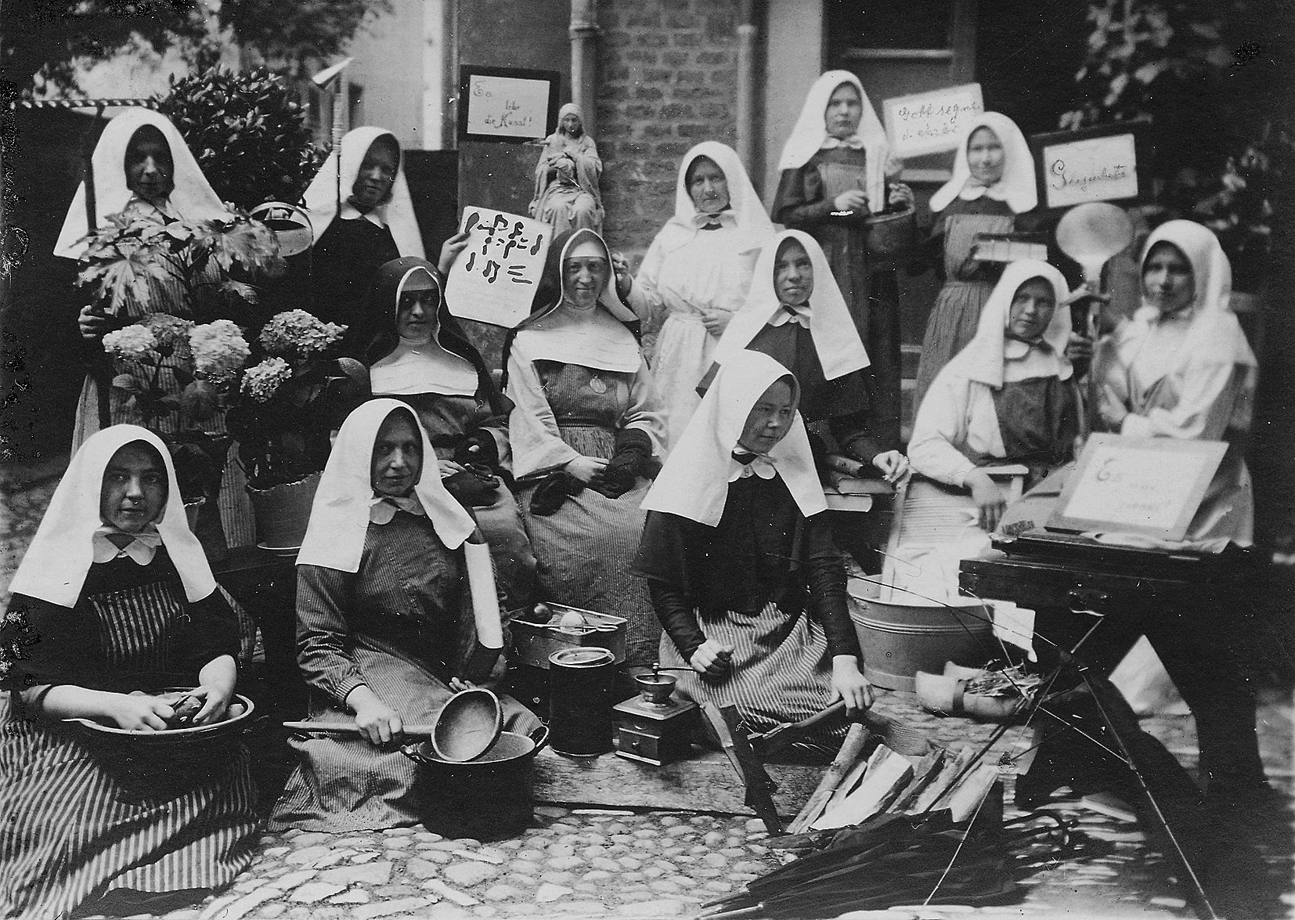
Postulants in 1917

Slide 5
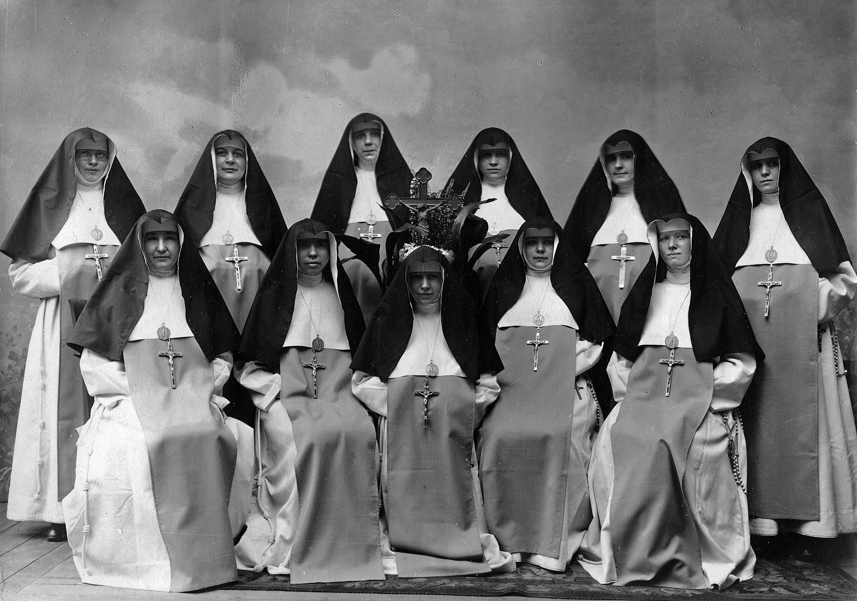
Sisters departing for Brazil in 1920

Slide 6
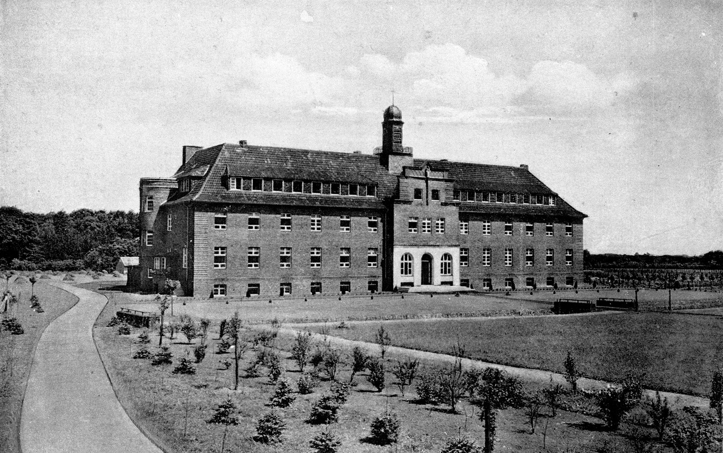
Newly built Missionkloster St. Josef
in Muenster-Wilkinghege 1928

Slide 7
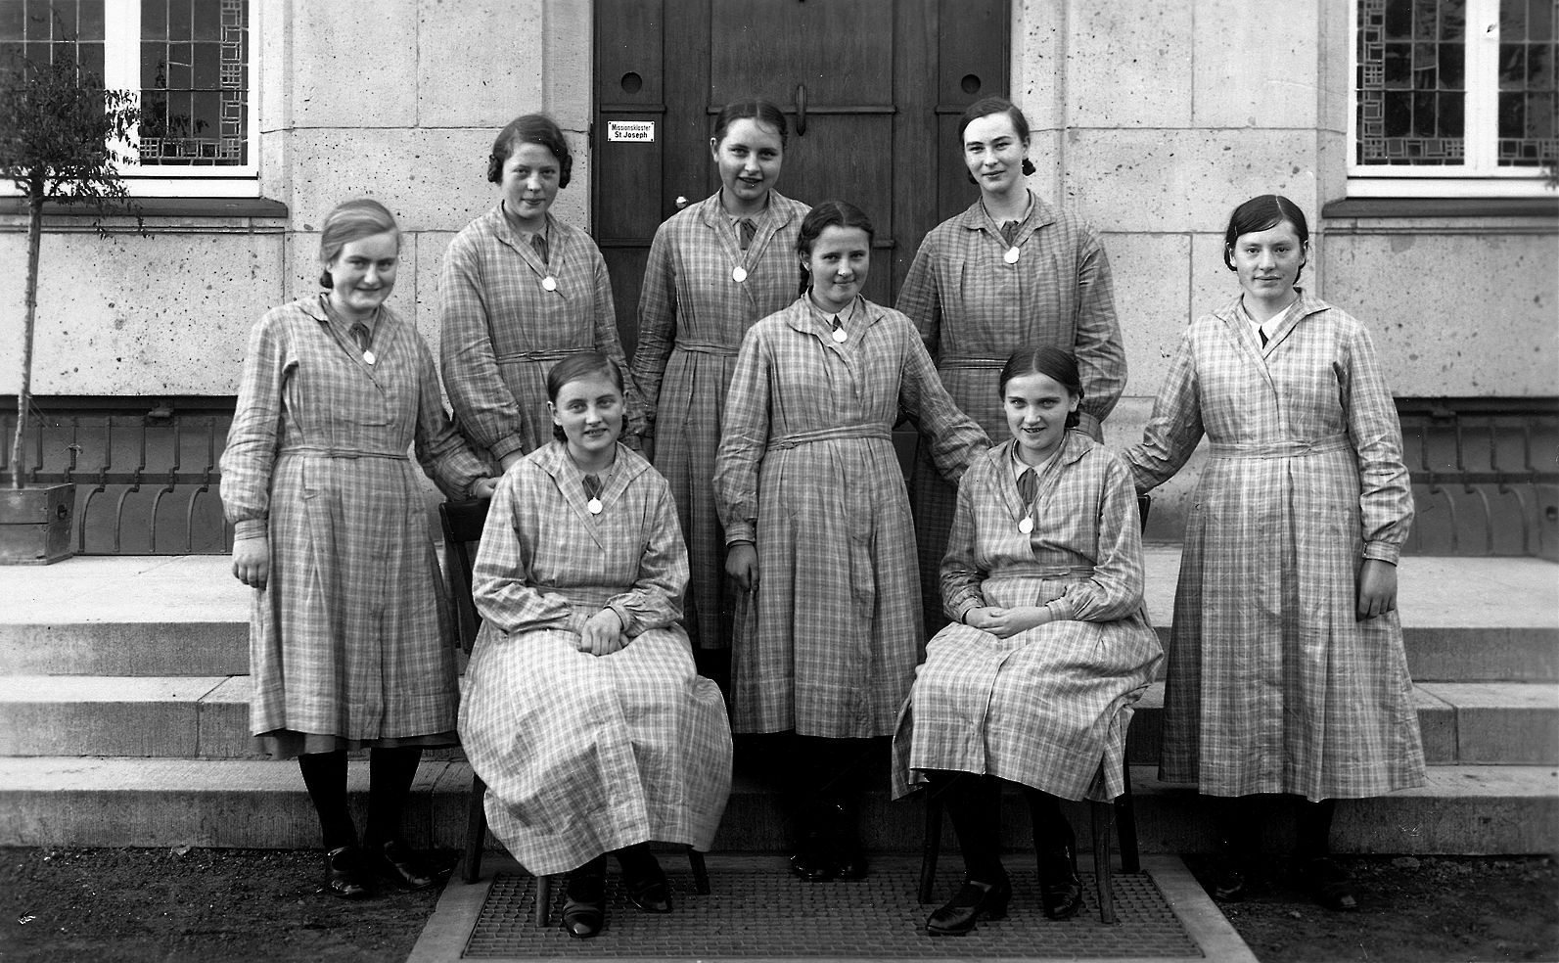
Preparation of the Missionaries

Slide 8
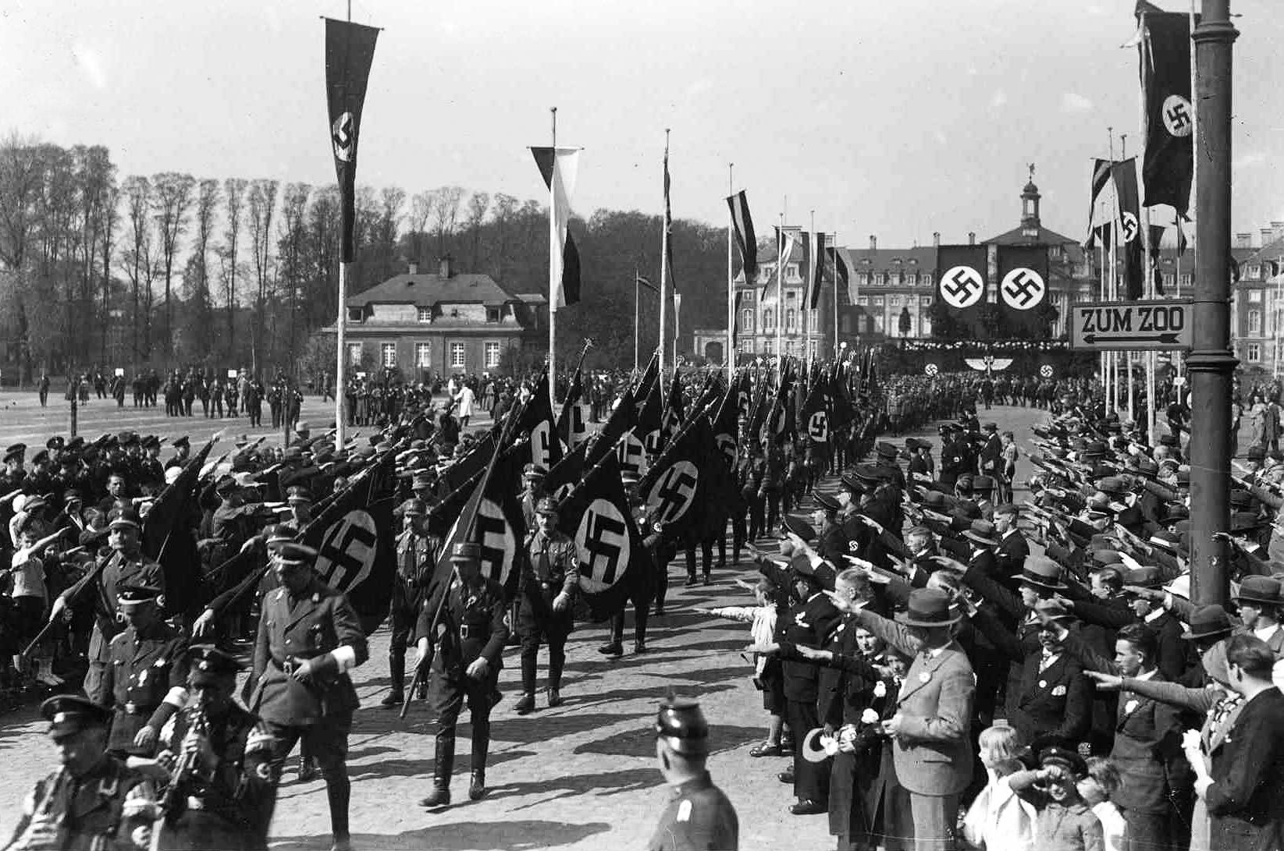
Nationalistic German Workers Party
The Nazi Regime 1933

Slide 9
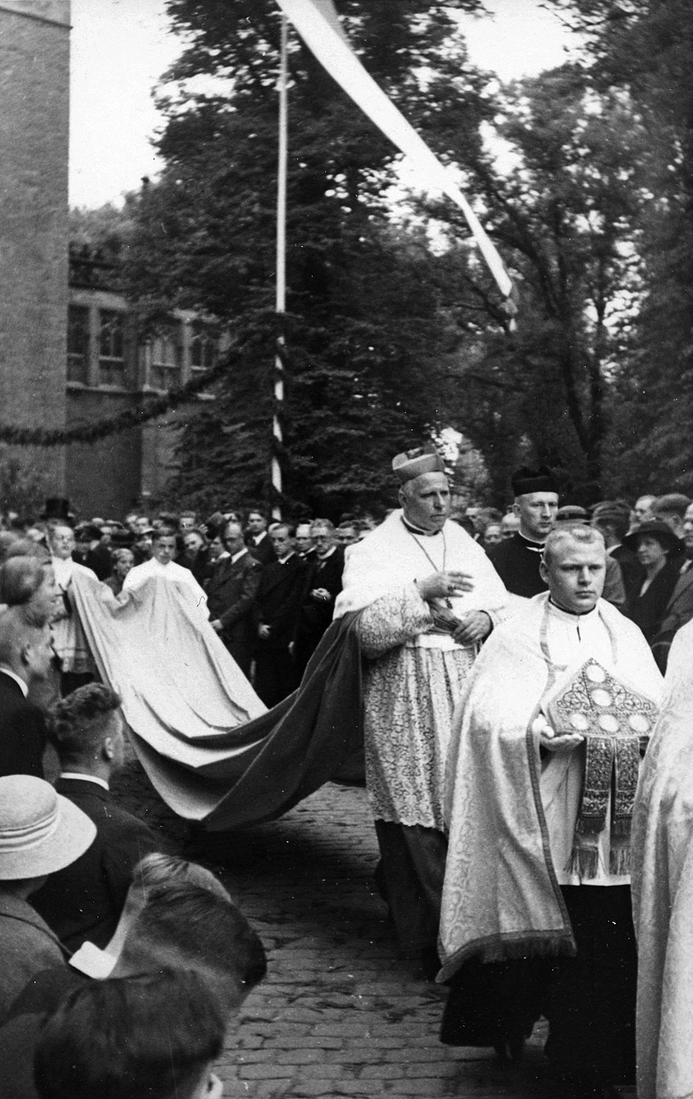
Bishop Clemens August van Galen in
Corpus Christi Procession
Friend and Defender of the Sisters

Slide 10
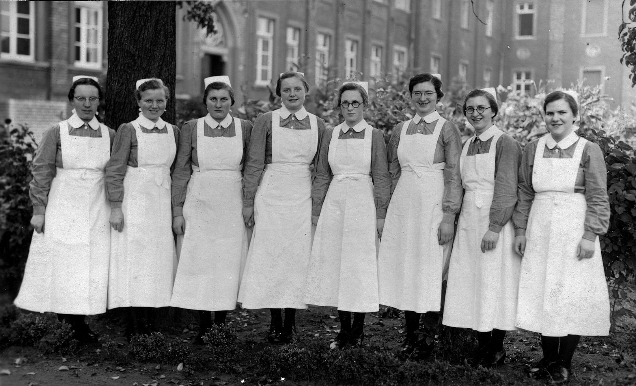
Post war ministry:
Nursing and baby care training

Slide 11
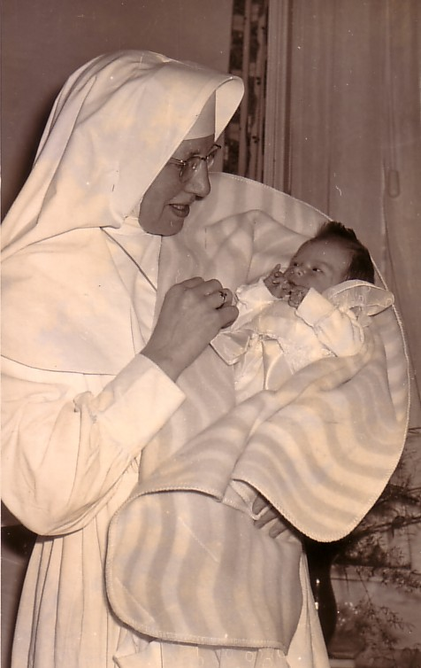
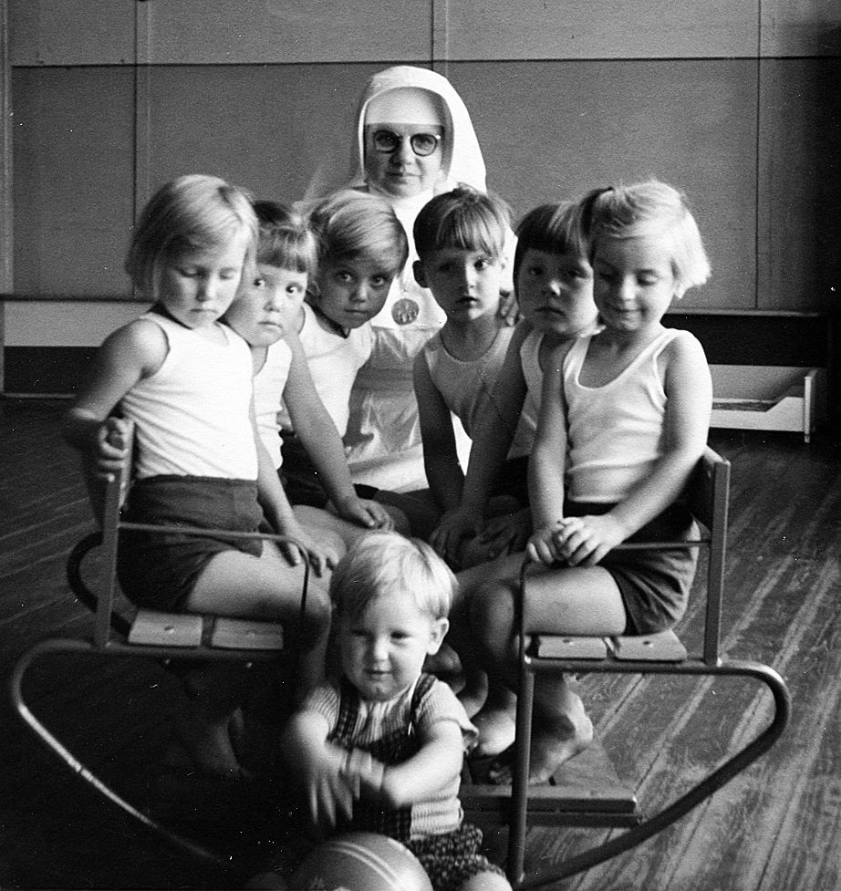
Kindergarten,
Mecklenbeck
Sr. Thiatildis
Meckenheim

Slide 12
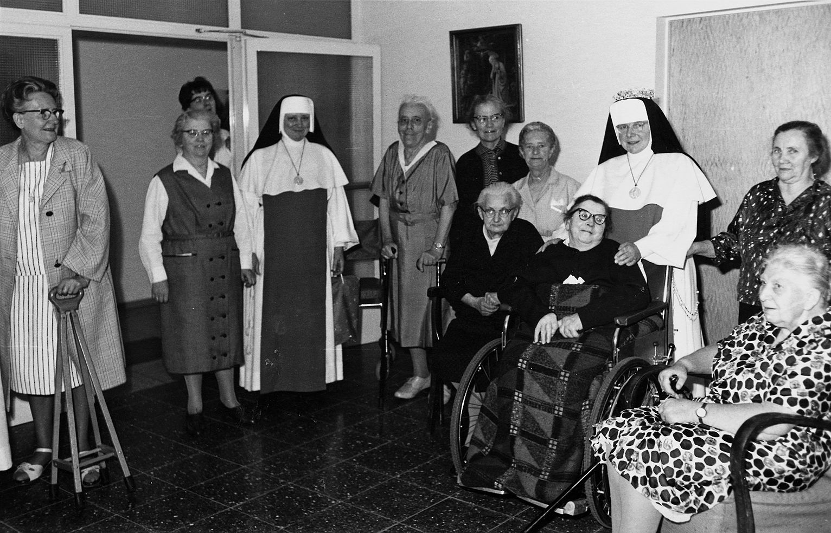
Resident care at St. Joseph Home,
Meckenheim

Slide 13
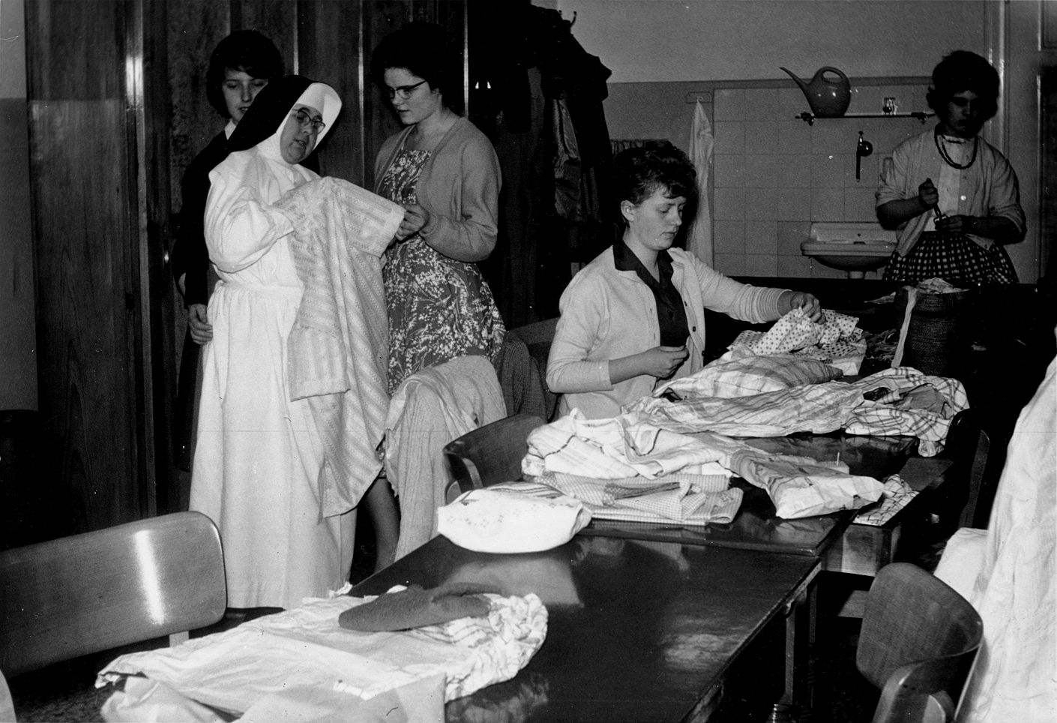
Sewing School, Homberg

Slide 14
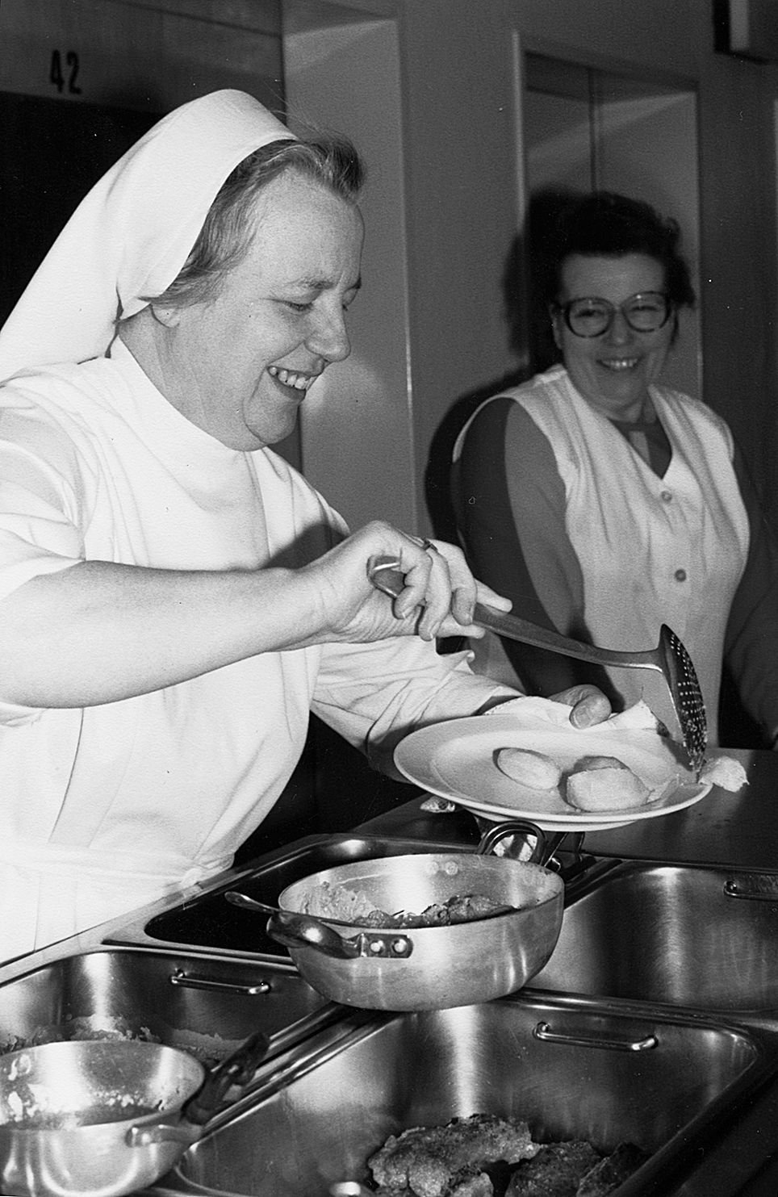
Sister Gertrud Nienhaus
a special touch to meal preparation

Slide 15
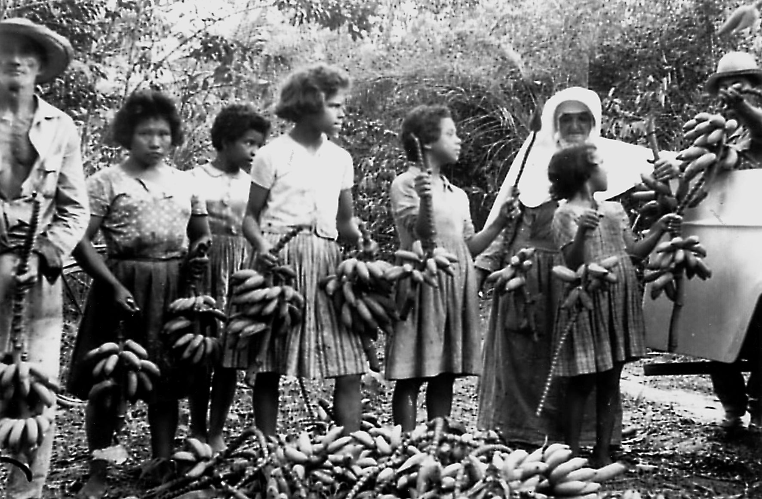
Sister Ambrosia Hesker with children picking bananas

Slide 16
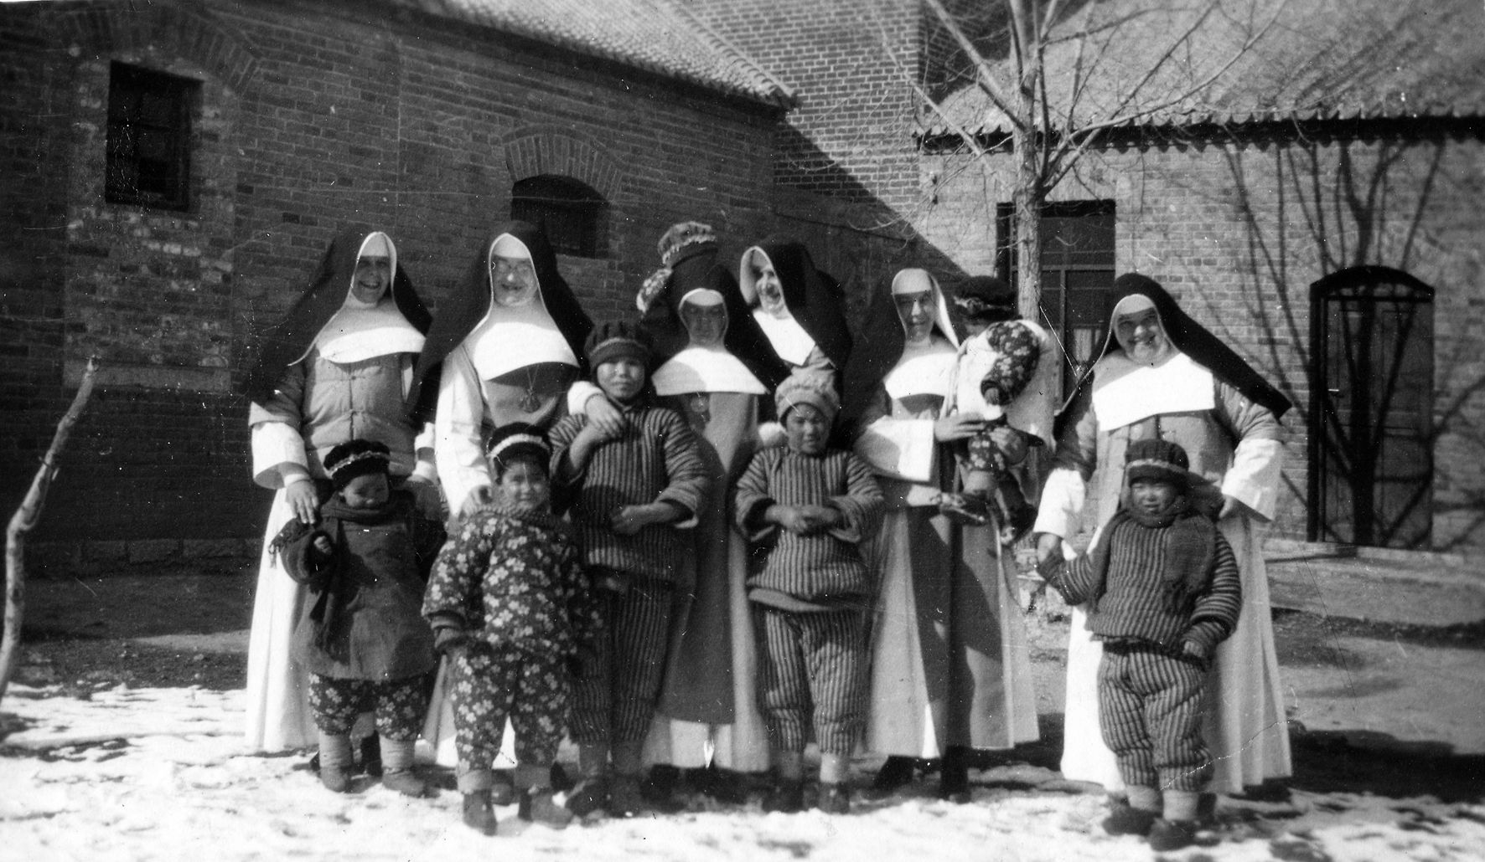
Hunkialou, China

Slide 17
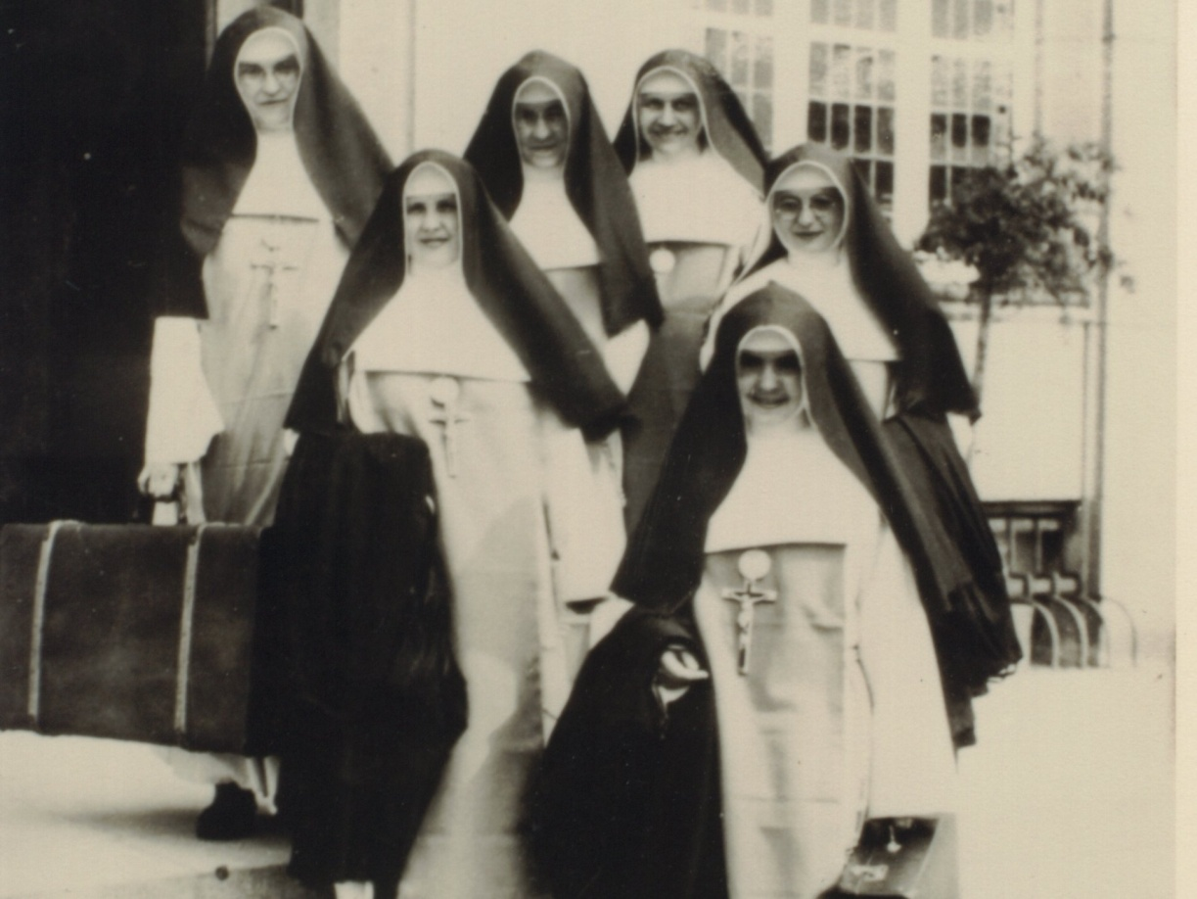
Missionaries to the United States

Slide 18
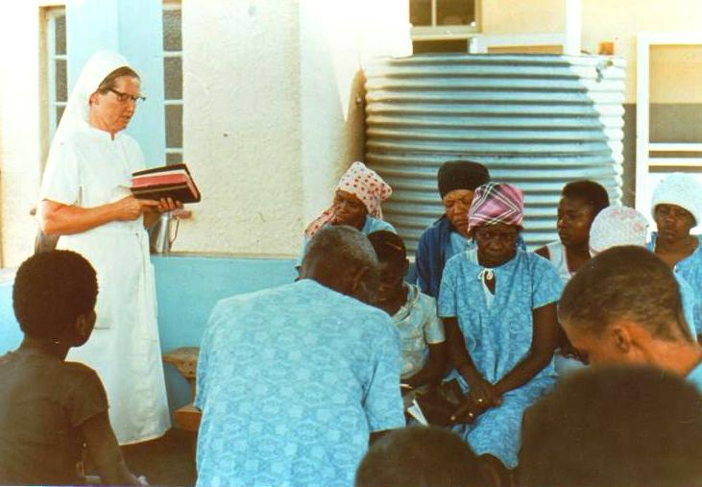
Sharing the Word of God in Namibia
German Sisters arrive in Namibia in 1962

Slide 19
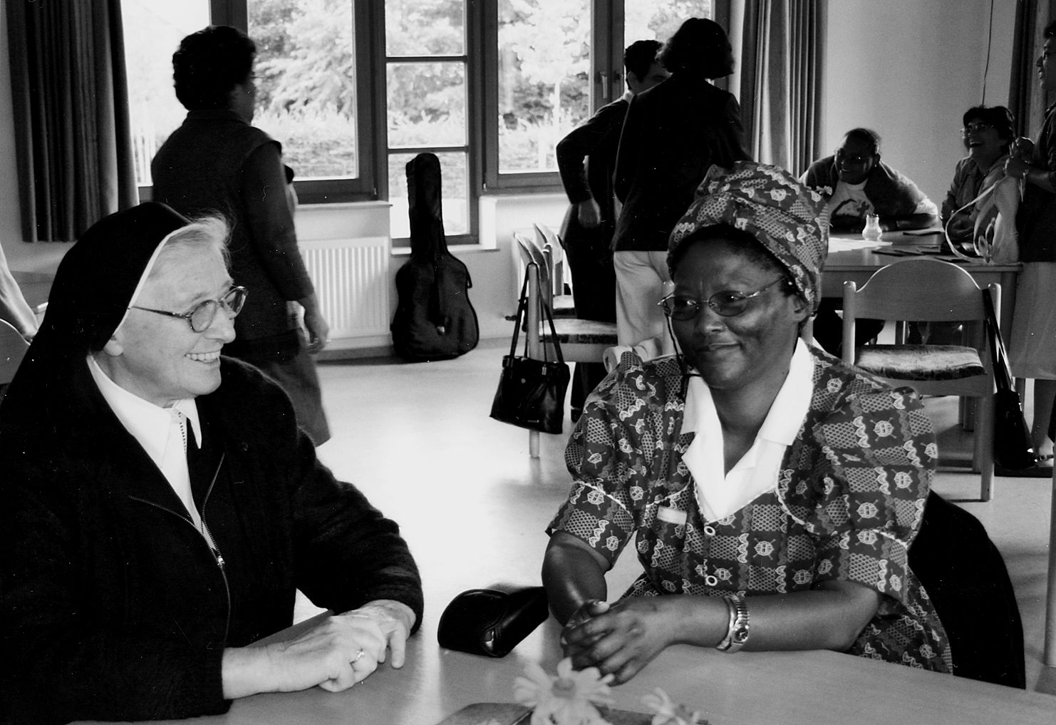
Two Sister Nurses recall their experiences
in Namibia

Slide 20
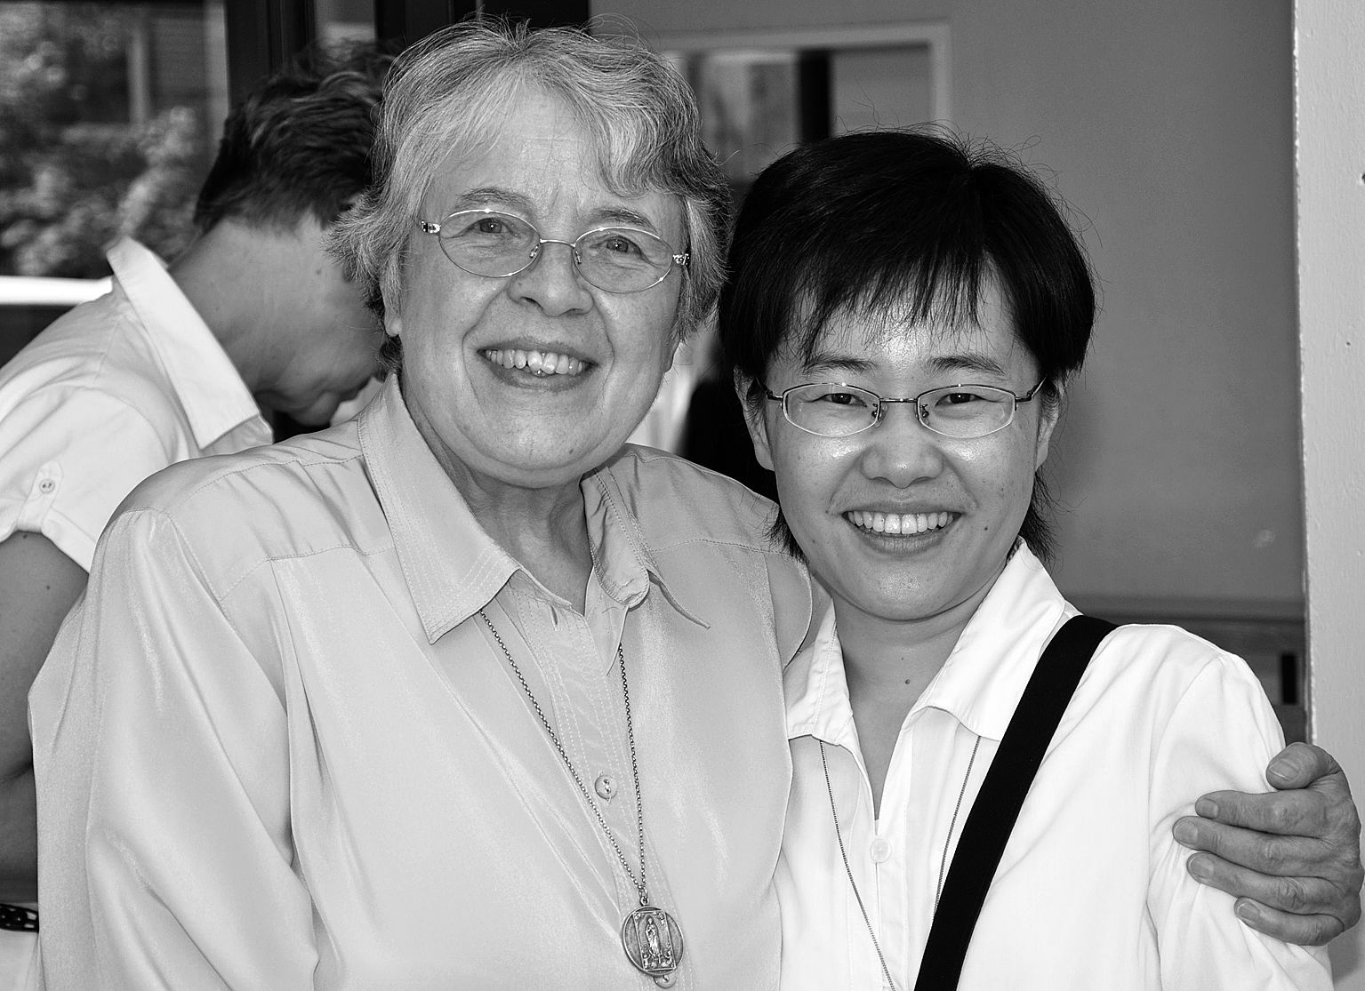
Sister Gudula Thimm caring for
a Chinese Sister student

Slide 21
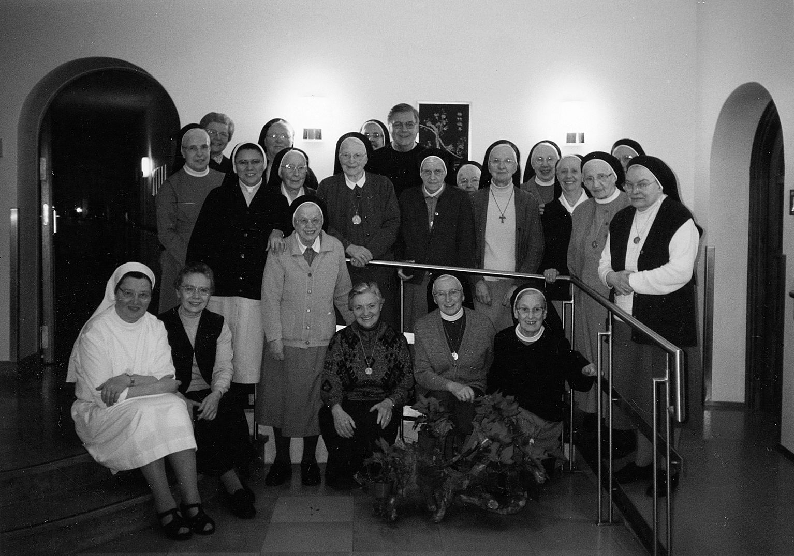
Welcoming Visitors:
Fr. John Schweiters,OFM
visit in 2005

Slide 22
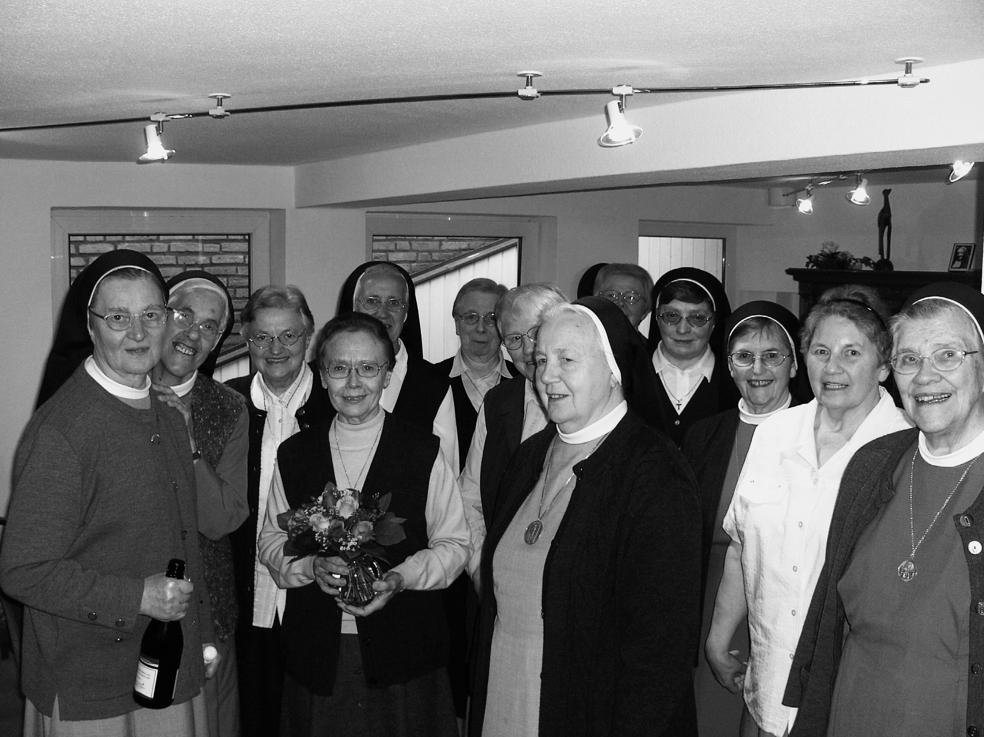
Provincial Chapter Delegates of 2010

