Slide 1
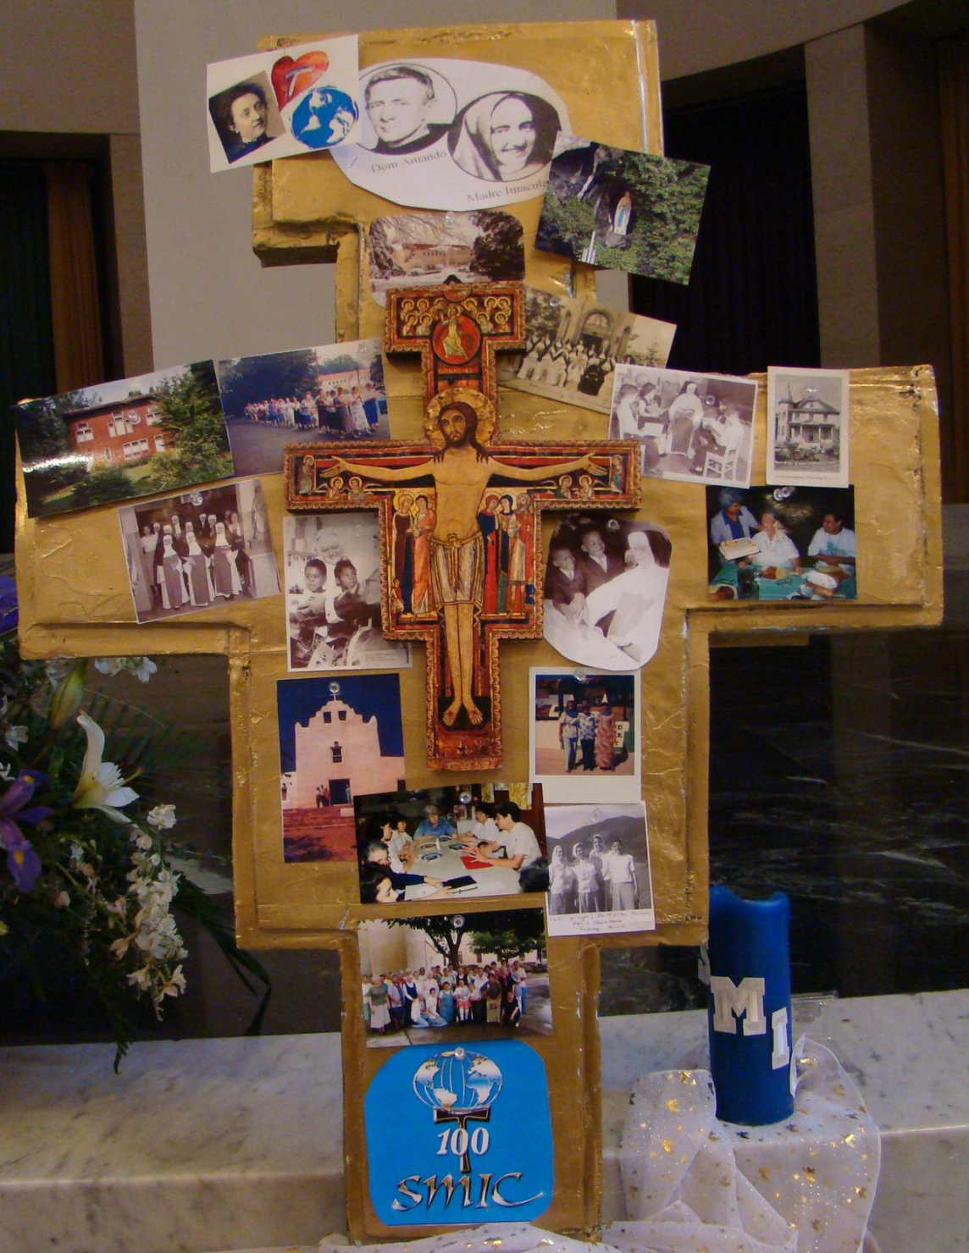
The USA Province
of the
Immaculate
Conception

Slide 2
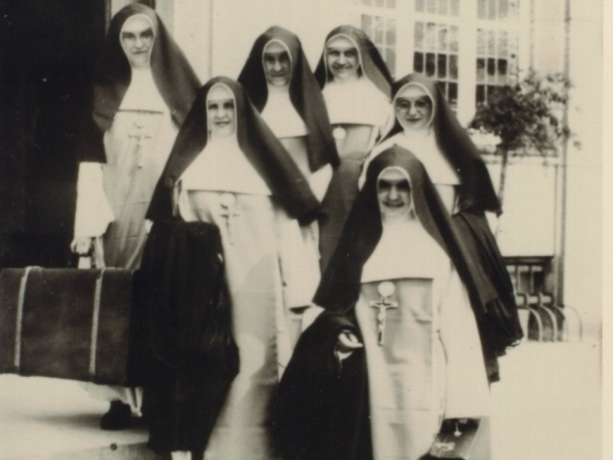
Women with a Mission for Christ

Slide 3
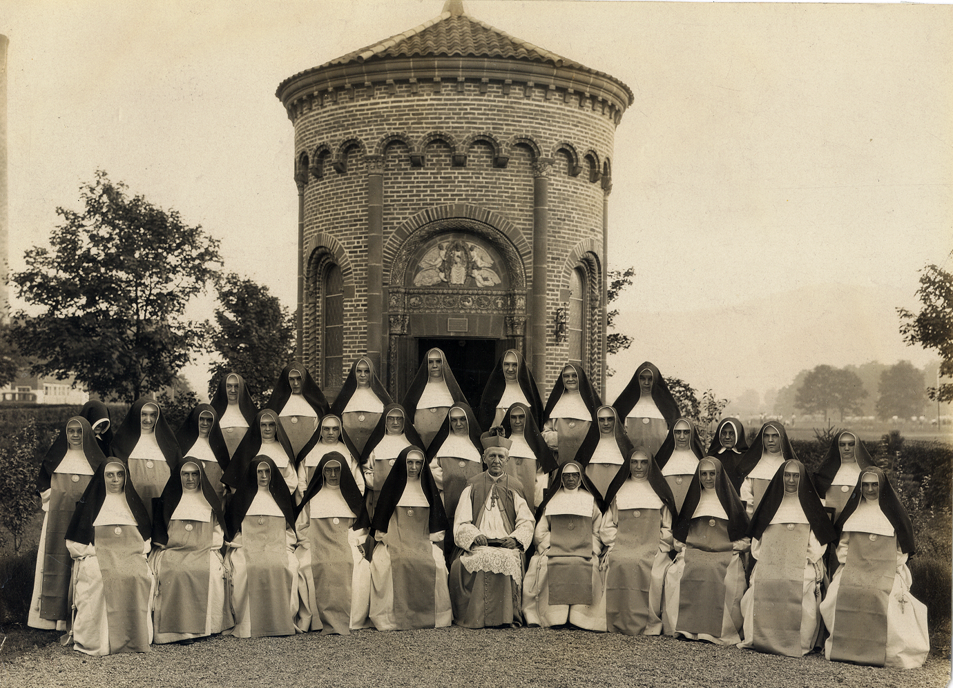
First US location: St. Bonaventure ,
New York, 1924

Slide 4
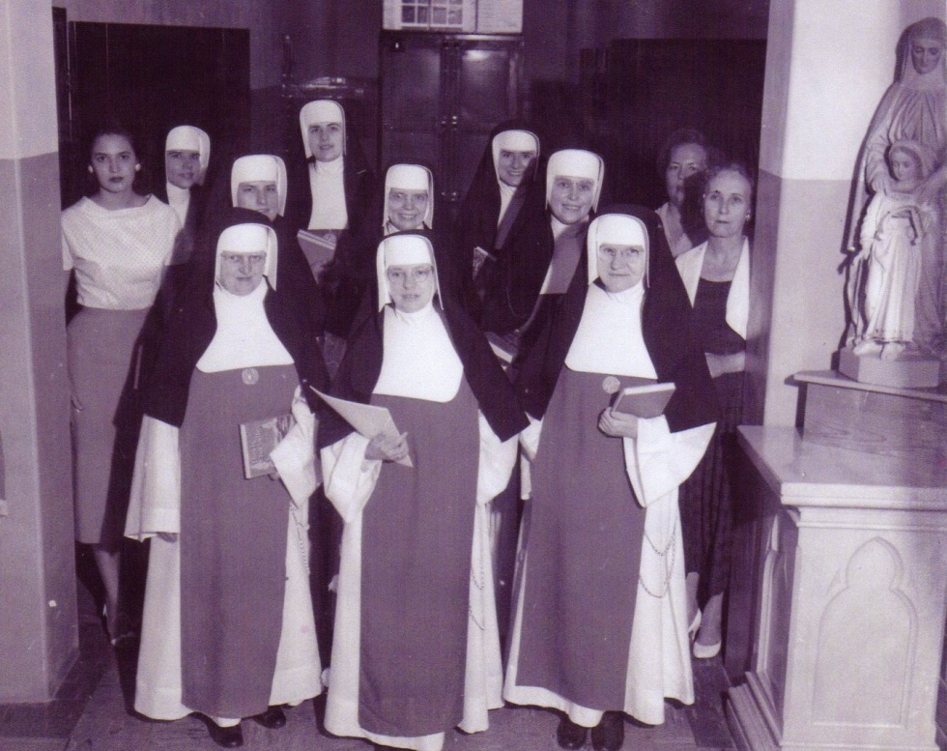
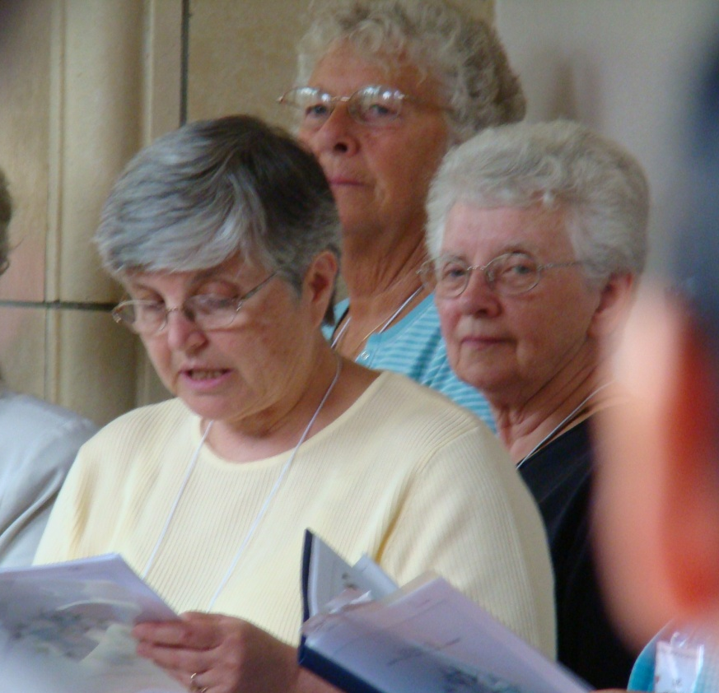
A call to mission
Yesterday and Today

Slide 5
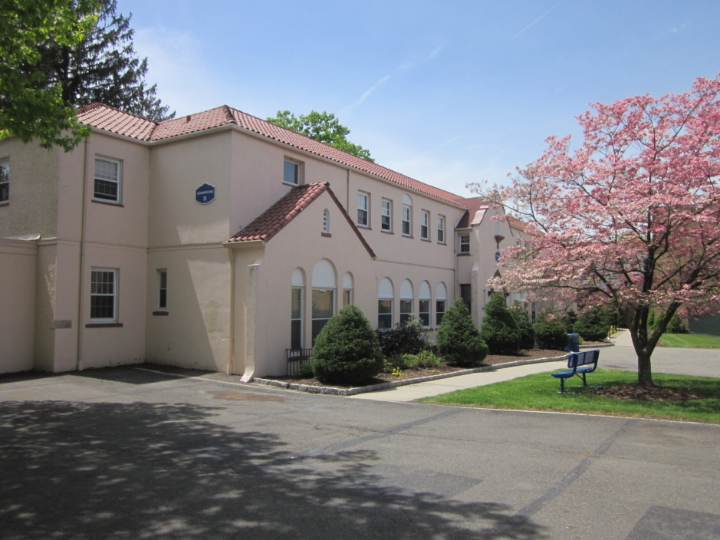
Generalate-Provincial Center
From 1942 to 1960 this building served as the Congregation’s generalate
From 1960 to 1995 it was the provincial headquarters of the US Province

Slide 6
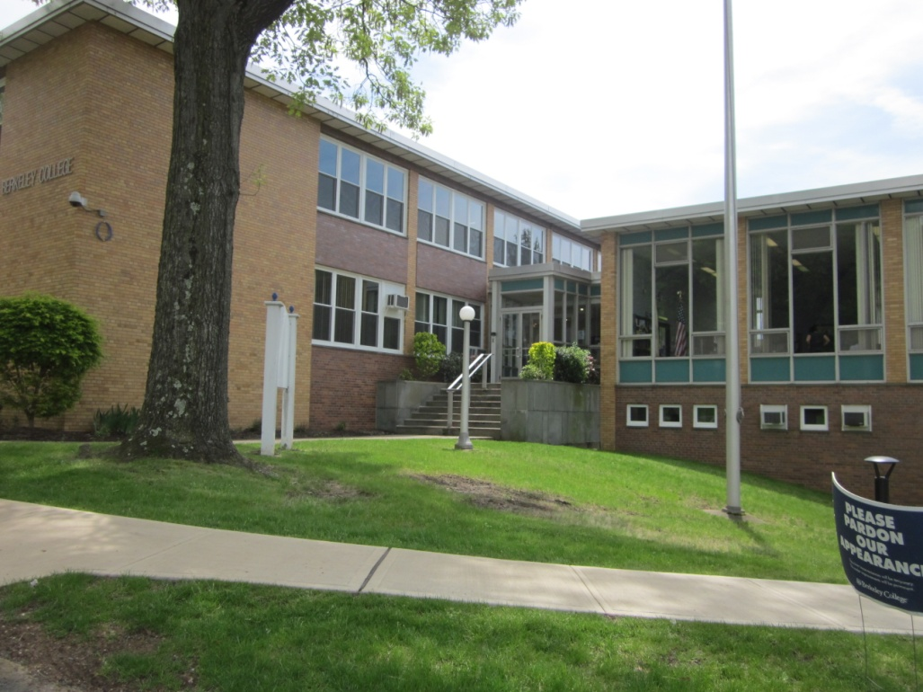
Tombrock College
Tombrock College (1956-1976) began as a Sisters Formation College and eventually expanded to include co-educational programs and AA degrees.
Tombrock College (1956-1976) began as a Sisters Formation College and eventually expanded to include co-educational programs and AA degrees.
Tombrock College (1956-1976) began as a Sisters Formation College and eventually expanded to include co-educational programs and AA degrees
From 1956 to 1976
Tombrock College
provided for the professional education needed by the Sisters for ministry.
Tombrock was Mother Immaculata’s family name

Slide 7
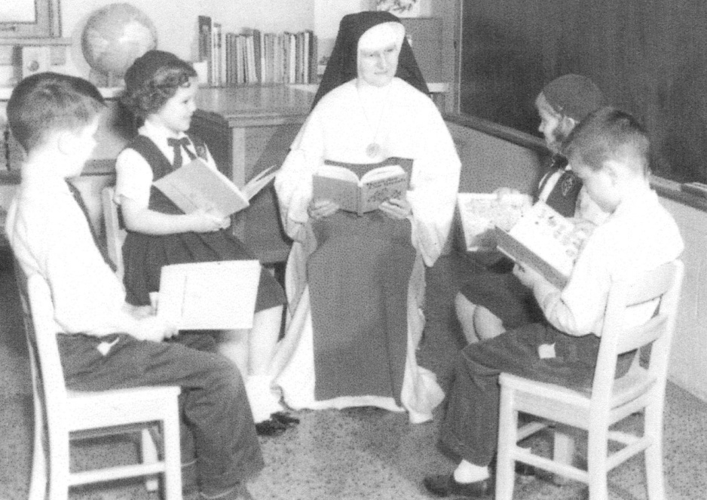
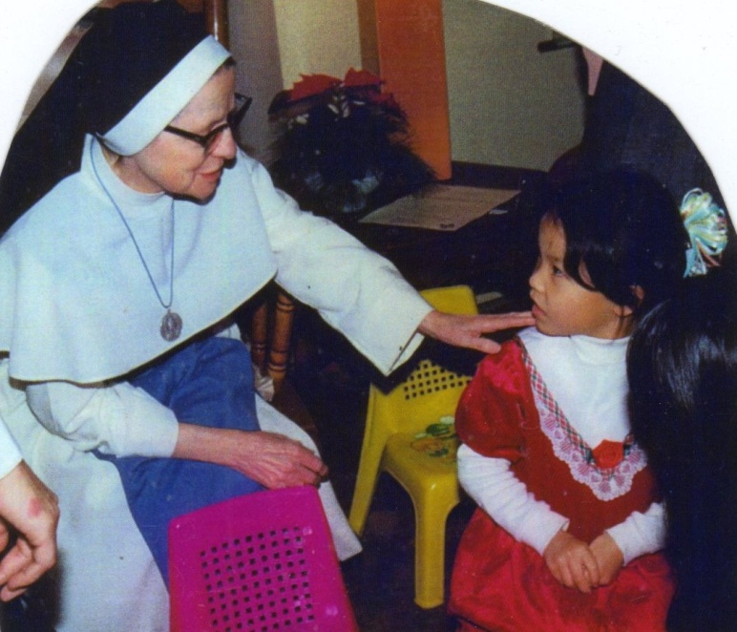
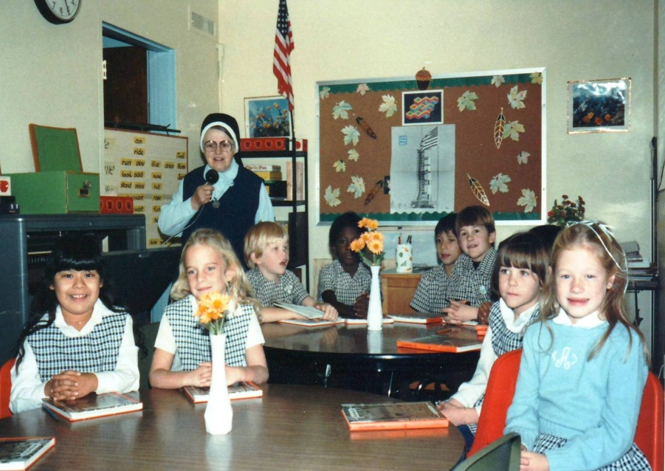
Parish schools
Illinois, Texas, New Jersey

Slide 8
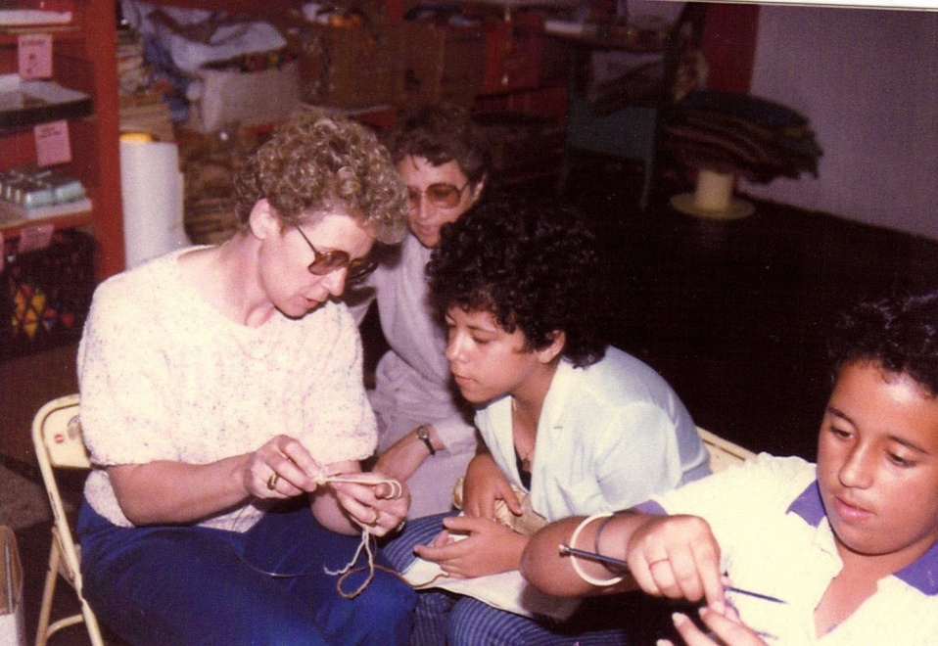
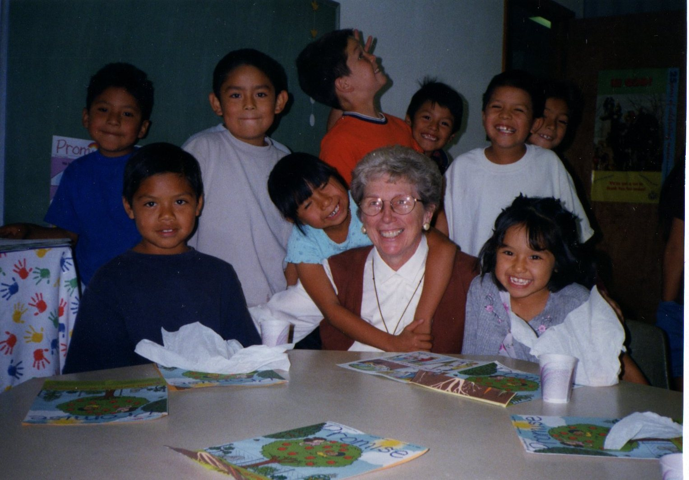
Pastoral education

Slide 9
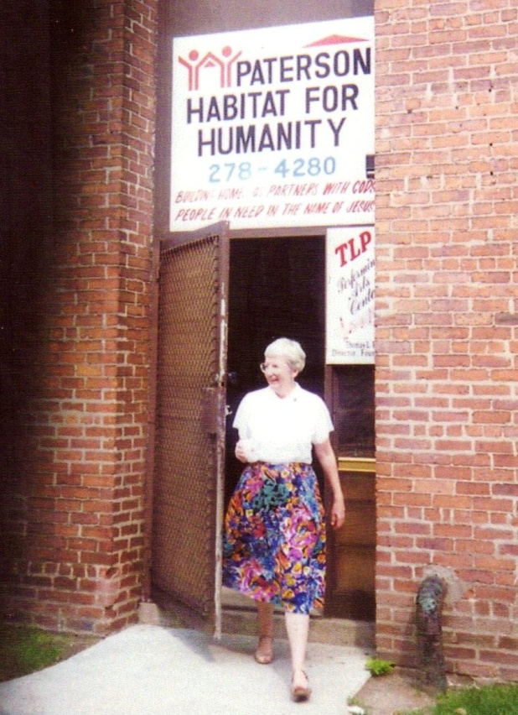
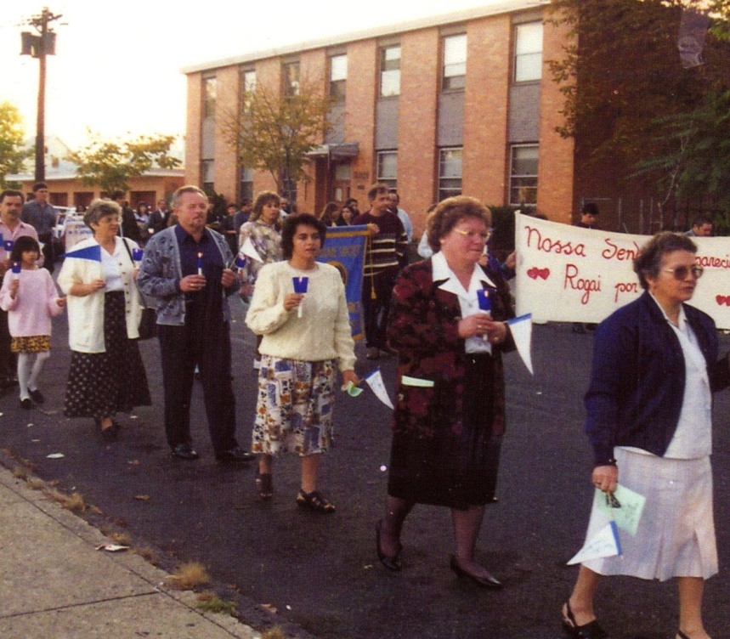
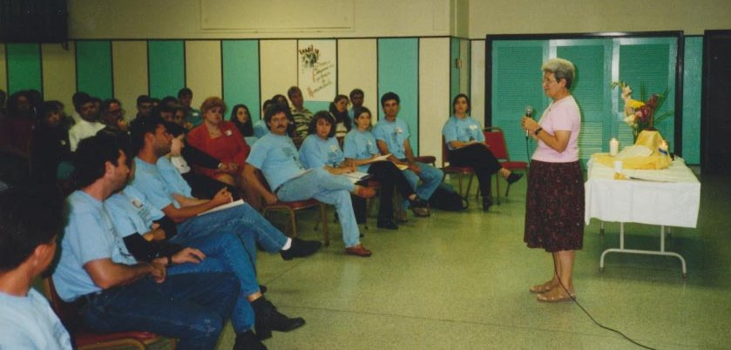
Pastoral services

Slide 10
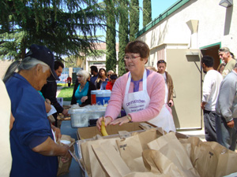
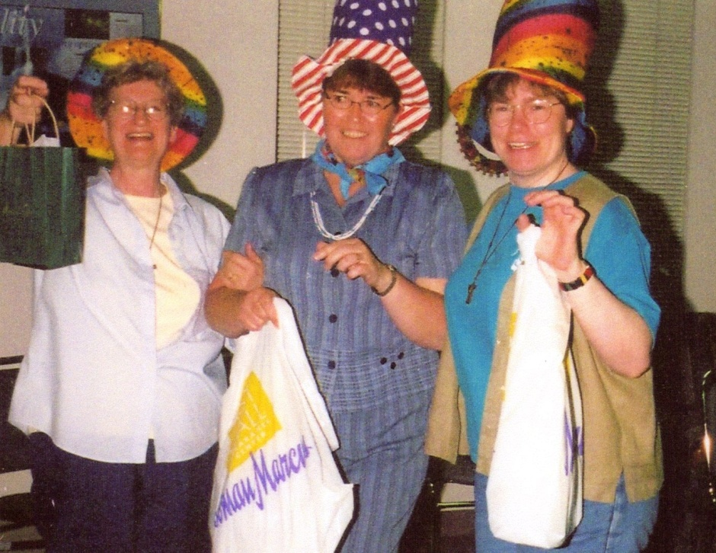
Bringing hope, sharing joy

Slide 11
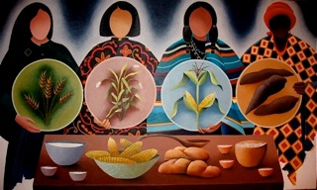
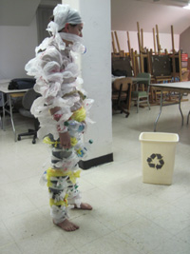
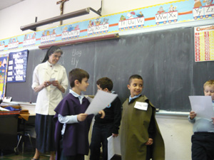
Teaching through Art
Through painting
Bucksport, Me.
Becoming art
Through drama
Newark, NJ
Felician College, Lodi, NJ

Slide 12
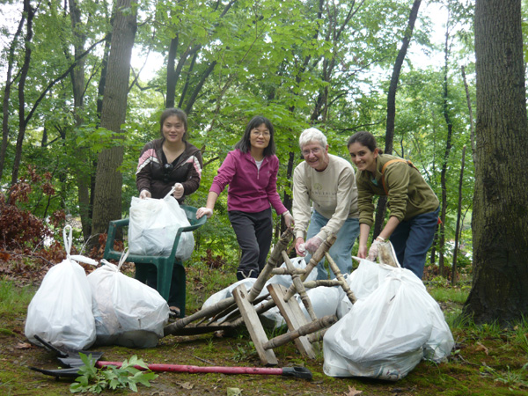
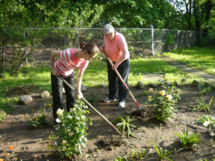
Caring for Creation
with a Franciscan spirit of respect

Slide 13
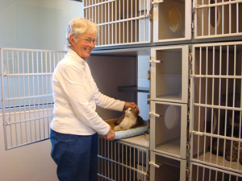
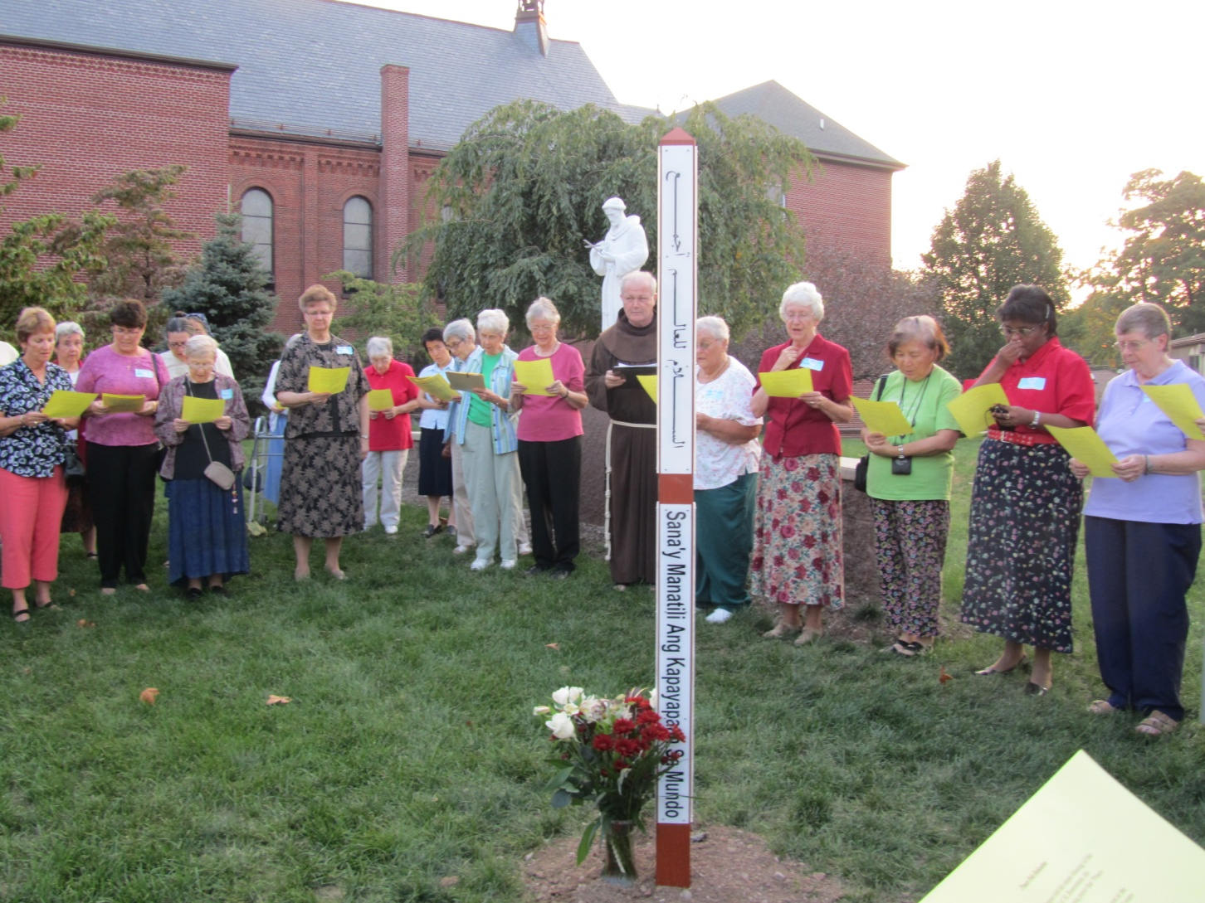
Loving all our brothers & sisters, animals too
Creating space for peace

Slide 14
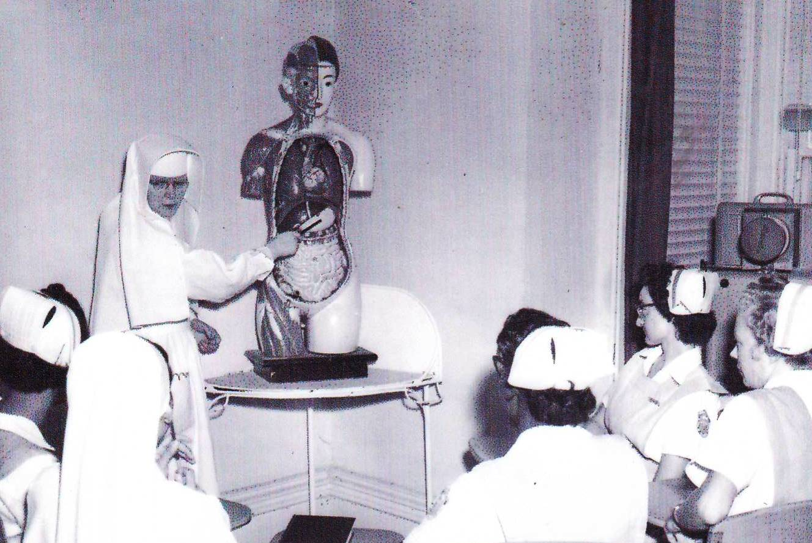
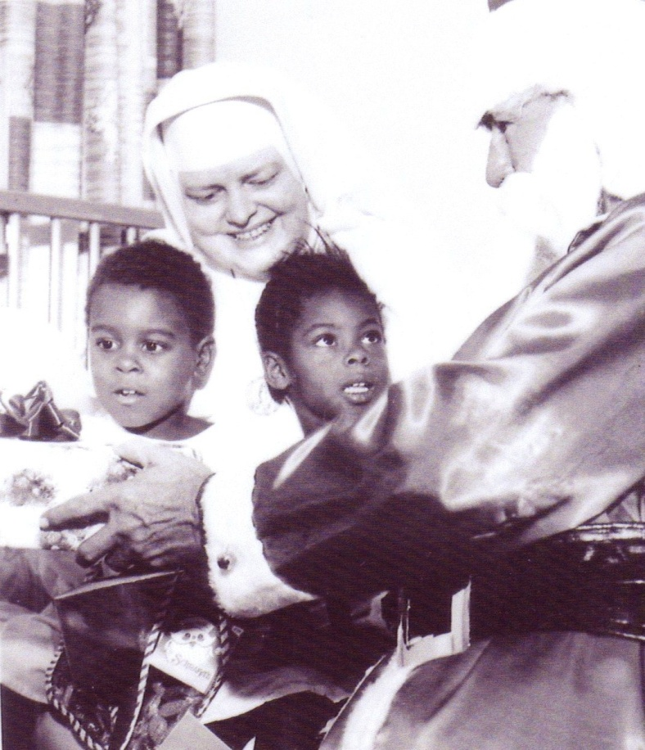
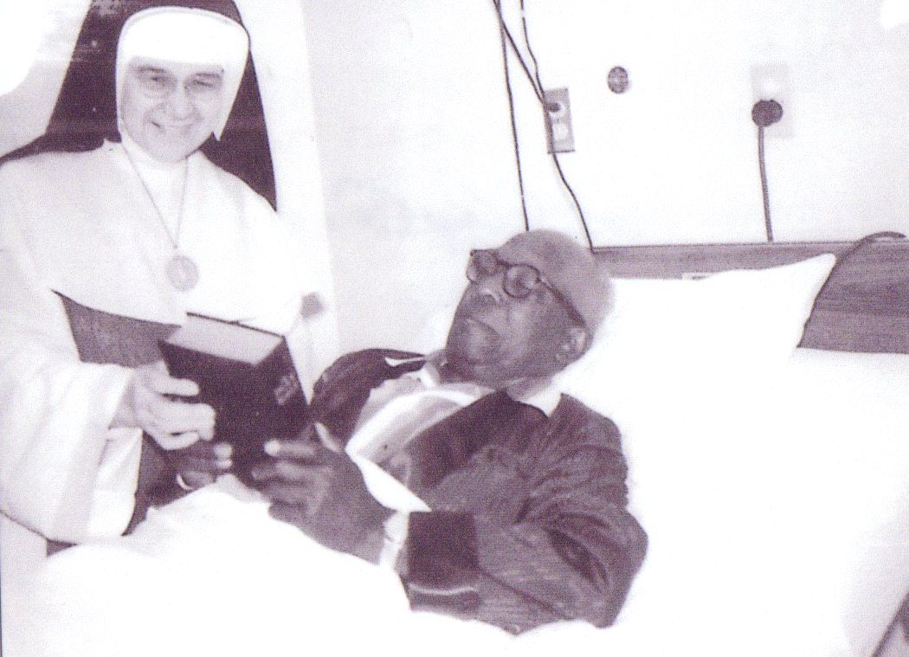
Health ministries
1940 ~ 1981
St. Elizabeth and Holy
Cross Hospitals
Texas

Slide 15
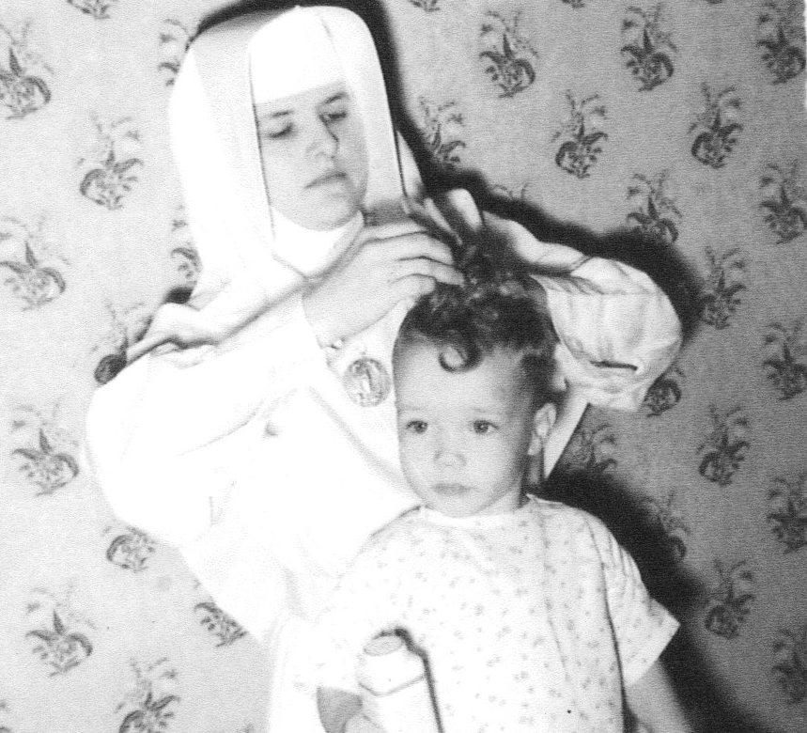
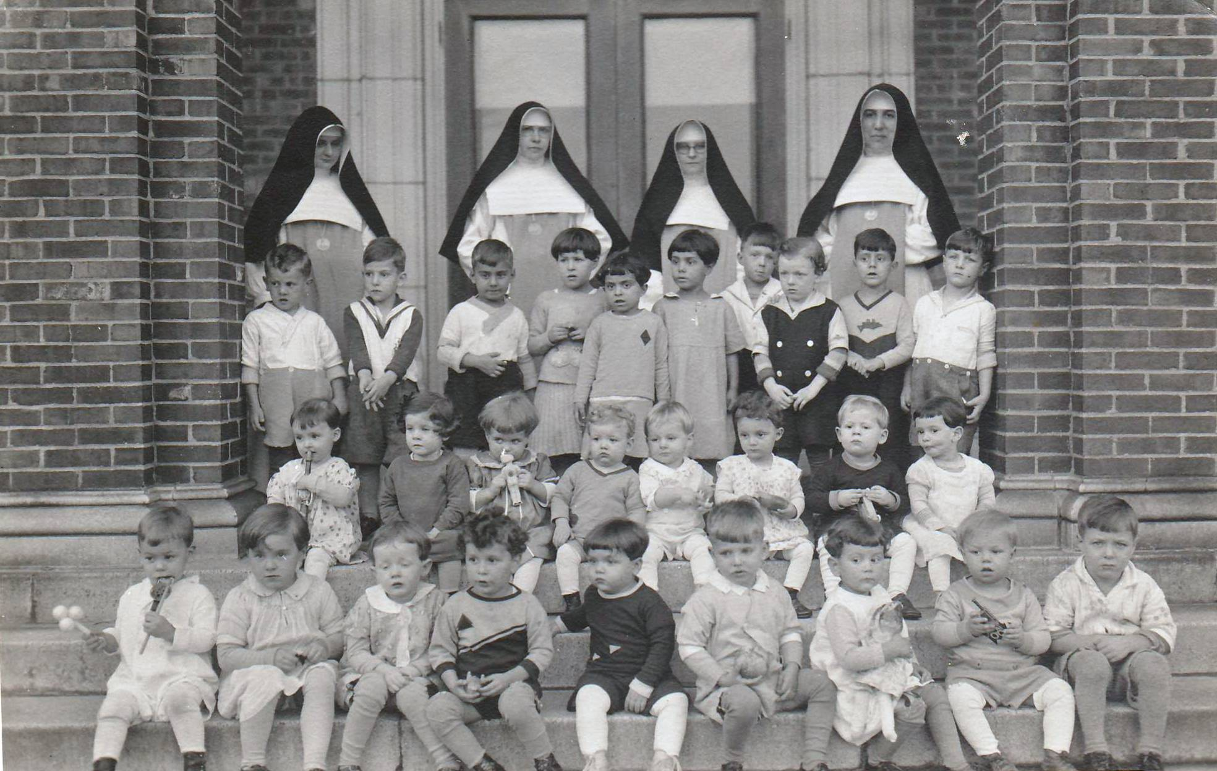
Social Care Ministries
St. Walberga’s
Orphanage,
New Jersey 1931 ~ 1962

Slide 16
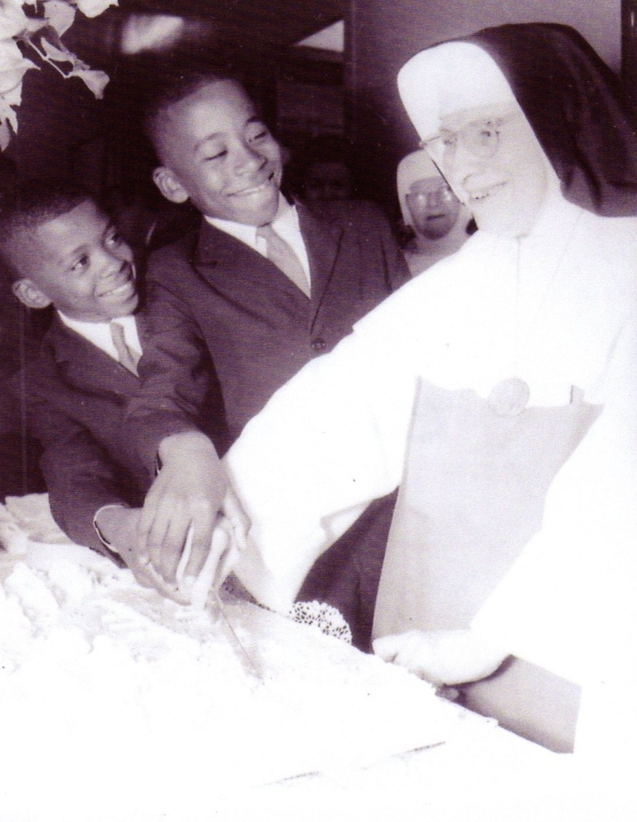
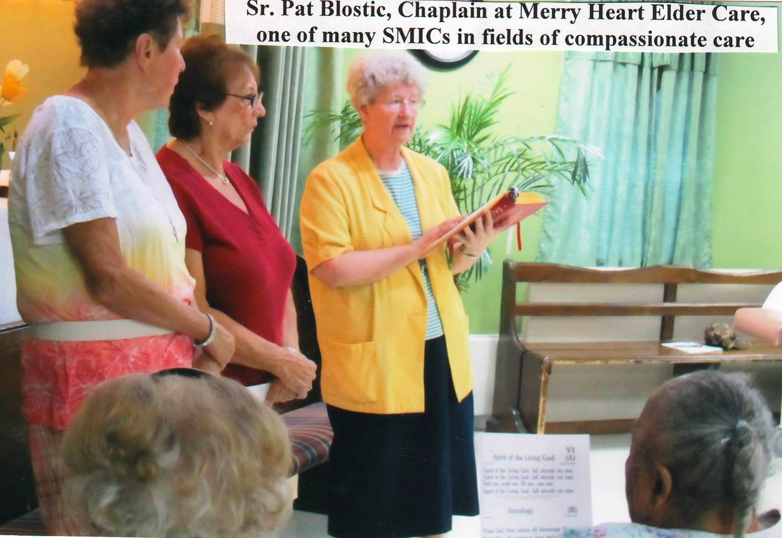
Sharing sacred times

Slide 17
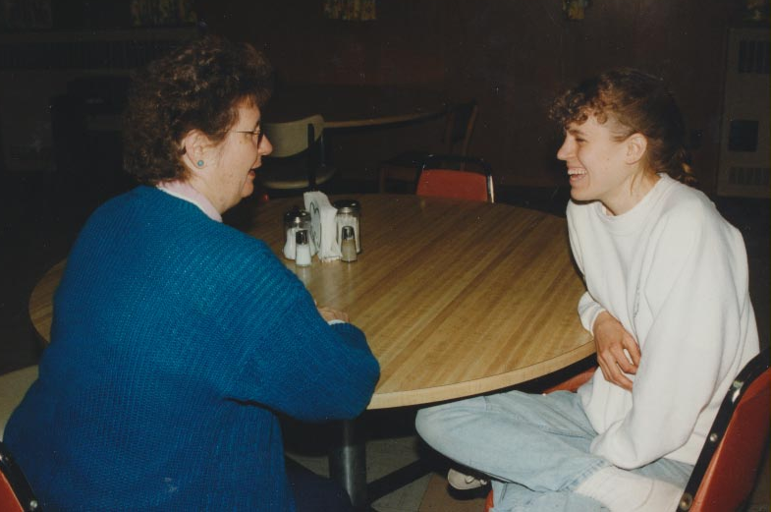
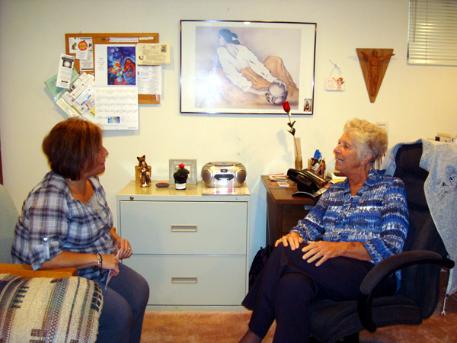
Sharing the journey of life through counseling

Slide 18
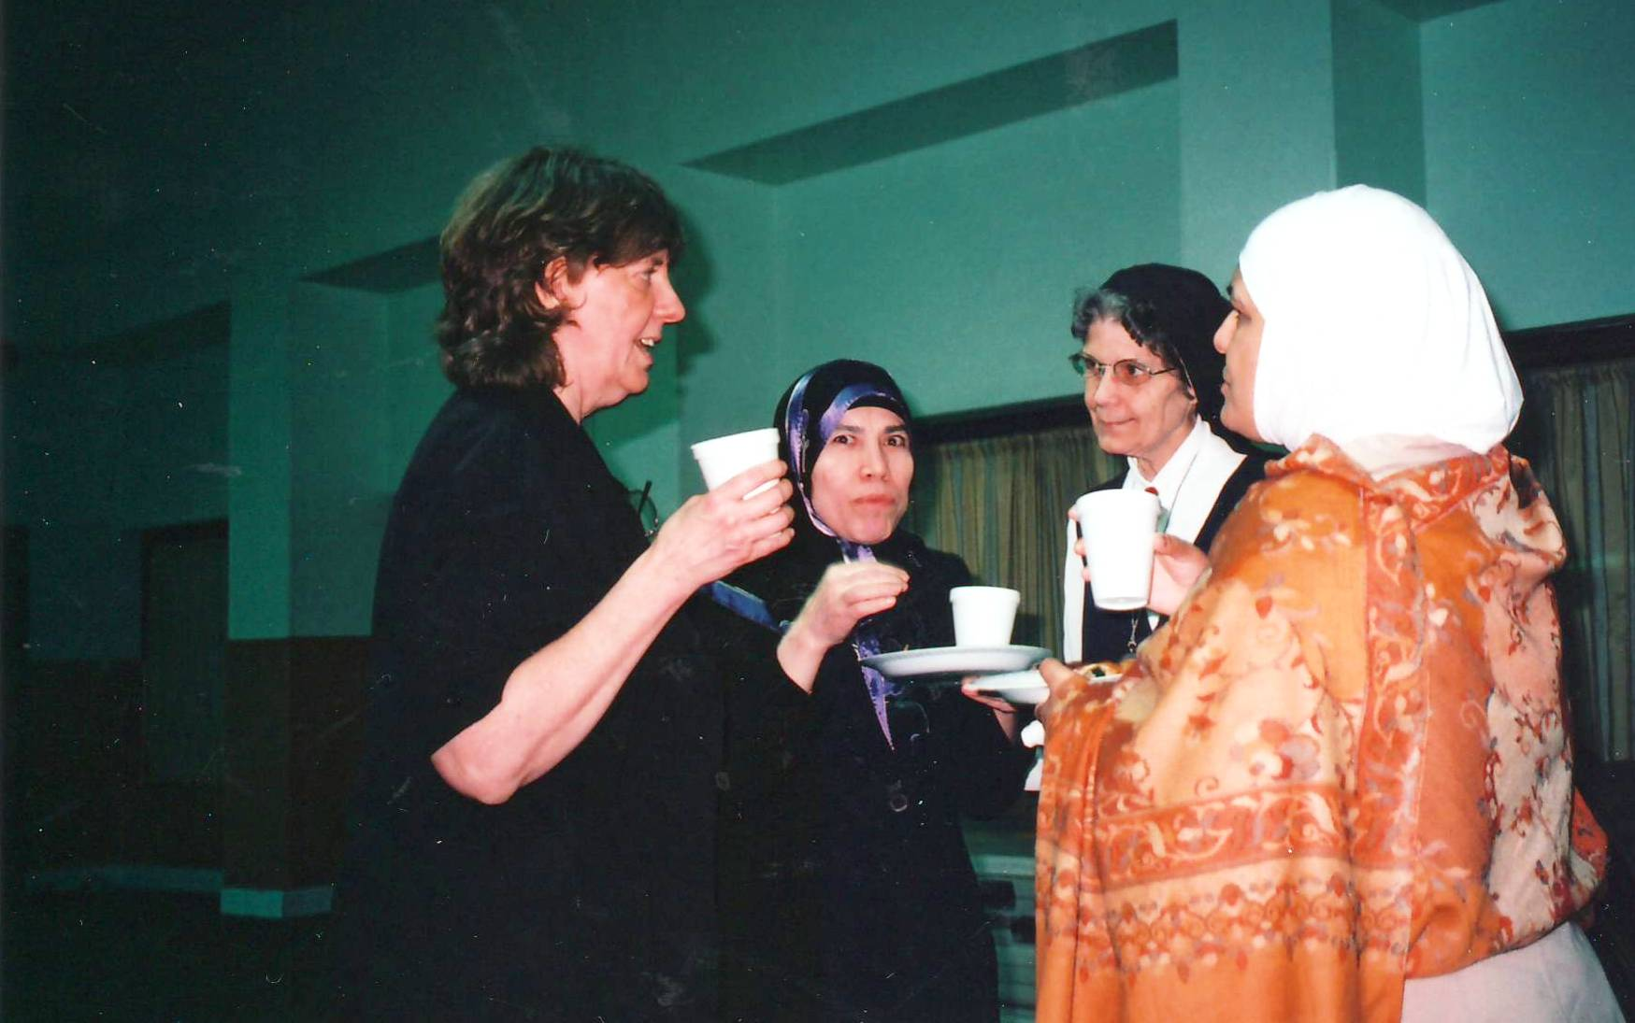
Inter religious Dialogue

Slide 19
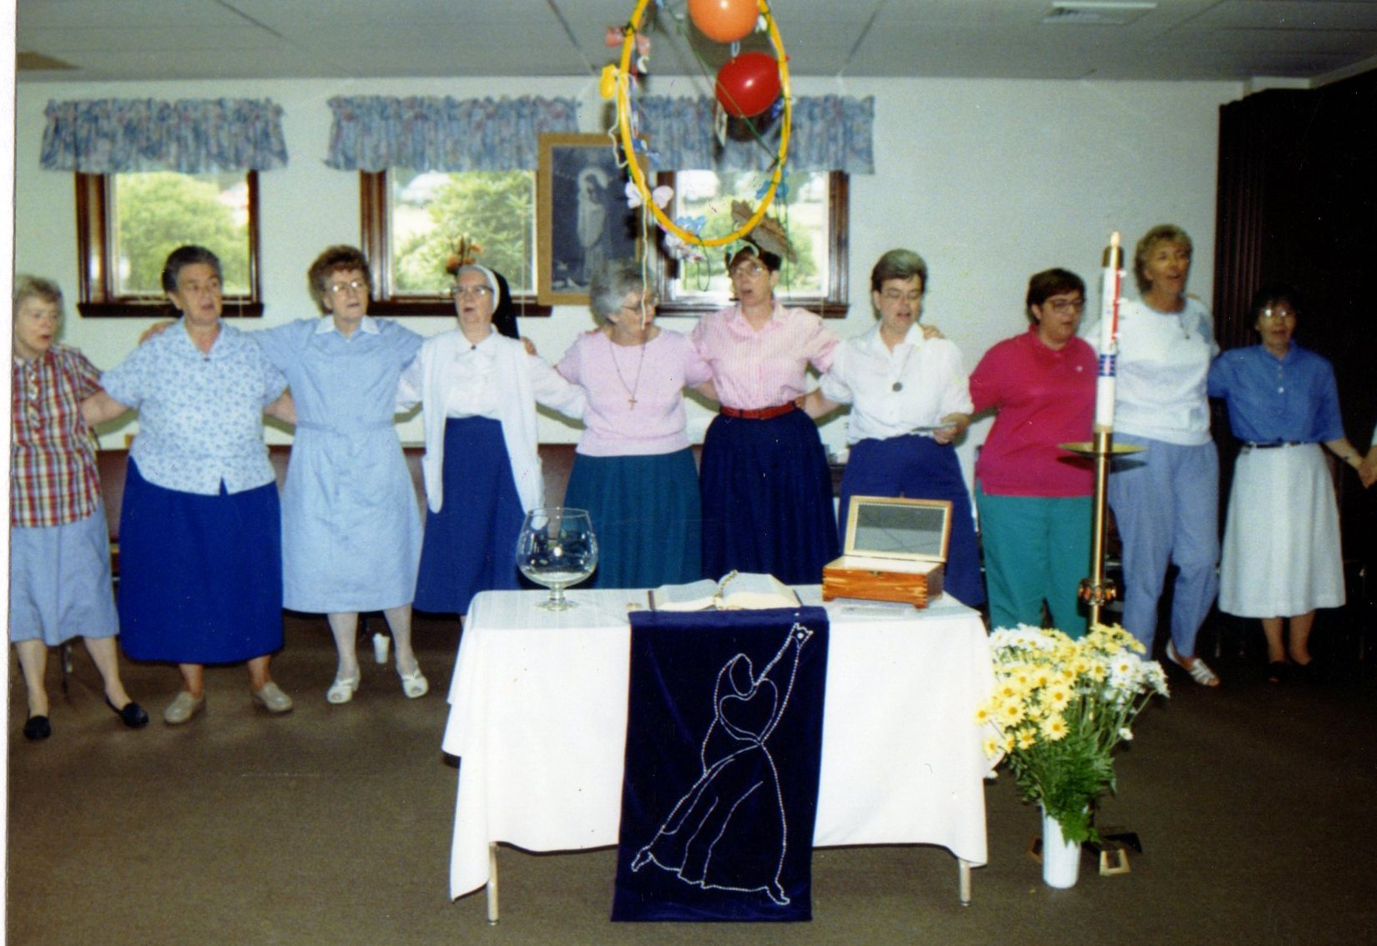
And restoring communal faith

Slide 20
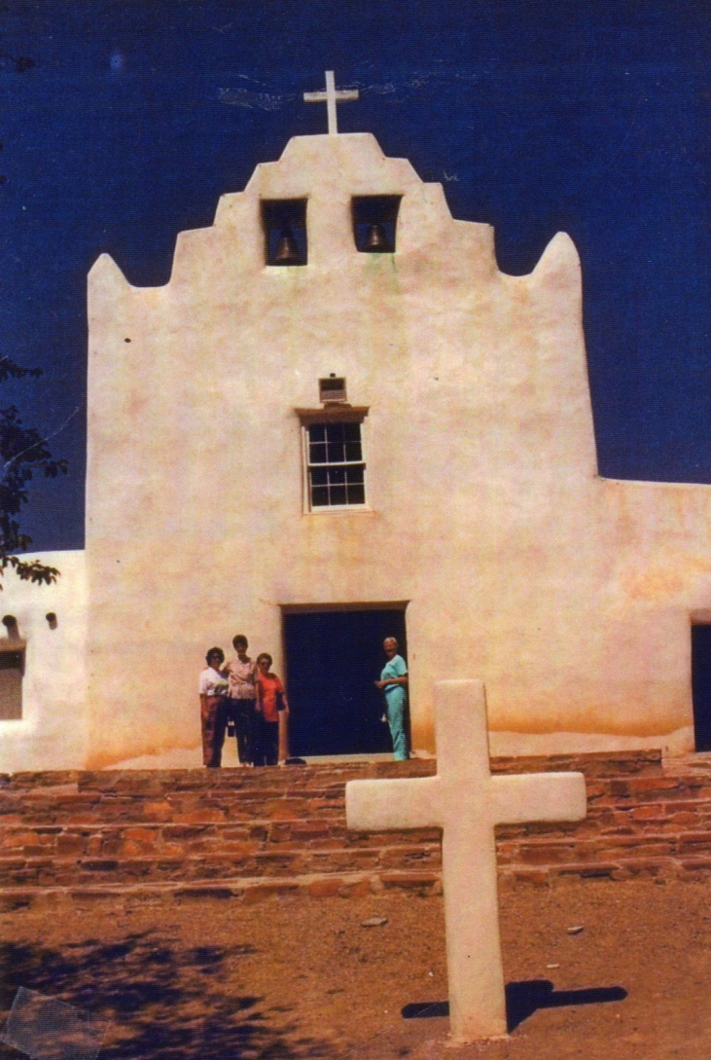
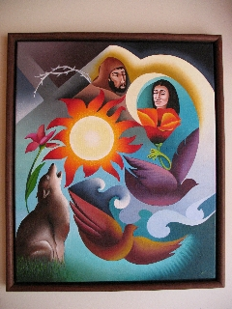
Southwestern blessings
Artistic Expression by
Sr. Nancy Earle, smic

Slide 21
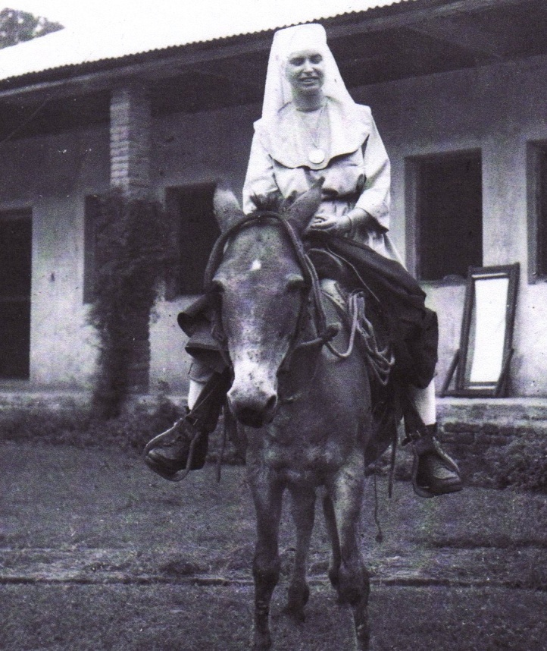
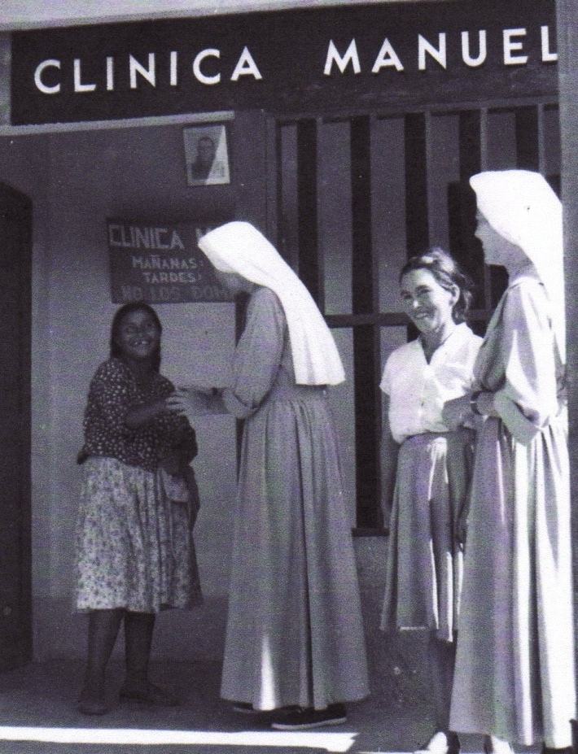
International mission: Bolivia
1964~68
Gospel witness through catechetical, medical,
and social services

Slide 22
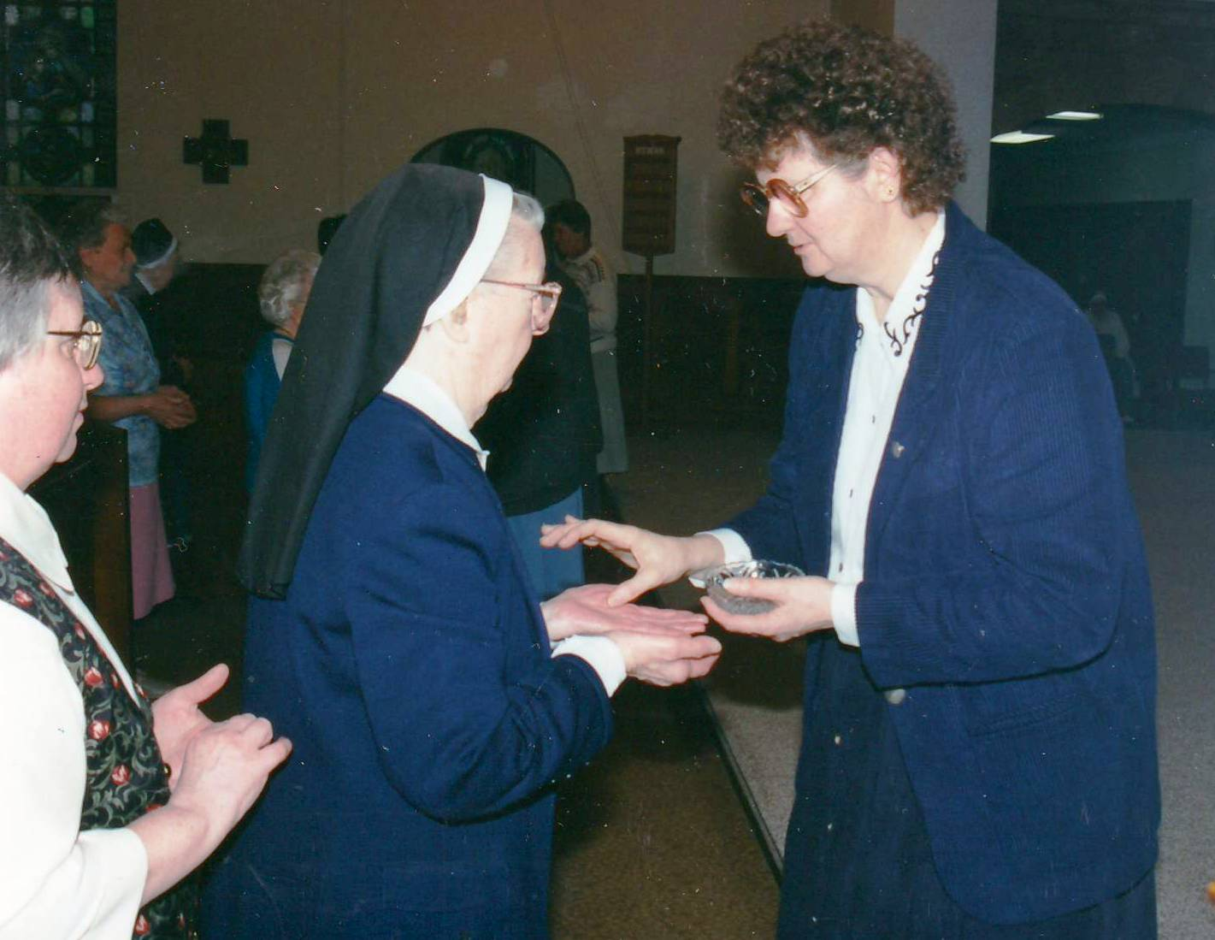
A sisterly blessing for the journey

Slide 23
Charism continued: A contemplative compassionate presence…
Advocacy for
Victims of human trafficking
Immigration reform that is human and just
Care for creation: against fracking and other pollutants to endanger our sister water.

