Slide 1
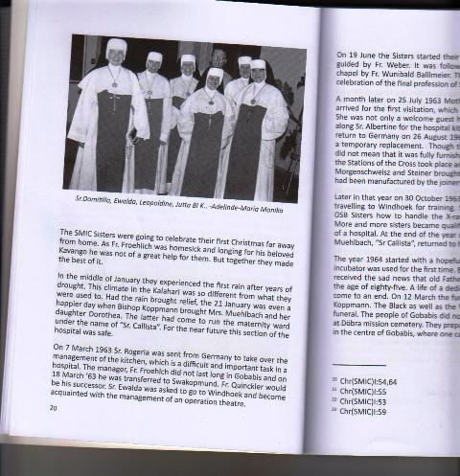
Province of the Epiphany, Namibia
1961
A new historical venture for the Lord…responding to Vatican II’s call to extend the Gospel message to all peoples, even to those in Africa

Slide 2
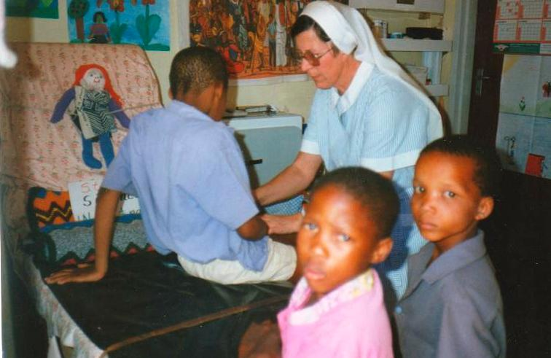
Sr. Dominika responds to health needs

Slide 3
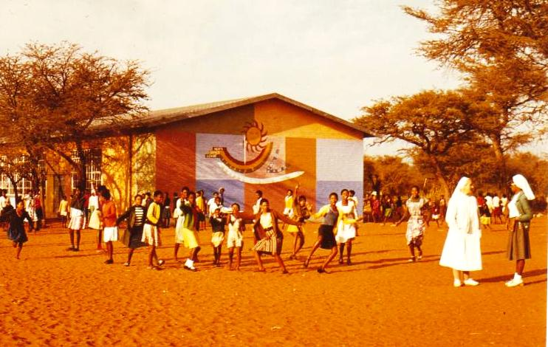
Mission school at Farm Gunichas,
South of Gobabis

Slide 4
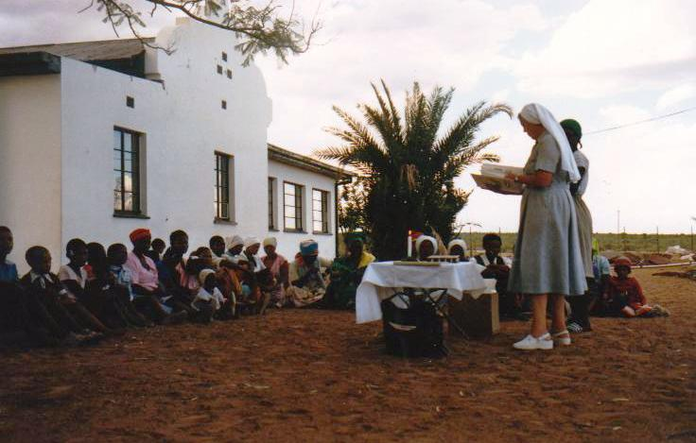
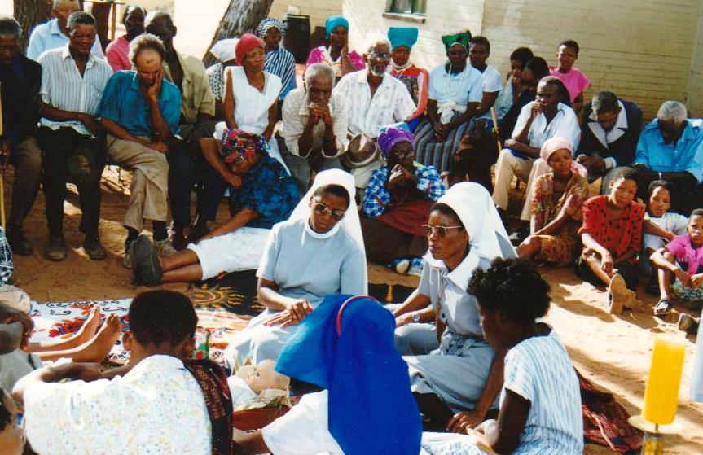
Eucharistic celebrations
at the farms
Bringing the Community together

Slide 5
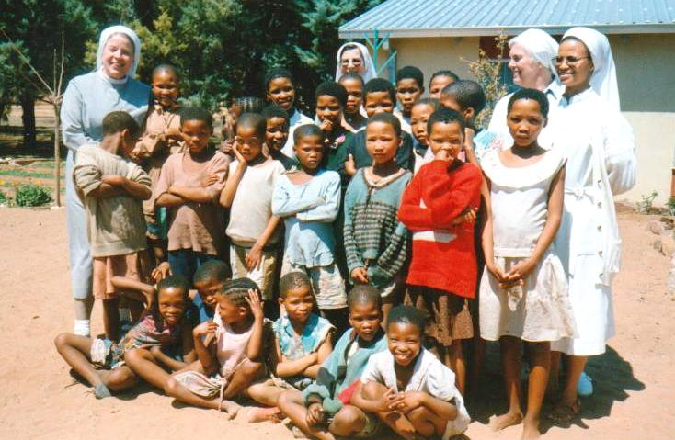
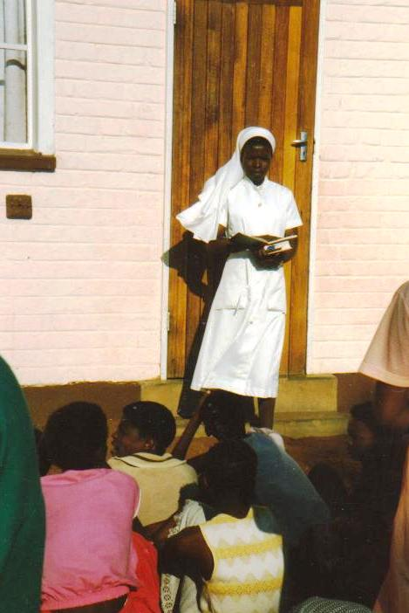
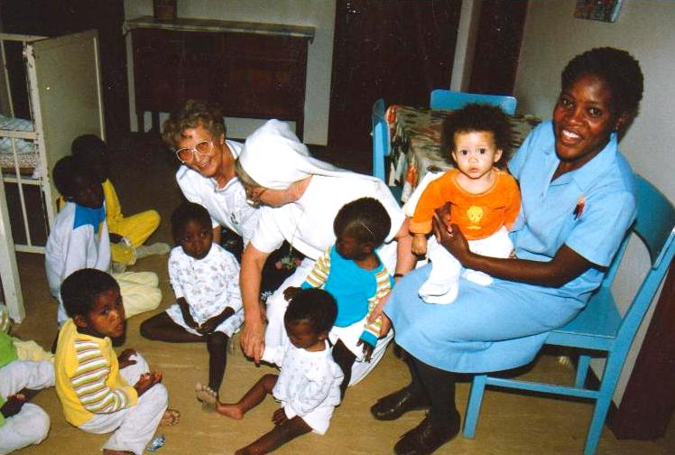

Slide 6
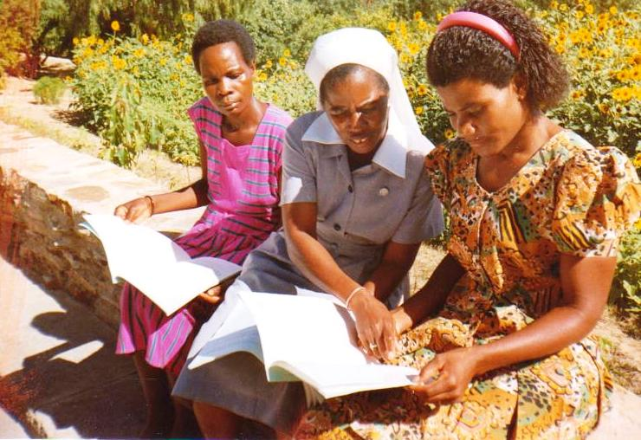
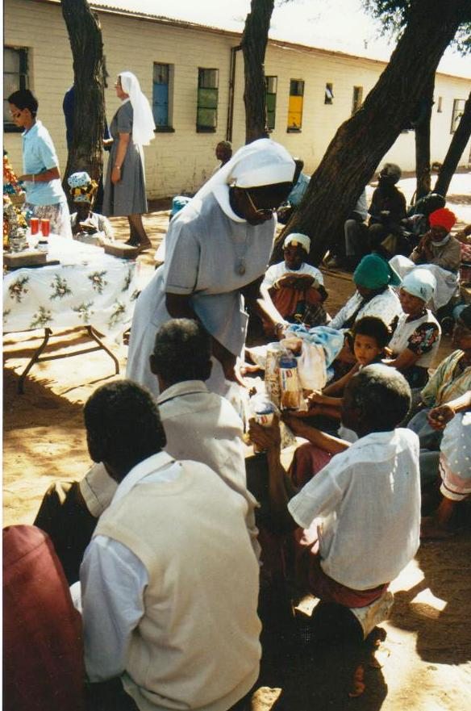
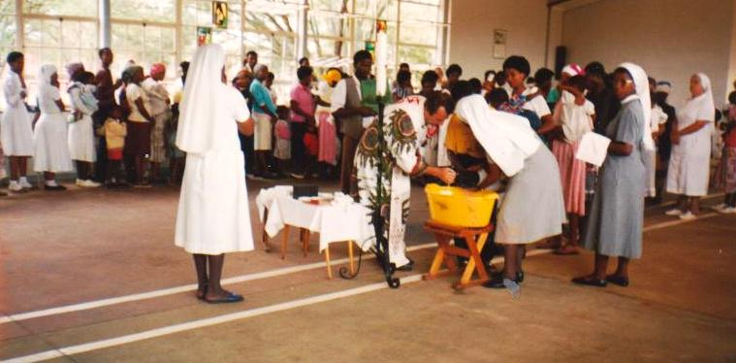

Slide 7
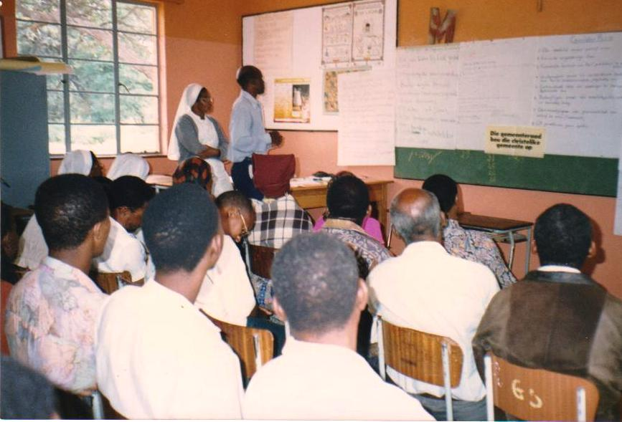
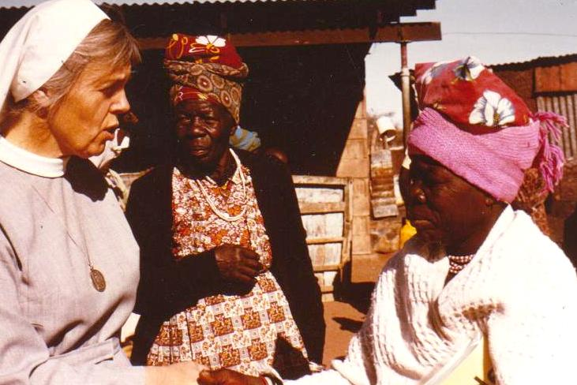
Preparing Candidates for the Permanent
Diaconate
Home visits

Slide 8
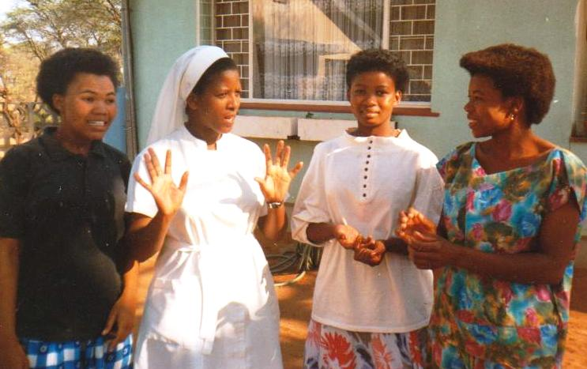
an invitation to follow Christ with the
Missionary Sisters of the Immaculate Conception

Slide 9
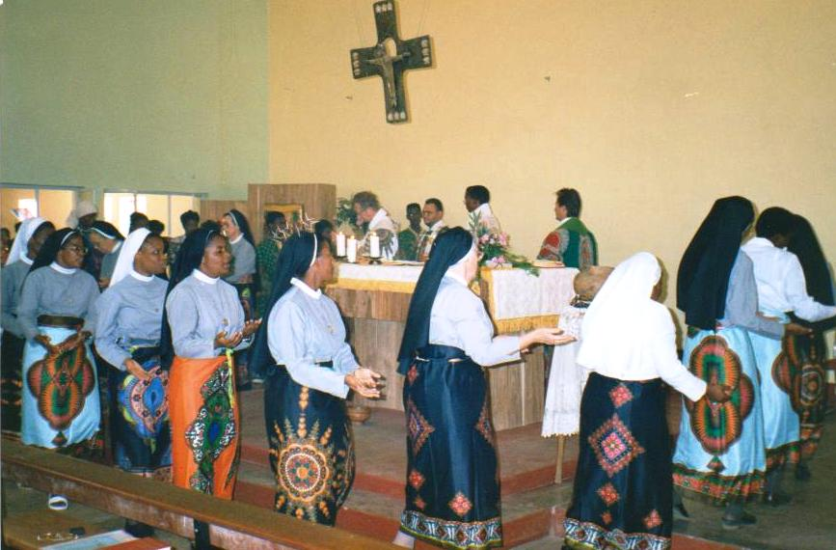
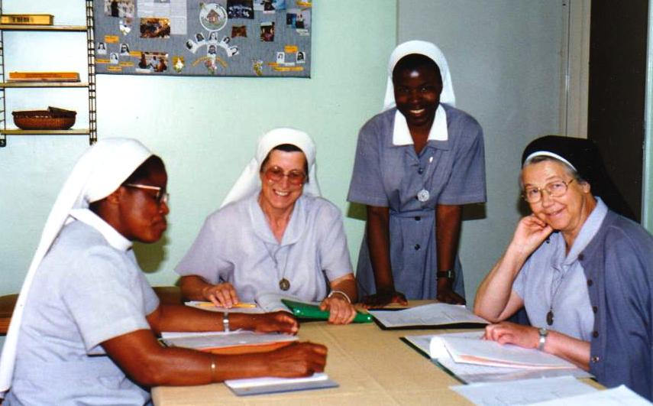
We are today’s legacy to the Church

Slide 10
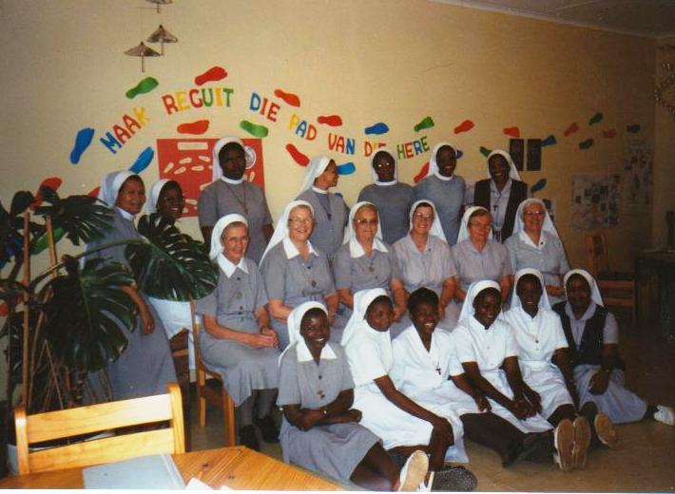

Slide 11
