Slide 1
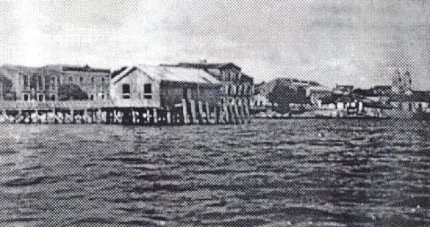
SMIC Mission in Santarém Brazil

Slide 2
Amandus Bahlmann, OFM
Man of God, sent to proclaim the Good News to the marginalized

Slide 3
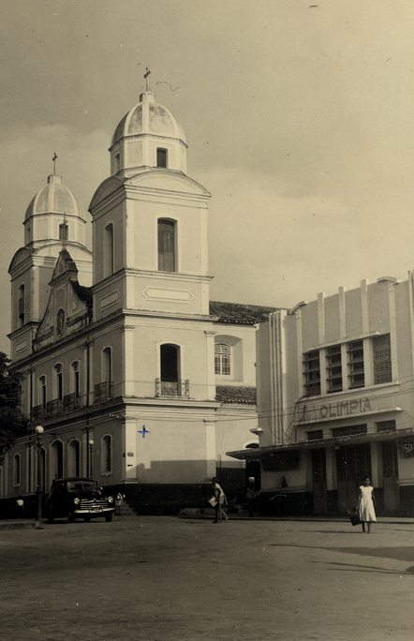
Bishop of Santarém 1903
Cathedral
Photo taken in 1908

Slide 4
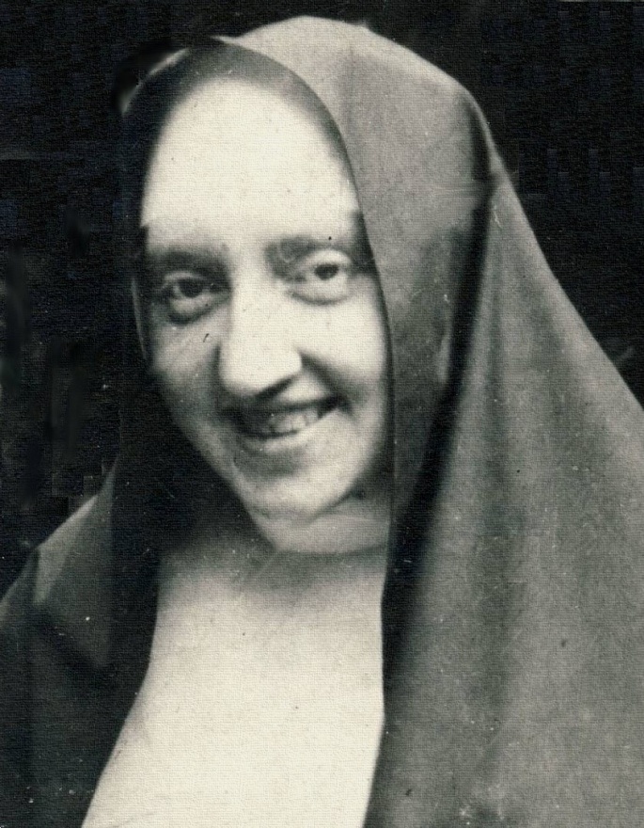
Elisabeth Tombrock-Mother Immaculata of Jesus

Slide 5
Educational Ministry
First School: Santa Clara School in 1913
Education for extern and intern students

Slide 6
Orphanage care
Always “ room for one more ”

Slide 7
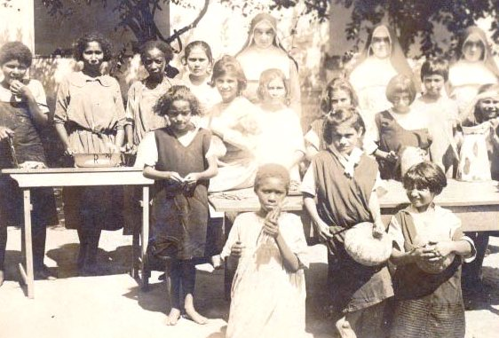
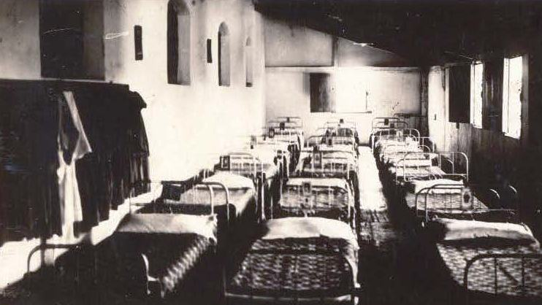
A work done with much love and faith

Slide 8
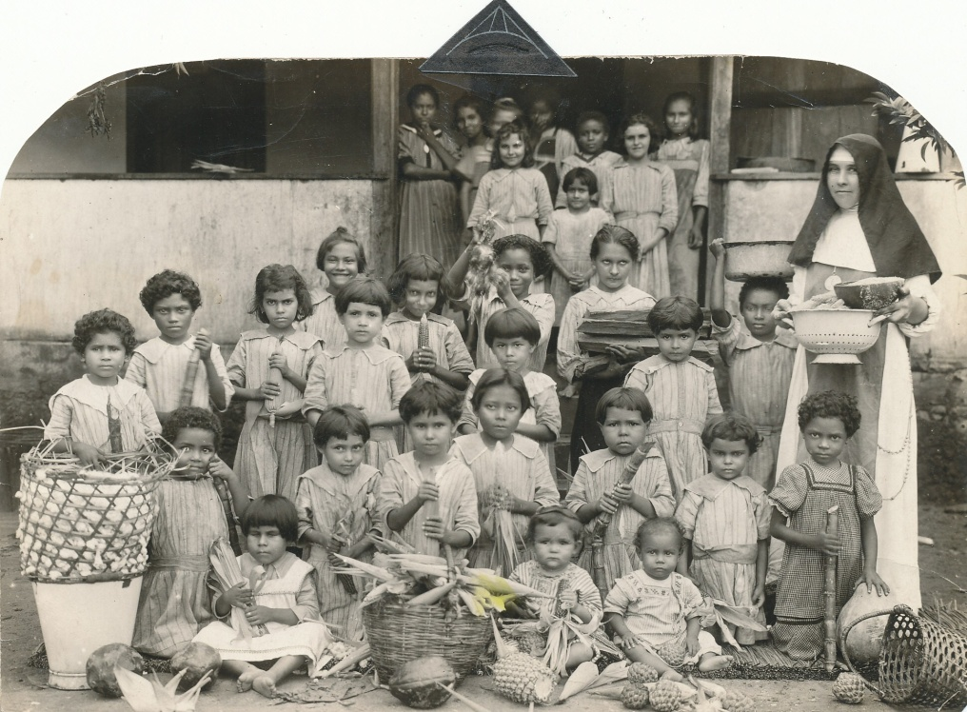
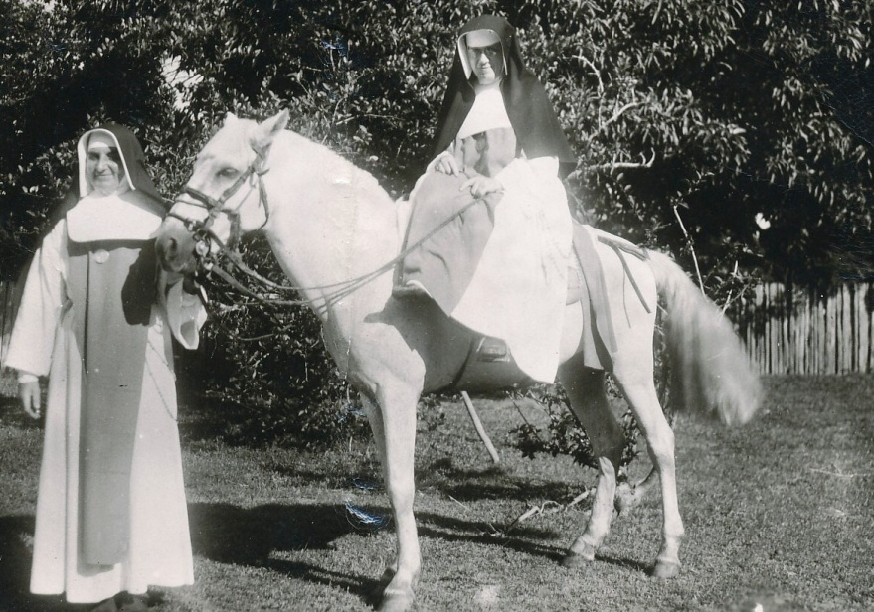
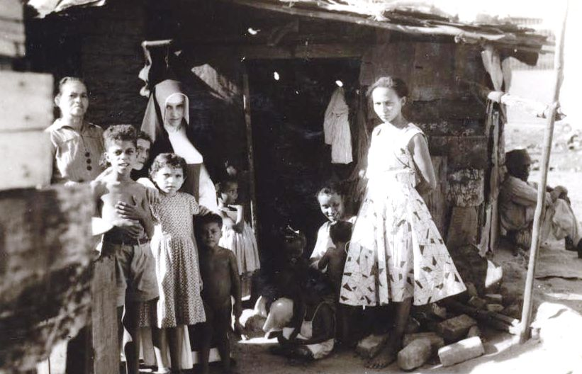
Sisters responding with missionary zeal: the Missionary Sisters of the Immaculate Conception

Slide 9
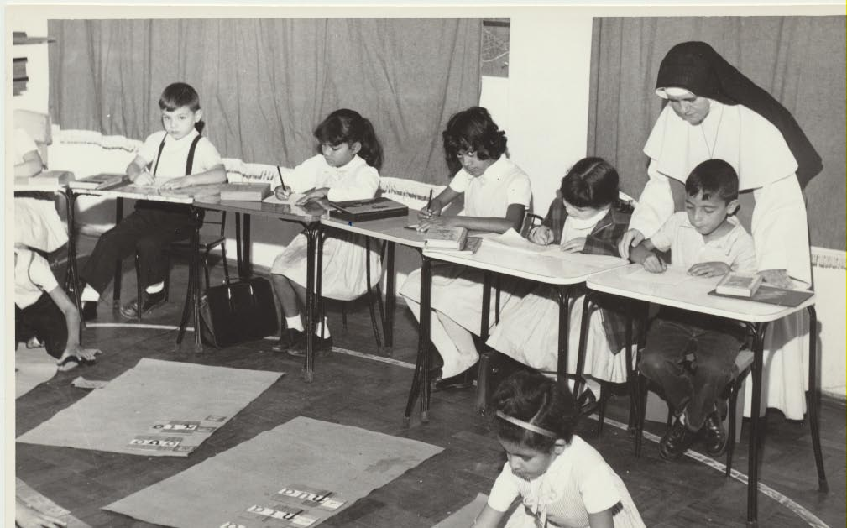
A History of Educational Ministry

Slide 10
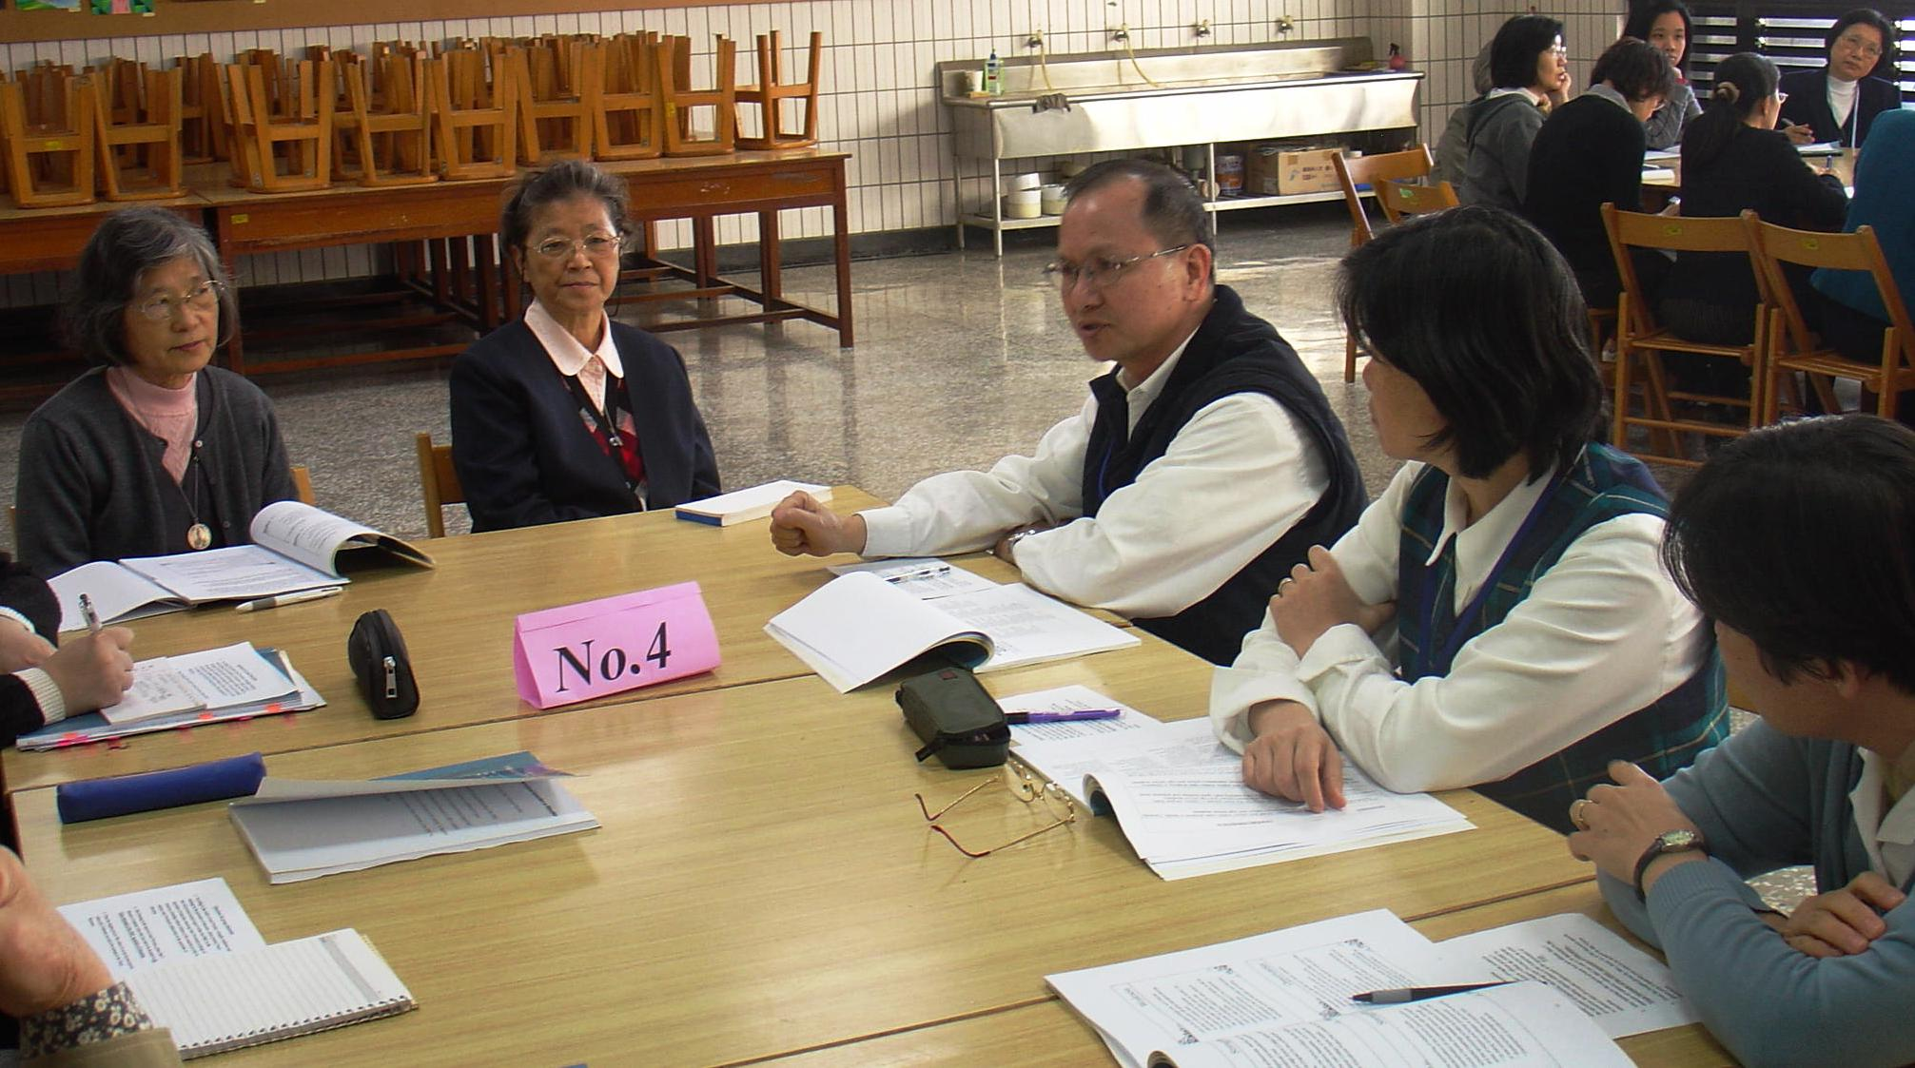
Education now, interdisciplinary

Slide 11
Bringing in the Light of Christ

Slide 12
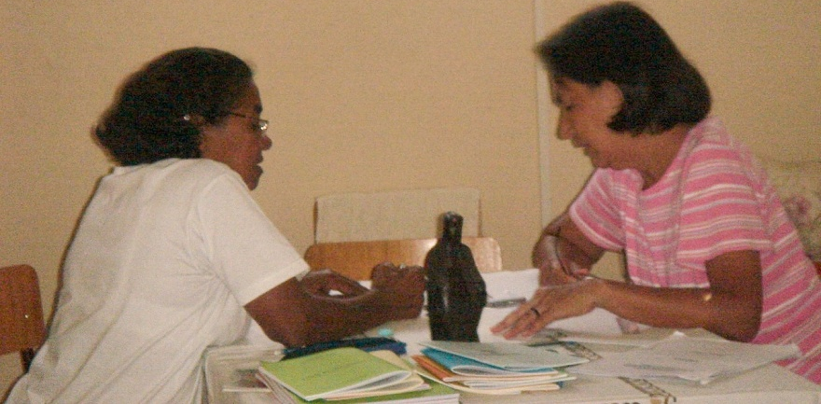
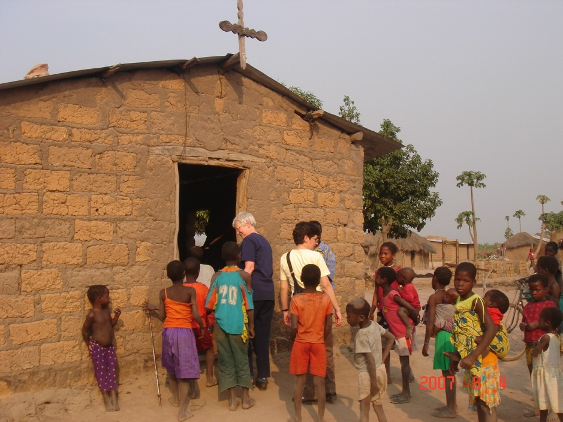

Slide 13
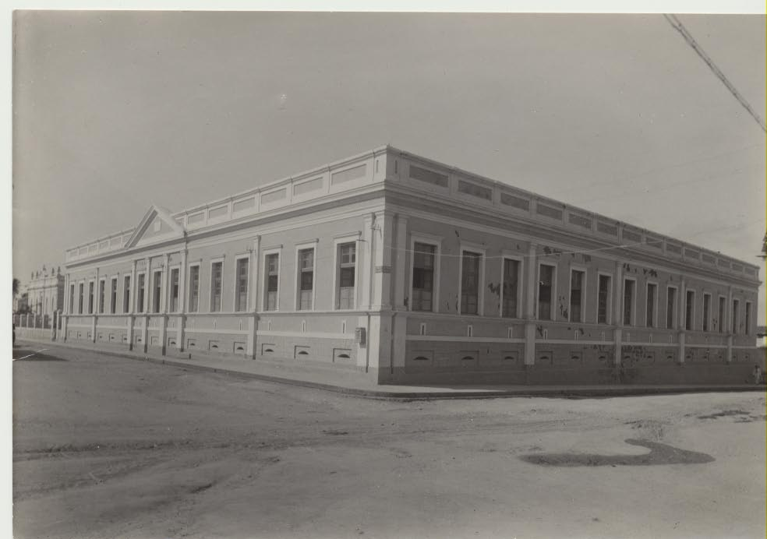
Many Sisters dedicate themselves ton the care of the sick
Santa Casa de Misericordia

Slide 14
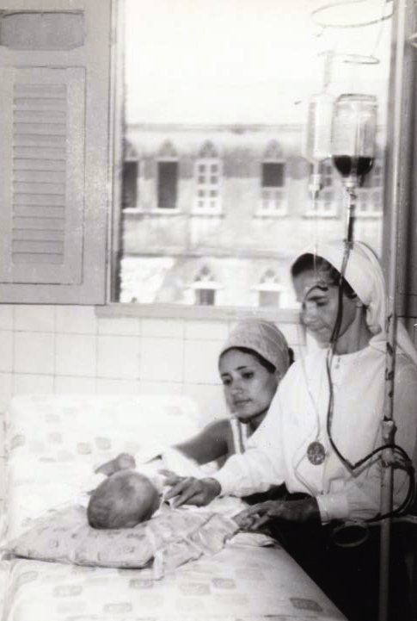
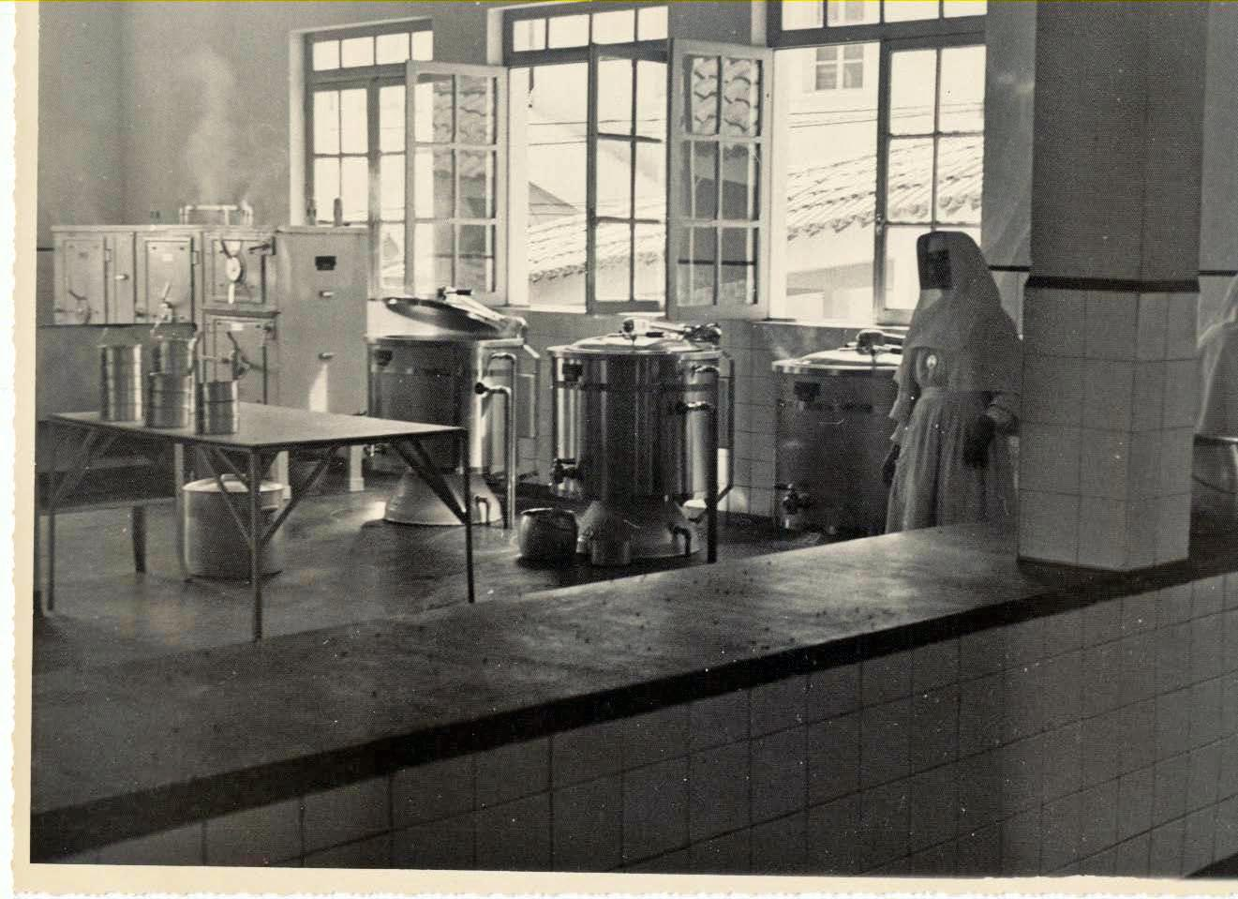
Santa Casa Hospitals State hospitals for the poor

Slide 15
Tricentenario Hospital -1955

Slide 16
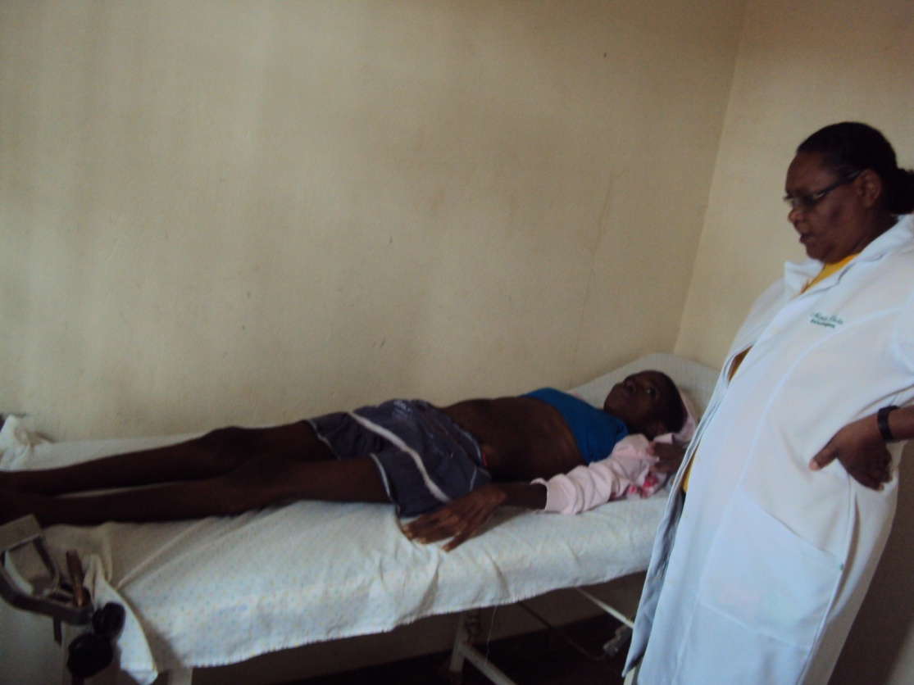
Responding today to health care needs,
Canindé, Ceará
Malange, Angola

Slide 17
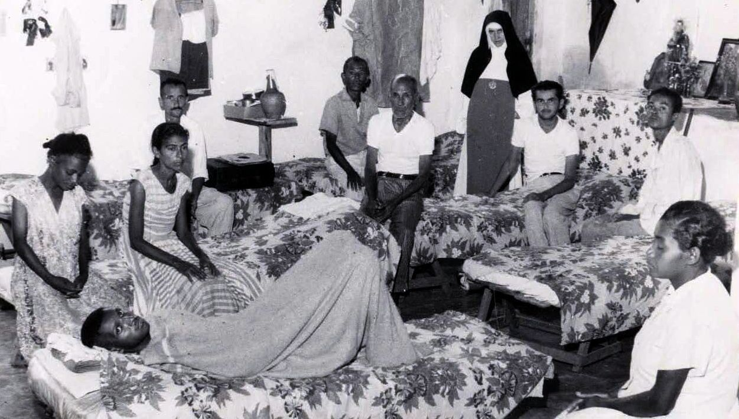
Blessed Sister Dulce, smic
Always “room for one more”

Slide 18
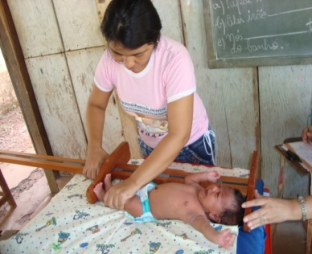
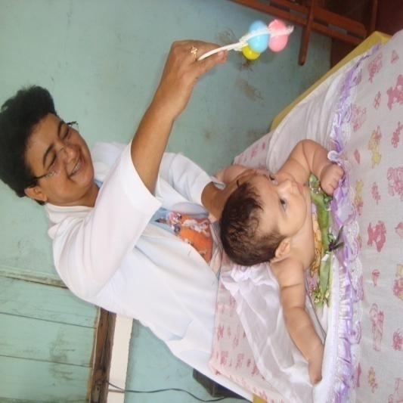
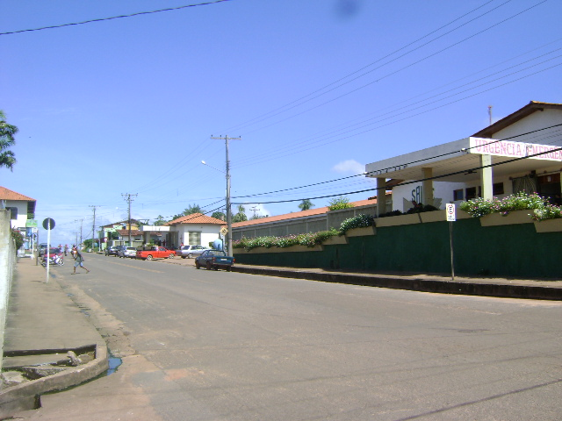
St. Anthony Hospital, Alenquer

Slide 19
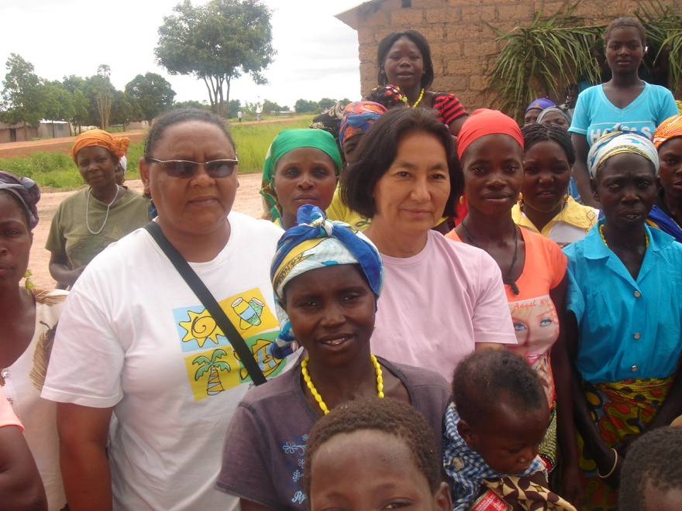
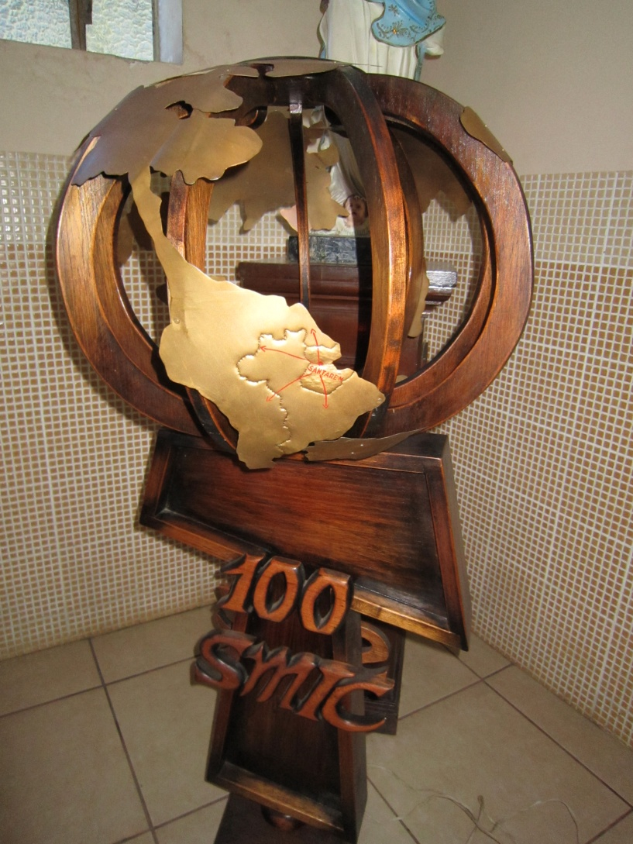
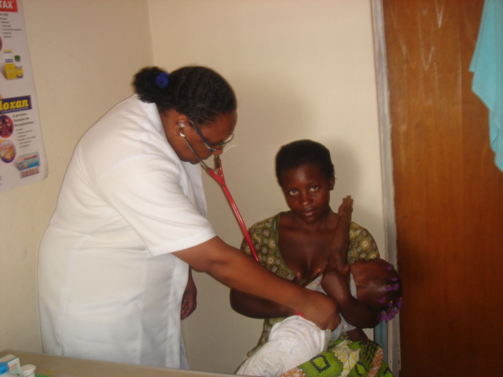

Slide 20
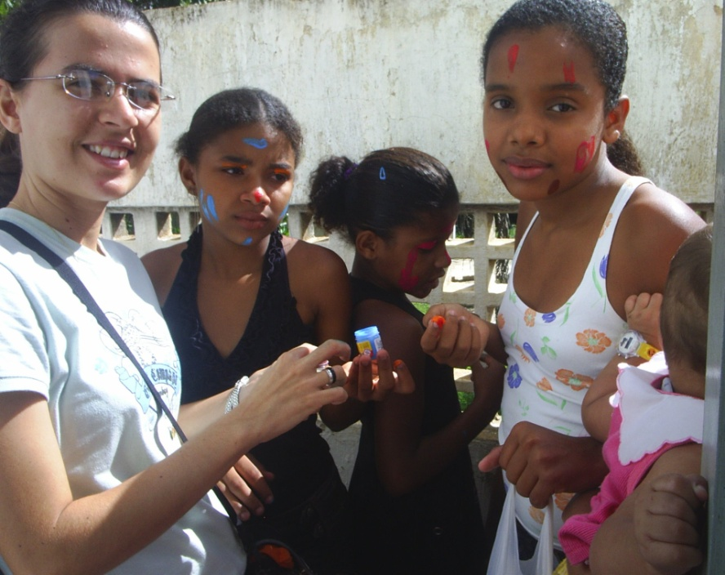
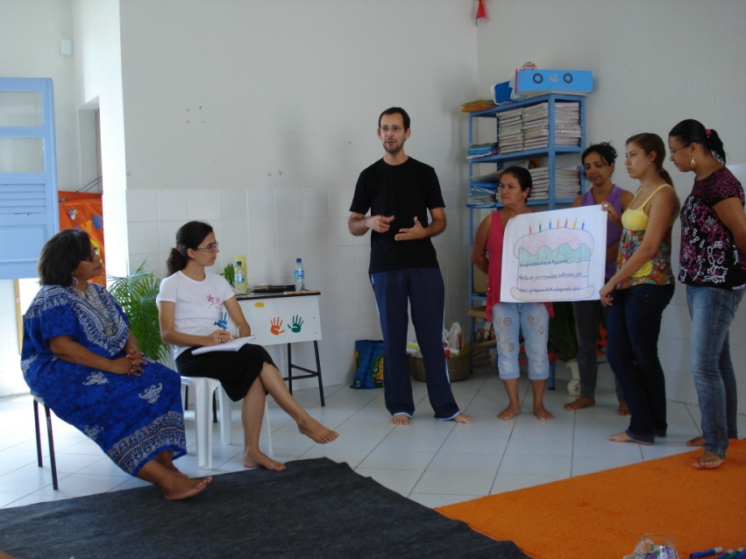
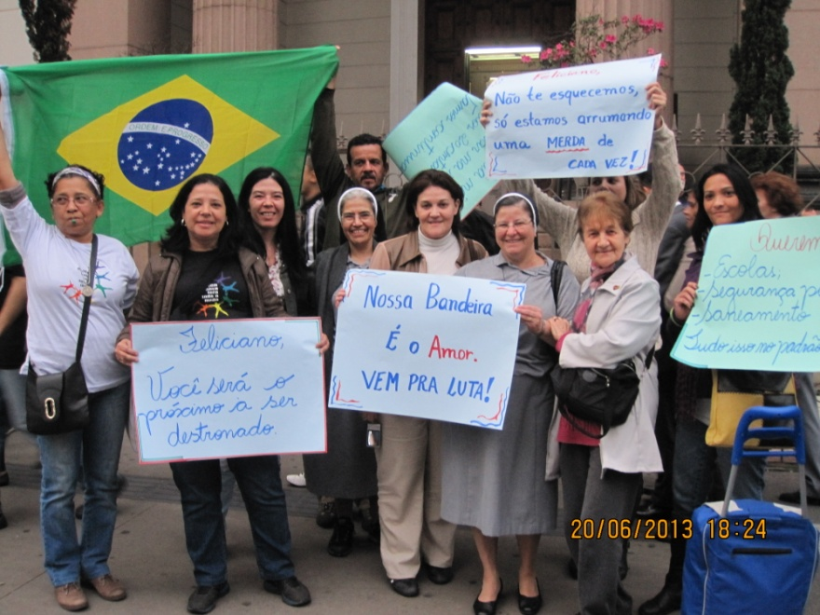
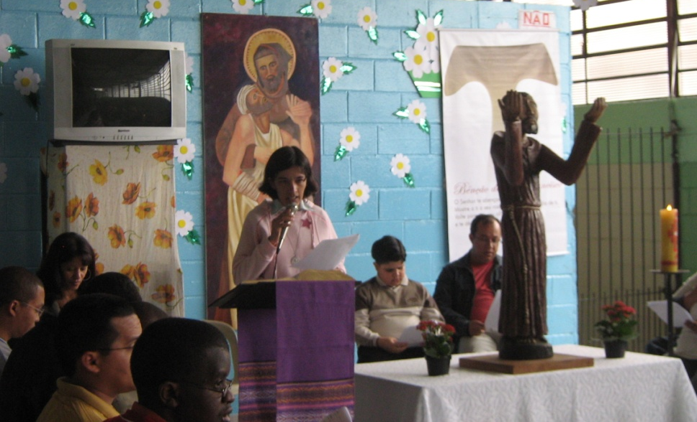

Slide 21
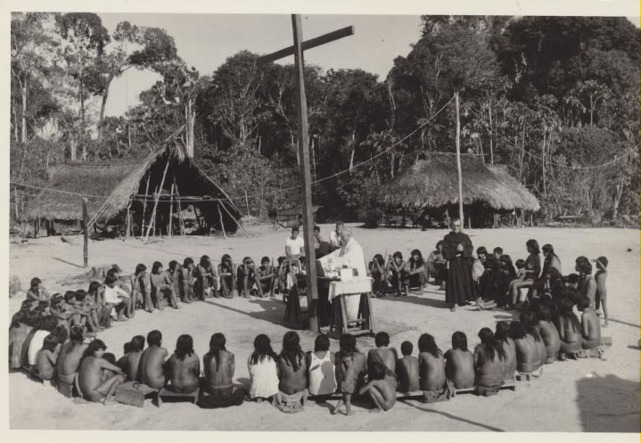
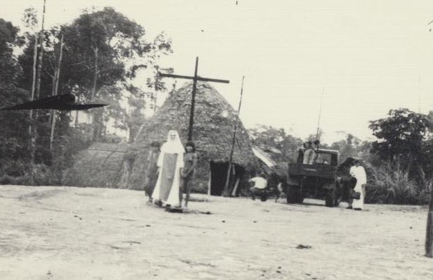
Early Cururu Photos
Mission São Francisco

Slide 22
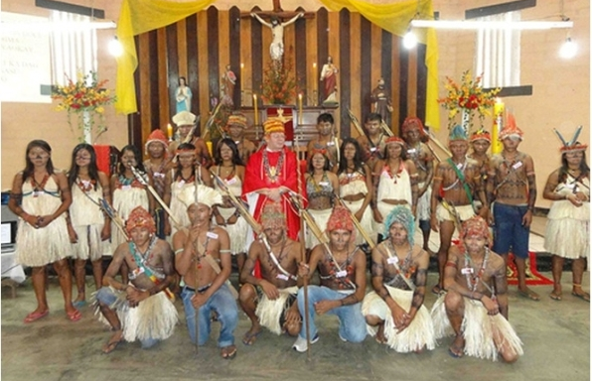
Cururu Mission today

Slide 23
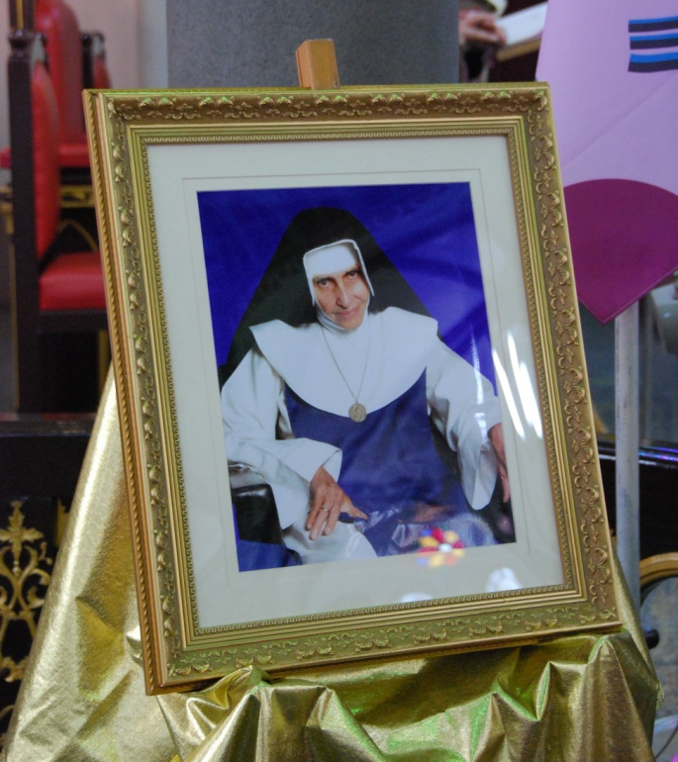
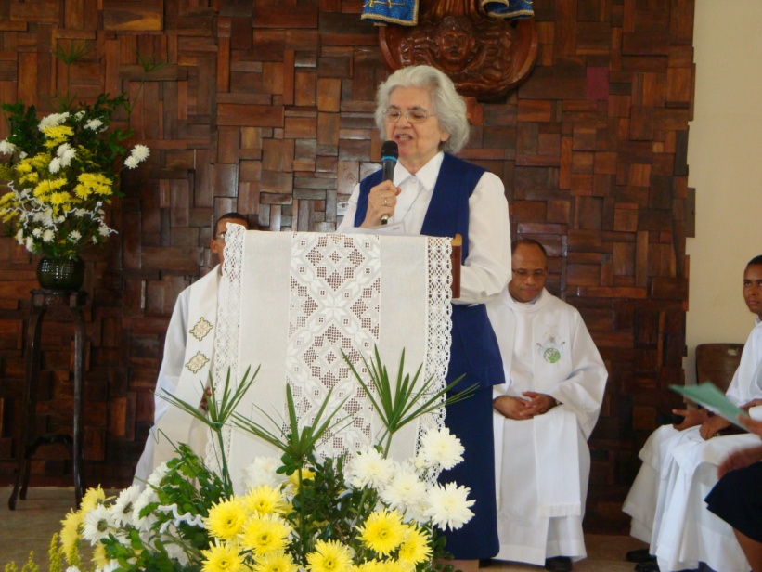
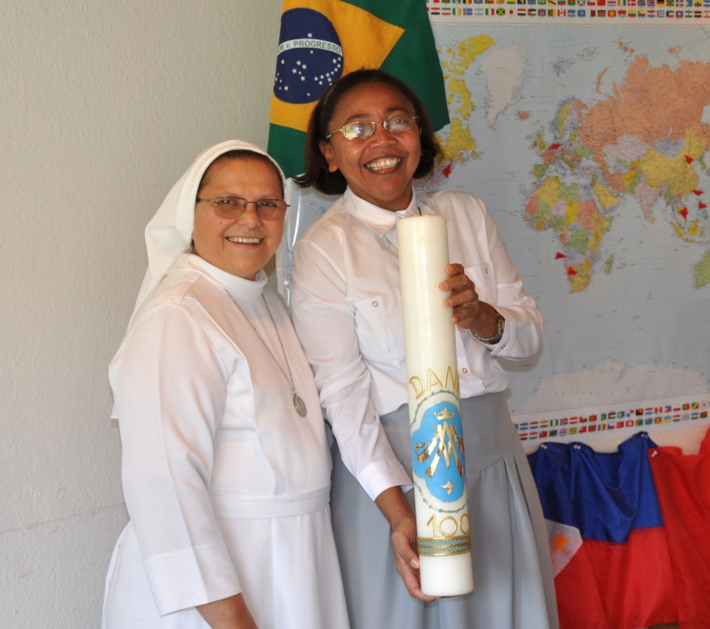
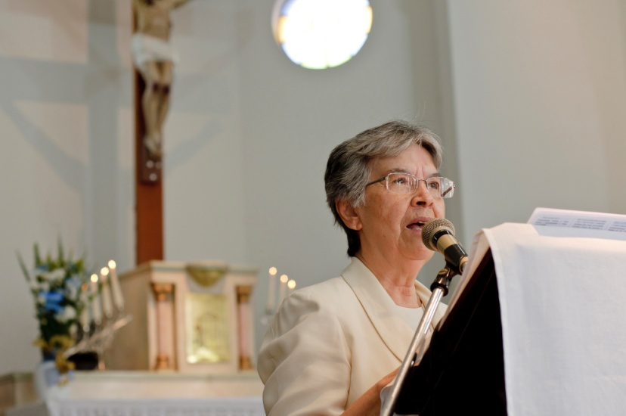

Slide 24
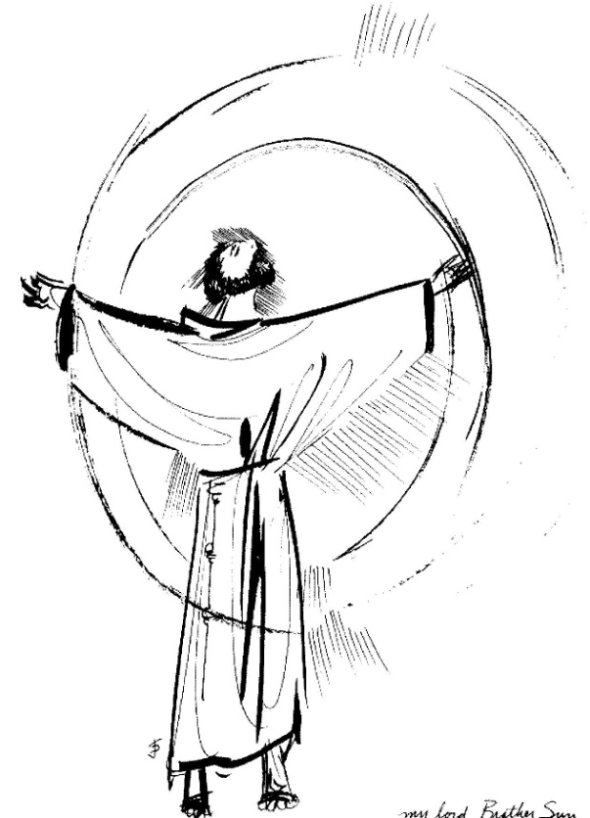
Missionary Sisters of the Immaculate Conception
Rooted in Christ,
Sharing God’s Love,
Embracing the Future

