Slide 1
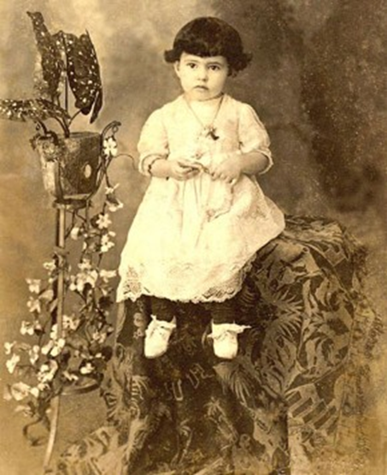
MARIA RITA DE SOUSA BRITO LOPES PONTES

Slide 2
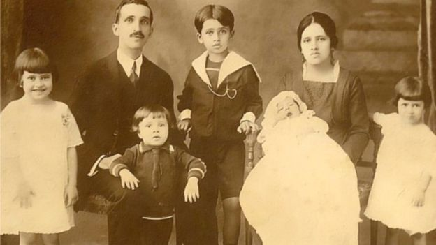
SISTER DULCE’S FAMILY
Maria Rita de Sousa Brito Lopes Pontes was born in Brazil on May 26, 1914.
Daughter of Dulce Maria de Souza Brito and Doctor Augusto Lopes Pontes, dentist and professor at the Federal University of Bahia.
Father
Augustin
Maria Rita
Mother
Aloysio
Geraldo
Dulce

Slide 3
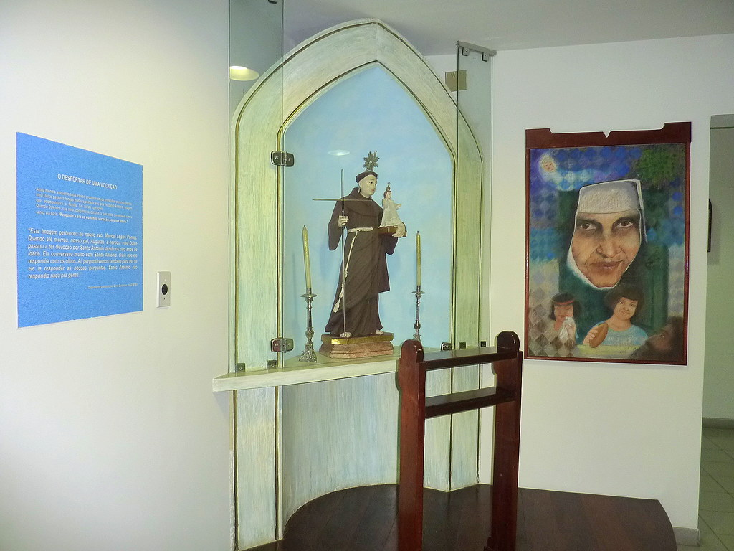
SHE HAD A DEVOTION TO SAINT ANTHONY

Slide 4
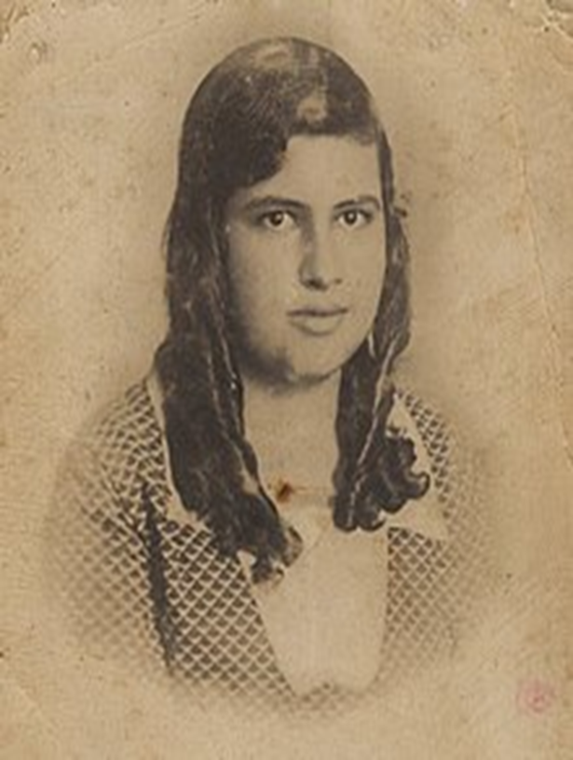
HER EARLY CALL TO MISSION
From the age of 13 when she visited areas of the poor with her aunt, she began to show a desire to dedicate herself to religious life.

Slide 5
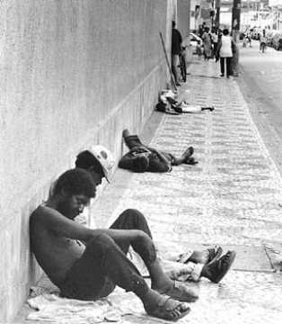
HER EARLY CALL TO MISSION
With the consent of her family and the support of her sister, Dulcinha, Maria Rita transformed the family home into a center of care for the most needy.

Slide 6
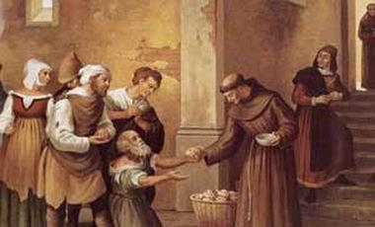
HER EARLY CALL TO MISSION
Her parents’ house was known as “the doorway of St. Francis”, many poor gathered there.

Slide 7
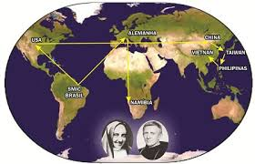
ENTRANCE INTO THE CONGREGATION February 8, 1933

Slide 8
CONTEMPLATIVE, COMPASSIONATE PRESENCE TO ALL… ESPECIALLY TO THOSE MOST IN NEED.

Slide 9
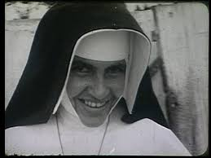
RELIGIOUS PROFESSION
On August 13, 1933- At age 19, she received the habit and the name of Sister Dulce, in remembrance of her mother.

Slide 10
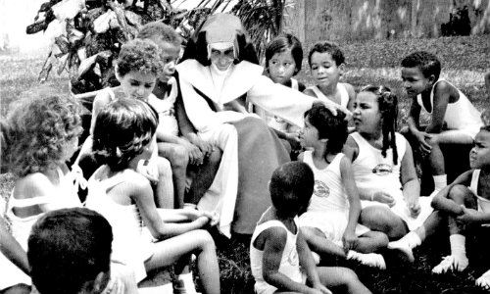
HER FIRST MISSION
In 1934, she professed her religious vows.
Her first mission as a religious was to teach at a school of the Congregation and to assist the poor communities in Salvador.

Slide 11
FOUNDING OF THE WORKERS’ UNION
In 1936, when only 22 years old

Slide 12
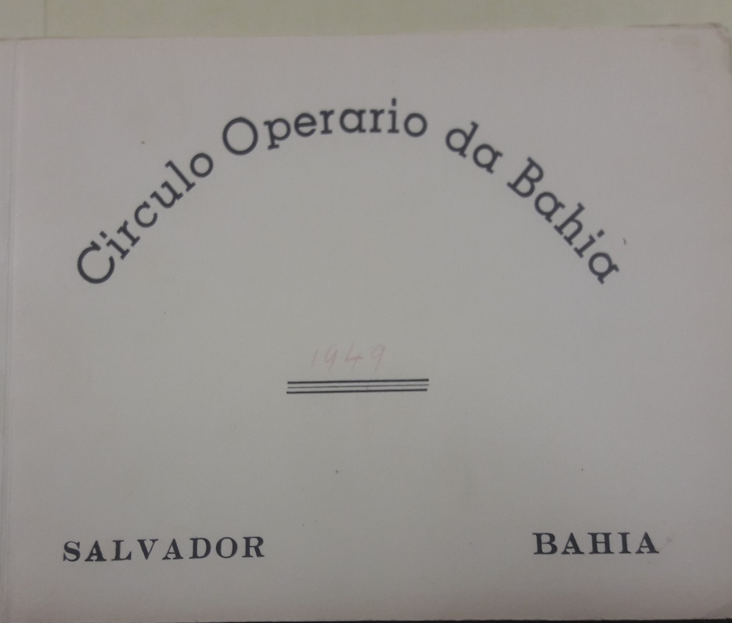
In 1937, together with Fr. Hildebrando, OFM, she created the Bahia Workers’Circle, financially made possible through the funds of three cinema theaters which they constructed through donations.

Slide 13
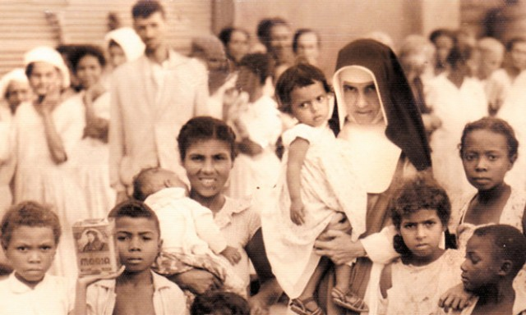
A LIFE IN MISSION
In May 1939, Sister Dulce started the Saint Anthony school for workers and their children.

Slide 14
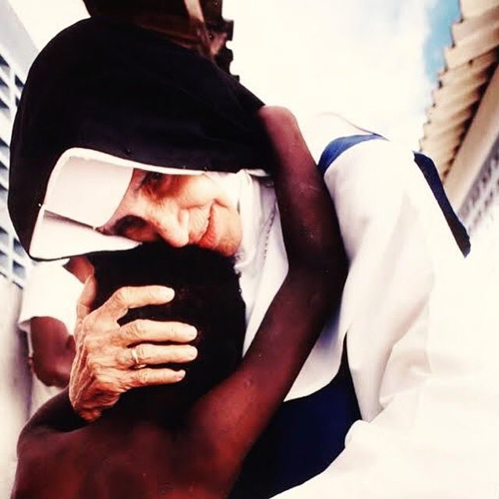
A LIFE IN MISSION
During the same year, 1939, in order to house the sick people found on the streets she used five abandoned houses on the periphery of Salvador, which was called “Rat Island”.

Slide 15
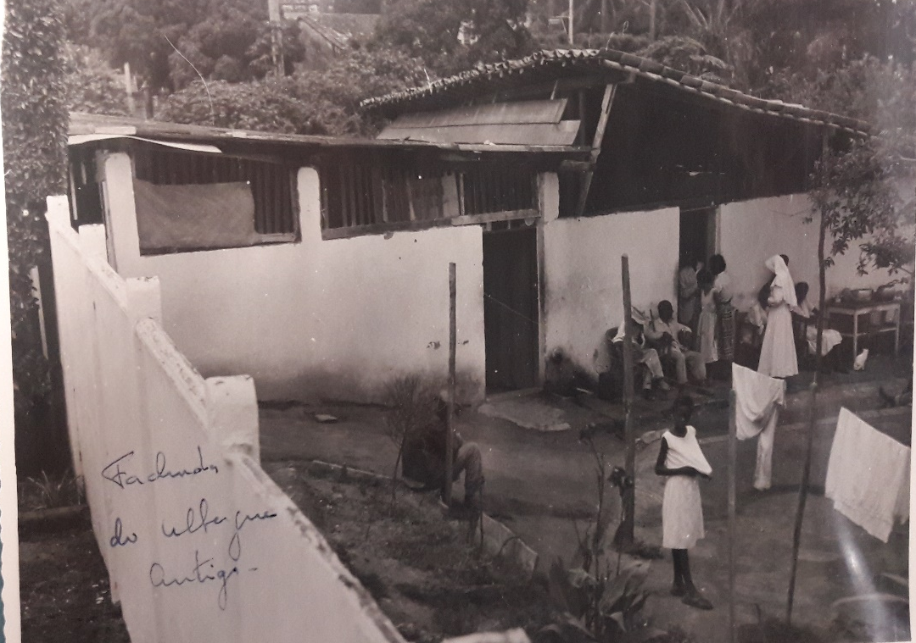
CHICKEN COUP
She transformed a chicken coup of St. Anthony Convent into a hostel. This later was the start of St. Anthony Hospital center

Slide 16
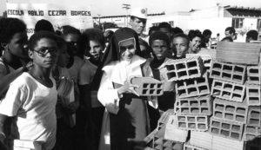
A LIFE IN MISSION

Slide 17
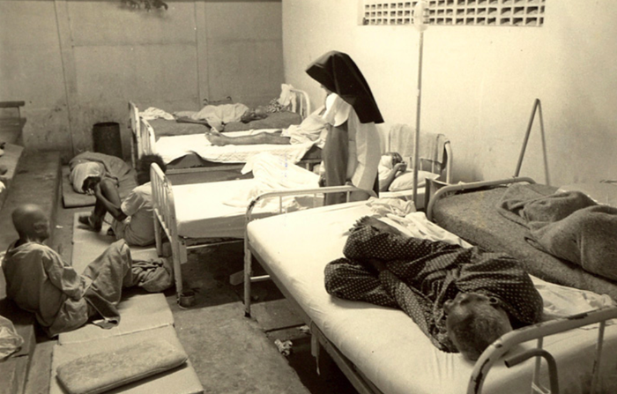
A LIFE IN MISSION

Slide 18
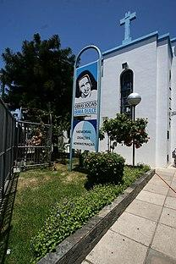
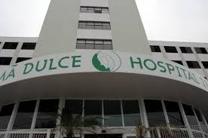
SAINT ANTHONY HOSPITAL Complex

Slide 19
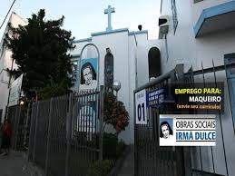

Slide 20
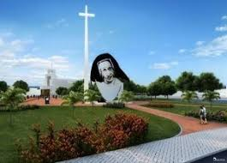

Slide 21
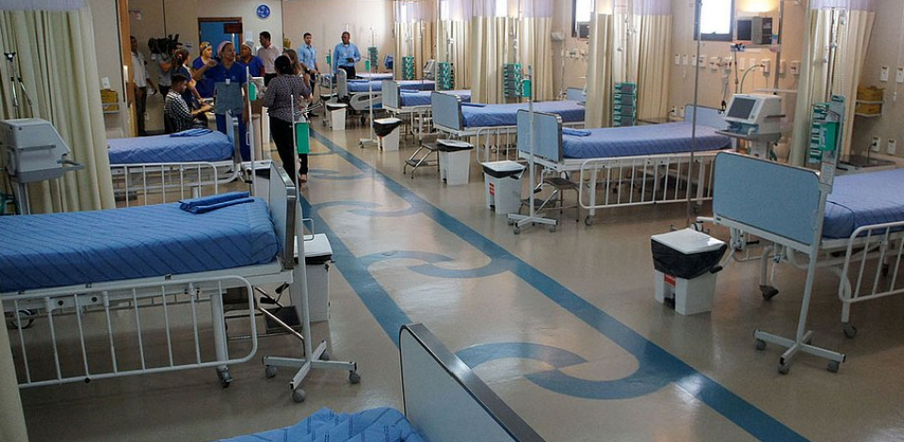

Slide 22
FEATURES OF THE LIFE OF SR. DULCE

Slide 23
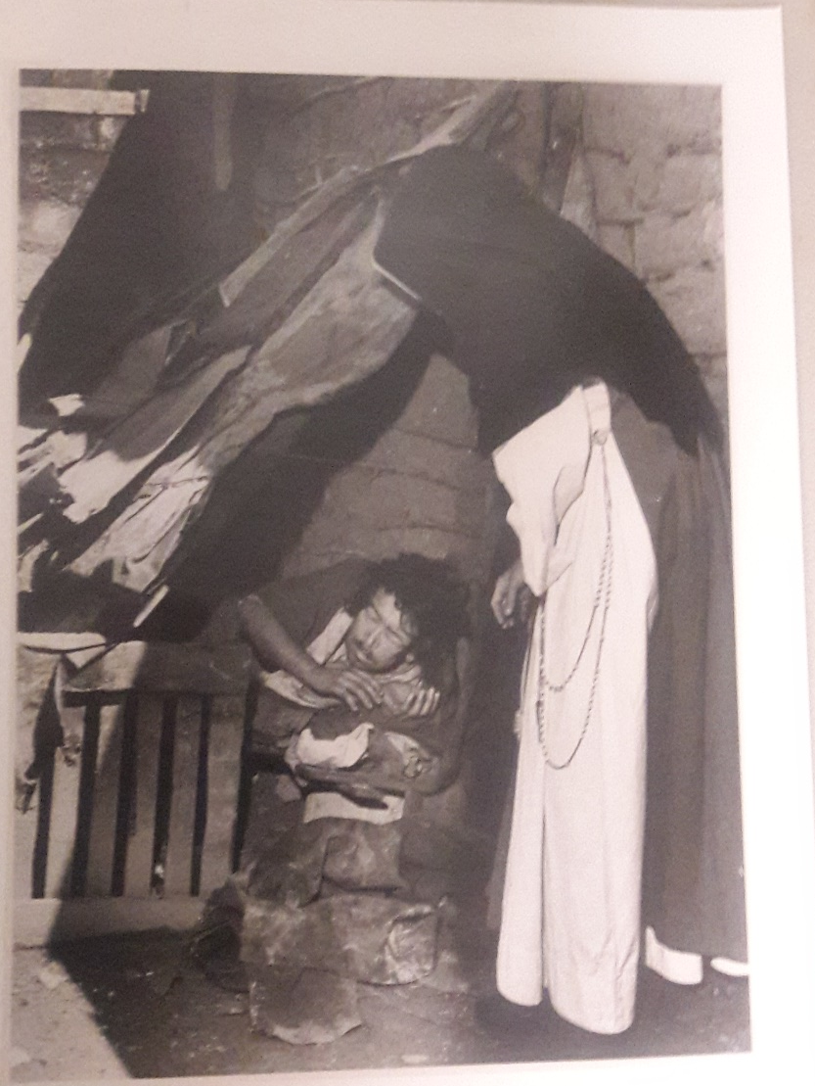
LOVE OF THE POOR

Slide 24
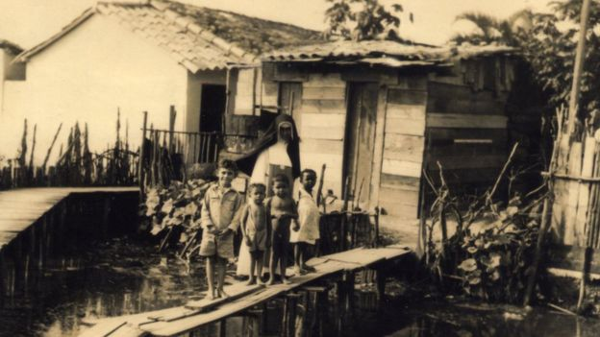
LOVE FOR THE POOR- RESTORATION OF HUMAN DIGNITY

Slide 25
LOVE OF THE INFIRM

Slide 26
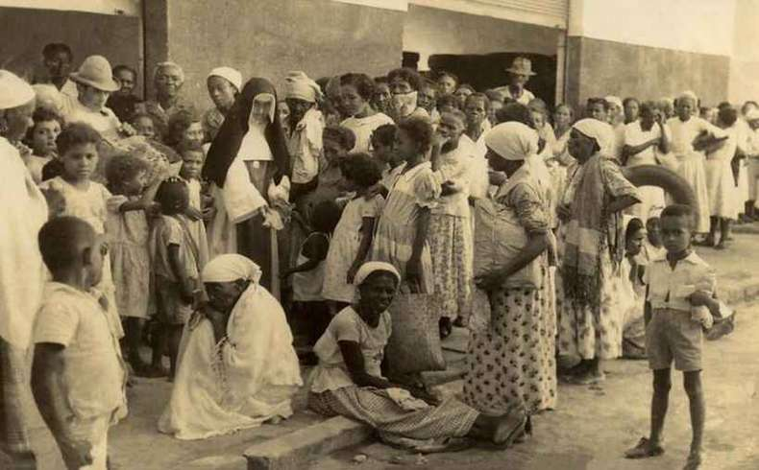
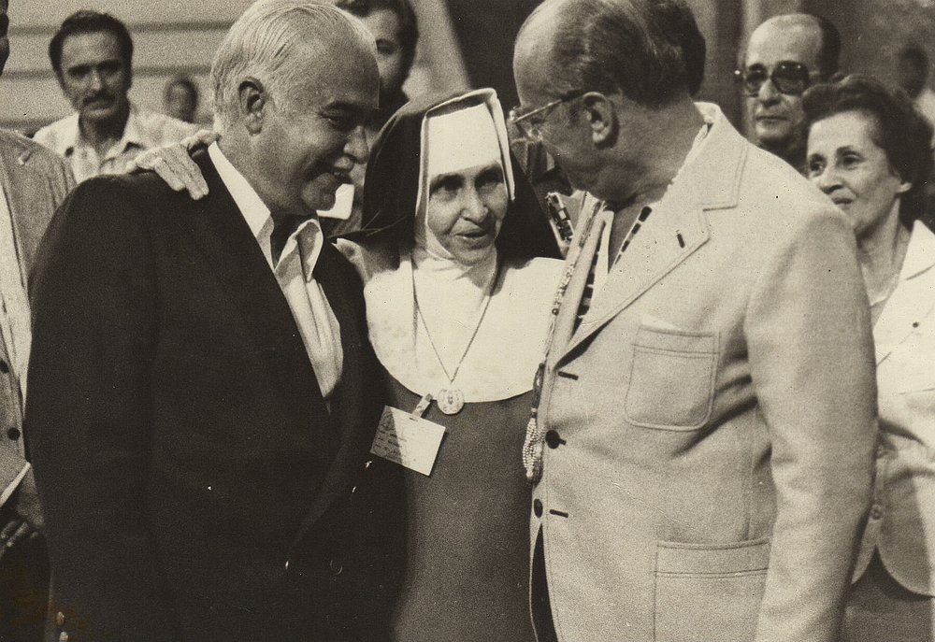
ABILITY TO WORK WITH DIFFERENT SOCIAL CLASSES

Slide 27
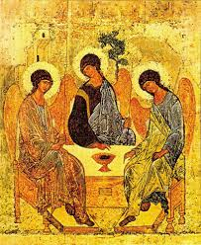
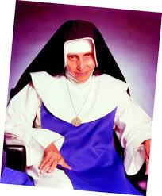
BLESSED TRINITY- FOUNT OF HOLINESS

Slide 28
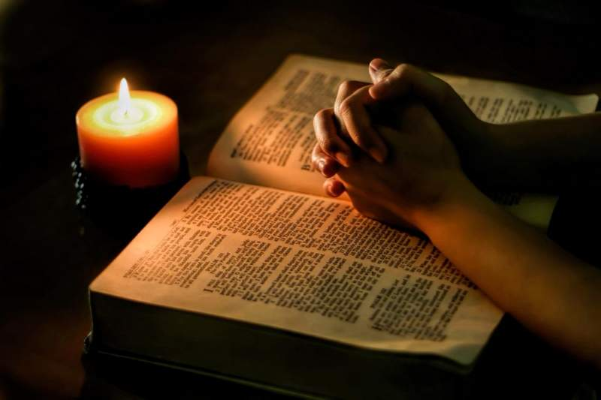
LIFE OF INTENSE PRAYER LOVE FOR THE WORD OF GOD

Slide 29
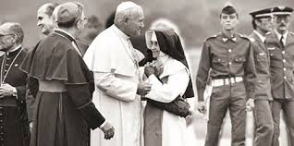
MEETING WITH THE POPE- 1980

Slide 30
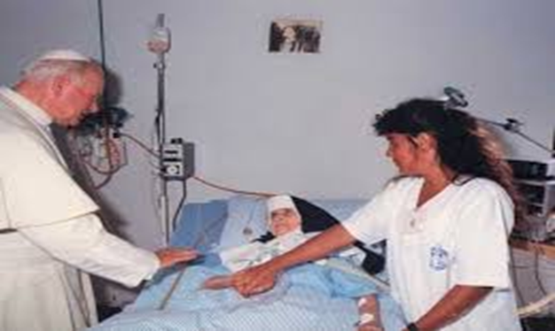
FRAGILITY
On October 20th 1991, she received a second visit from Pope John Paul II, with a blessing and the sacrament of the sick.

Slide 31
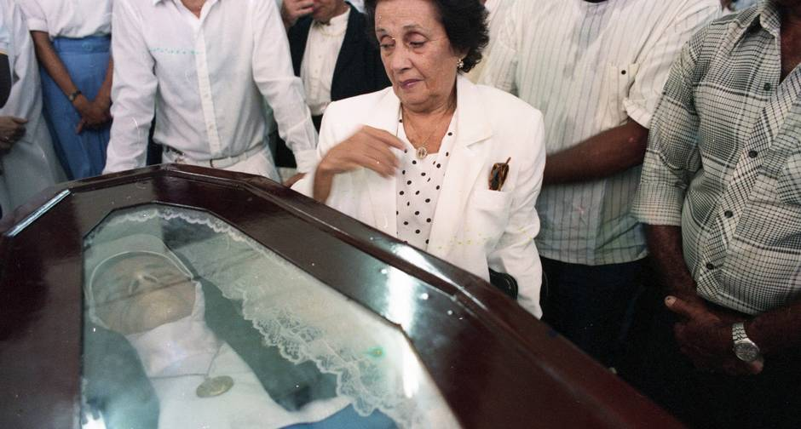
ON MARCH 13, 1992, AT 77 YEARS OF AGE, SHE WAS WELCOMED BY SISTER DEATH

Slide 32
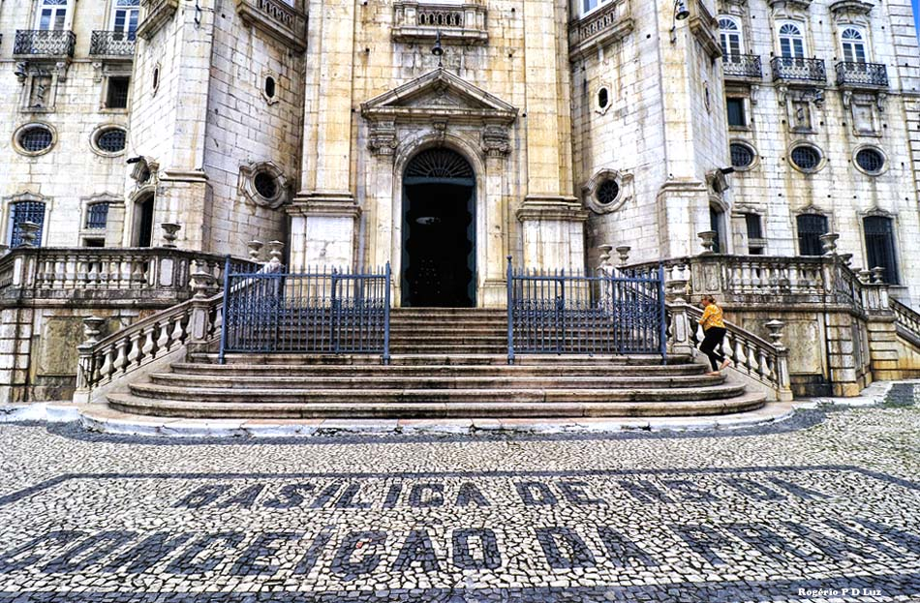
BURIAL
Her body was buried at the Shrine of Nossa Senhora da Conceição da Praia and after was transferred to the Chapel of St. Anthony Hospital, the center of the Social Works of Sr. Dulce.

Slide 33
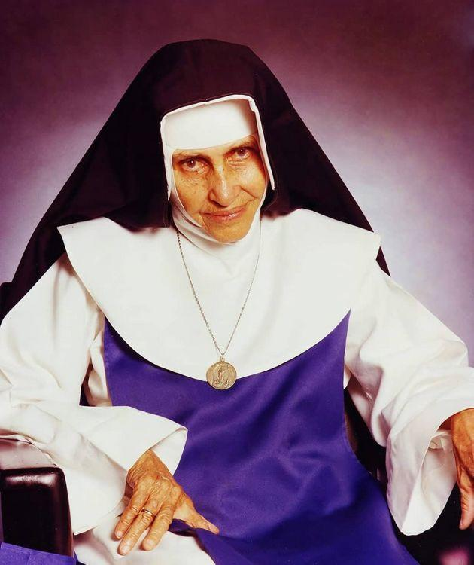
BEATIFICATION
Sister Dulce was declared venerable by the Vatican on January 21st, 2009.
On April 3rd of the same year Pope Benedict XVI approved the decree to recognize her virtues as heroic.

Slide 34
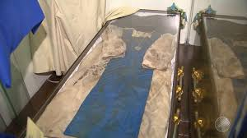
PROCESS OF BEATIFICATION
On June 9th 2010, the body of Sr. Dulce was exhumed, waked and again buried as the last stage of the process of beatification.

Slide 35
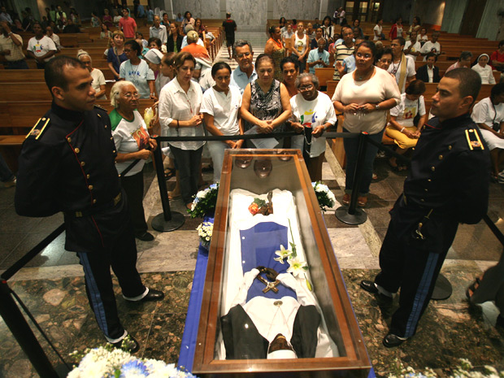
SISTER DULCE’S REMAINS

Slide 36
BEATIFICATION
On October 27th, 2010, the Cardinal Archbishop of Salvador and primate of Brazil, Dom Geraldo Majella Agnelo announced the beatification at the Social Works of Sr. Dulce, making her the first Blessed of Bahia.

Slide 37
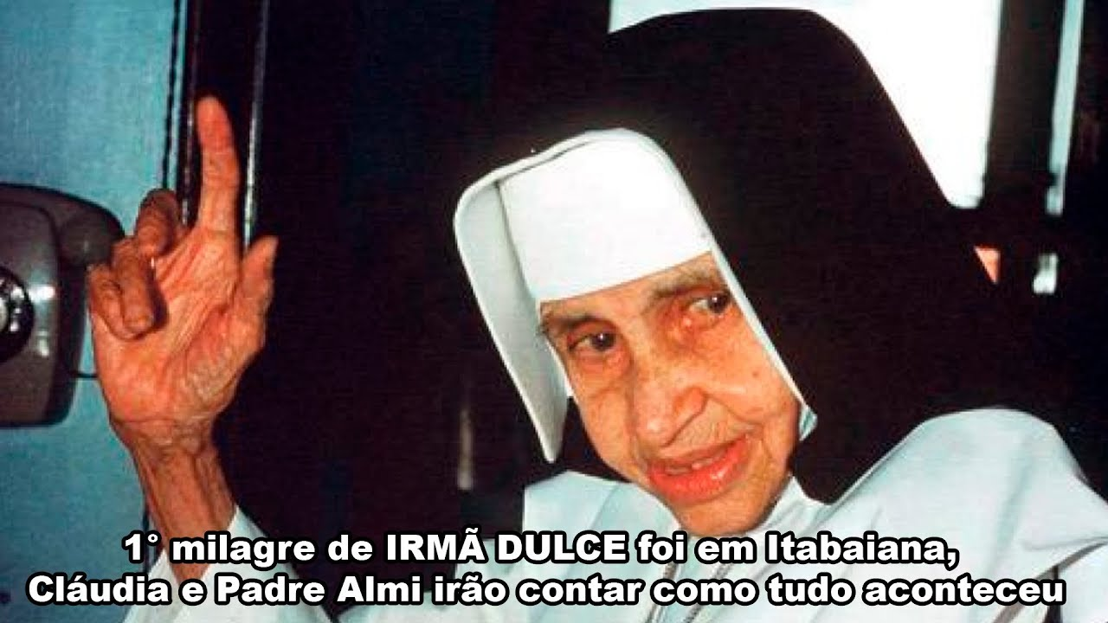
BEATIFICATION
The announcement occurred after the recognition of the miracle obtained through her intercession in the recouperation of a woman from Sergipe who miraculously recovered after hemorrhaging while giving birth.

Slide 38
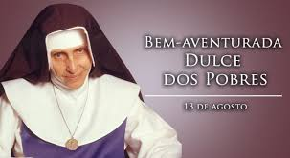
BEATIFICATION
On May 22, 2011, Sister Dulce was BEATIFIED in Salvador, and became known as"Blessed Dulce of the Poor". A Solemn Mass of Beatification was presided over by the especially sent envoy of Pope Benedict XVI, Dom Geraldo Majella Agnelo, Arcebishop Emeritus of Salvador.

Slide 39
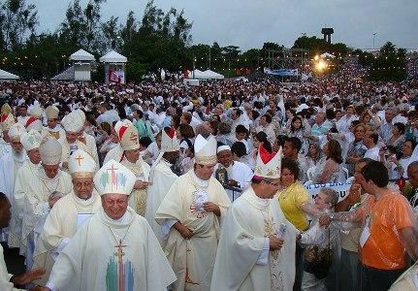
BEATIFICATION CELEBRATION

Slide 40
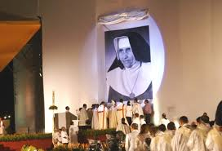
BEATIFICATION CELEBRATION

Slide 41
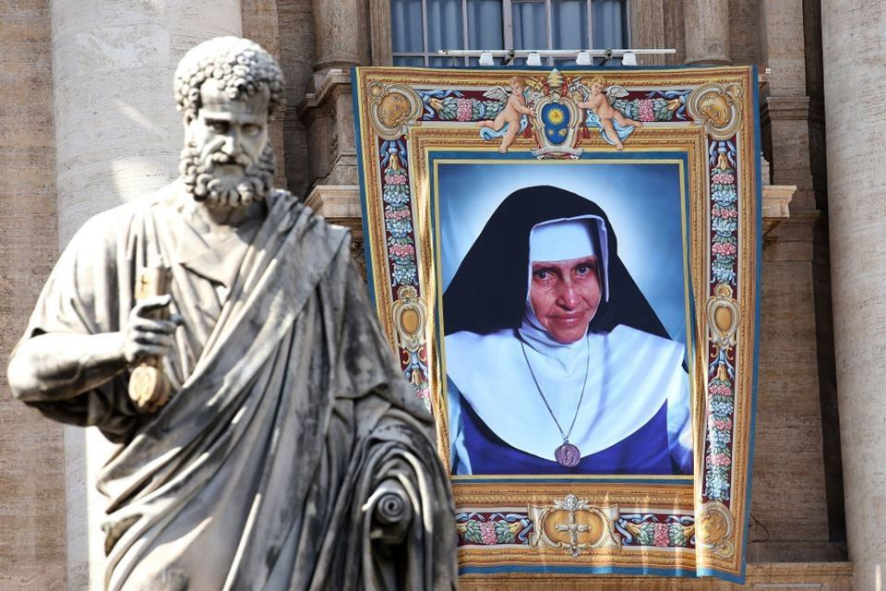
CANONIZATION
Canonization by Pope Francis on October 13th in a grand ceremony in the Vatican Square of St. Peter

Slide 42
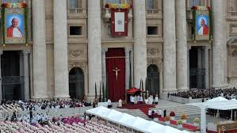
CANONIZATION

Slide 43
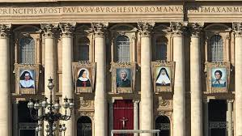
GENERAL PRINCIPLES OF CANONIZATION
The new Saints were symbolically presented to the Pope who received them as saints.

Slide 44
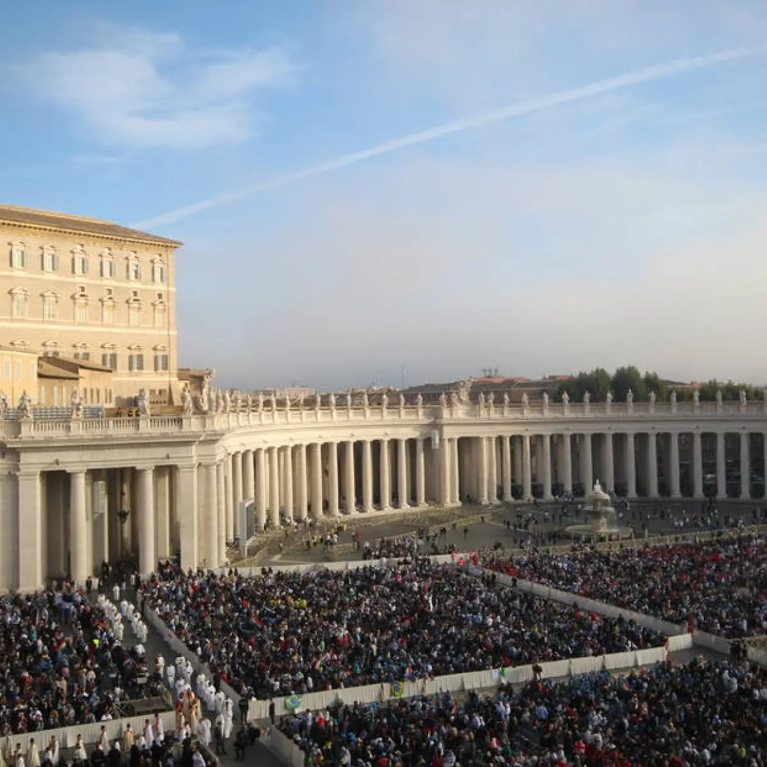
GENERAL PRINCIPLES OF CANONIZATION
For this reason Catholics pray to a saint and ask for help and miracles.
Beyond this, the church permits people to be considered as “models”of living, who can be admired with devotion.

Slide 45
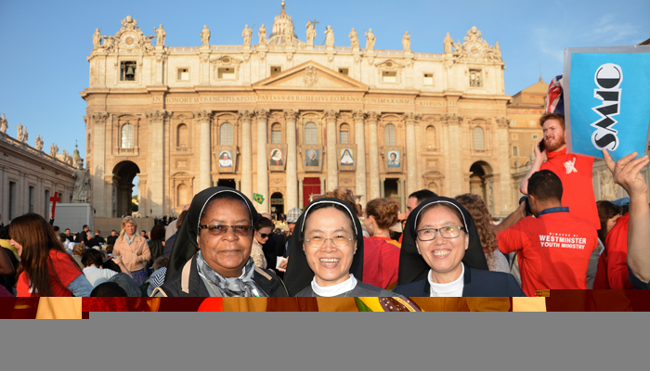
ROME CELEBRATION OCTOBER 13, 2019

Slide 46
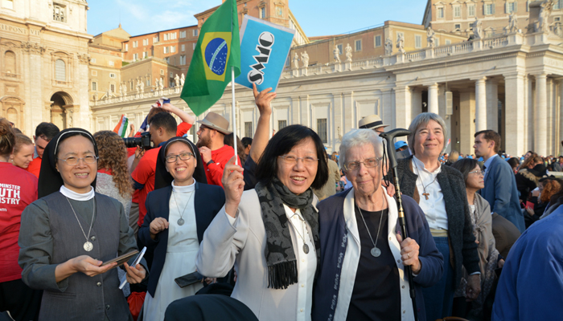
ROME CELEBRATION OCTOBER 13, 2019

Slide 47
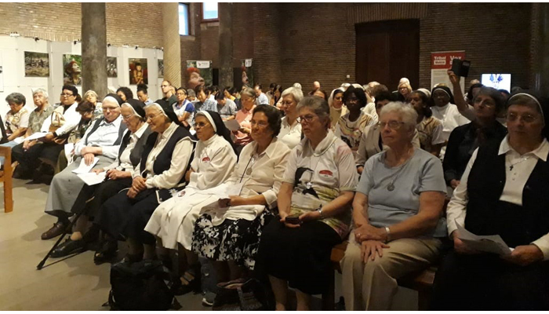
ROME CELEBRATION OCTOBER 13, 2019

Slide 48
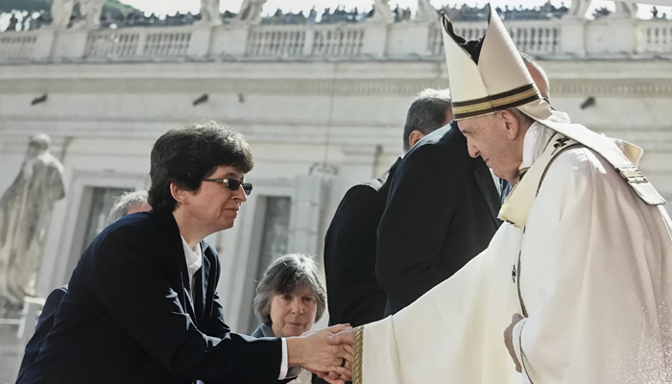
ROME CELEBRATION OCTOBER 13, 2019

Slide 49
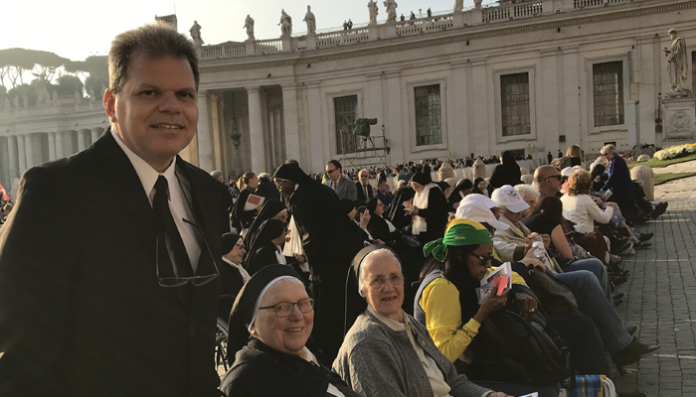
ROME CELEBRATION OCTOBER 13, 2019

Slide 50
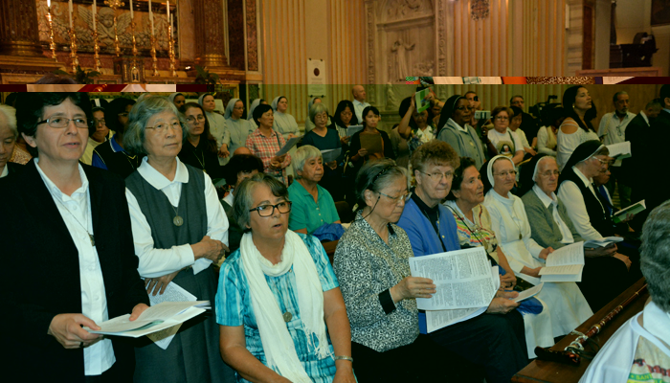
ROME CELEBRATION OCTOBER 14, 2019

Slide 51
ROME CELEBRATION OCTOBER 12, 2019

Slide 52
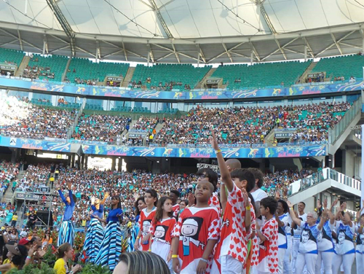
CELEBRATION OF CANONIZATION IN SALVADOR, BRAZIL OCTOBER 20, 2019

Slide 53
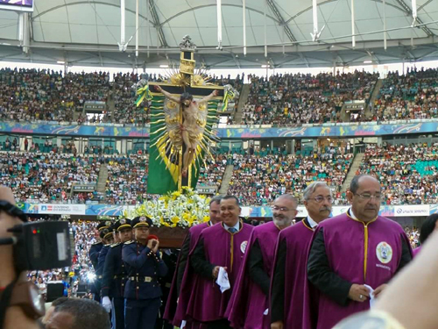
OCTOBER 20, 2019
BRAZIL

Slide 54
OCTOBER 20, 2019
BRAZIL

Slide 55
OCTOBER 20, 2019
BRAZIL

Slide 56
OCTOBER 20, 2019
BRAZIL

Slide 57
OCTOBER 20, 2019
BRAZIL

Slide 58
HONORARY DOCTORATE DEGREE
BRAZIL

Slide 59
HONORARY DOCTORATE DEGREE
BRAZIL

Slide 60
HONORARY DOCTORATE DEGREE
BRAZIL

Slide 61
HONORARY DOCTORATE DEGREE
BRAZIL

Slide 62
OCTOBER 20, 2019
BRAZIL

Slide 63
OCTOBER 20, 2019
BRAZIL

Slide 64
BROOKLYN CELEBRATION
NOVEMBER-2019

Slide 65
BROOKLYN CELEBRATION
NOVEMBER-2019

Slide 66
BROOKLYN CELEBRATION
NOVEMBER-2019

Slide 67
ASIA CELEBRATION- TAIWAN

Slide 68
ASIA CELEBRATION- TAIWAN

Slide 69
ASIA CELEBRATION- TAIWAN

Slide 70
ASIA CELEBRATION- TAIWAN

Slide 71
ASIA CELEBRATION- TAIWAN

Slide 72
ASIA CELEBRATION- TAIWAN

Slide 73
ASIA CELEBRATION- TAIWAN

Slide 74
ASIA CELEBRATION- TAIWAN

Slide 75
ASIA CELEBRATION-TAIWAN

Slide 76
ASIA CELEBRATION-PHILIPPINES

Slide 77
ASIA CELEBRATION-PHILIPPINES

Slide 78
ASIA CELEBRATION-PHILIPPINES

Slide 79
ASIA CELEBRATION-PHILIPPINES

Slide 80
ASIA CELEBRATION-PHILIPPINES

Slide 82
SR. DULCE MEMORIAL

Slide 83
SR. DULCE MEMORIAL

Slide 84
SR. DULCE MEMORIAL

Slide 85
SR. DULCE MEMORIAL

Slide 86
SR. DULCE MEMORIAL

Slide 87
SR. DULCE MEMORIAL

Slide 88
SR. DULCE MEMORIAL

Slide 89
SR. DULCE MEMORIAL

Slide 90
SR. DULCE MEMORIAL

Slide 91
SR. DULCE MEMORIAL

Slide 92
SR. DULCE MEMORIAL

Slide 93
FRATERNITY CAMPAIGN 2020 BRAZIL

Slide 95
Thank you!
Dankie!
Salamat!
Vielen Dank!
謝謝啦!
Cảm ơn!
Obrigada!

